Slide 1



UML Space Science Laboratory
Research, Engineering, and Operations
Presented by Paul Song and Ivan Galkin
Space Science Laboratory, University of Massachusetts Lowell
Wannalancit Mills, home of SSL
MITRE Site Visit to UML
August 1, 2019 $●$Umass Lowell $●$Lowell, MA

Slide 2
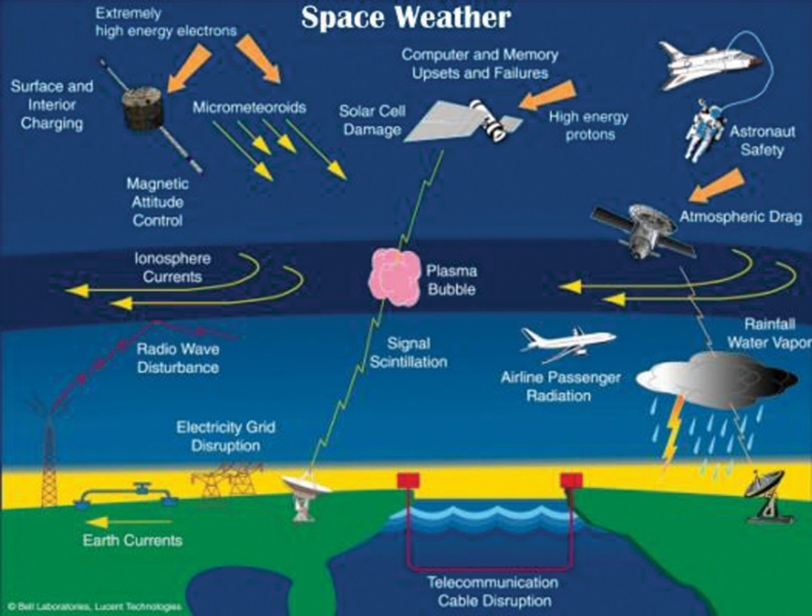
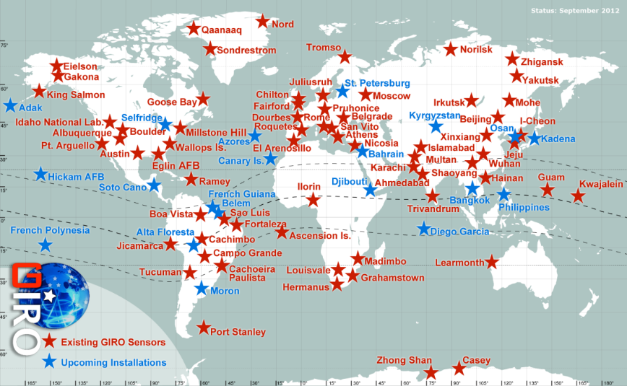
Predicting and Mitigating
Space Weather
Space Science Lab
(http://ulcar.uml.edu)
Space Sciences
  Theoretical models: Develop fundamental theories: plasma physics, fluid mechanics
  Numerical simulations: Develop original codes: MHD, particle
  specialized in partially ionized medium
  Space data analyses and interpretations
Global Ionospheric Radio Observatory
  Operation of a global ionosonde network of 100+ stations in 26 countries
  Real time ionospheric weather and forecast for space technology operators/astronauts

Slide 3
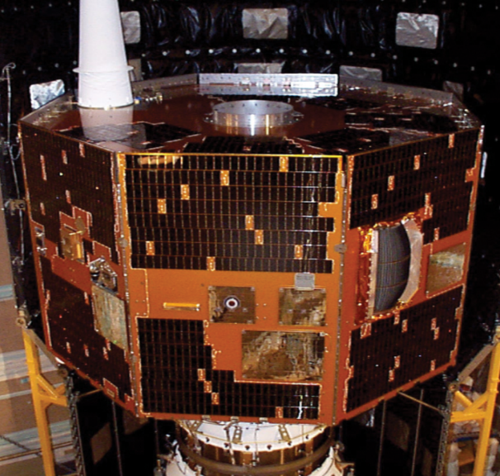
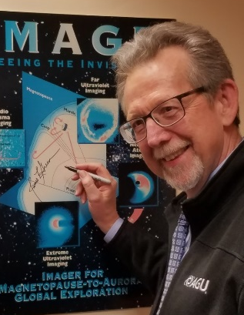
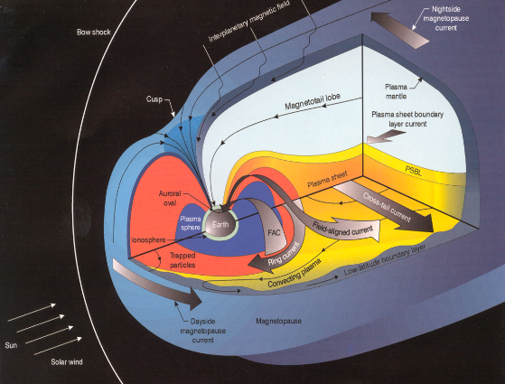
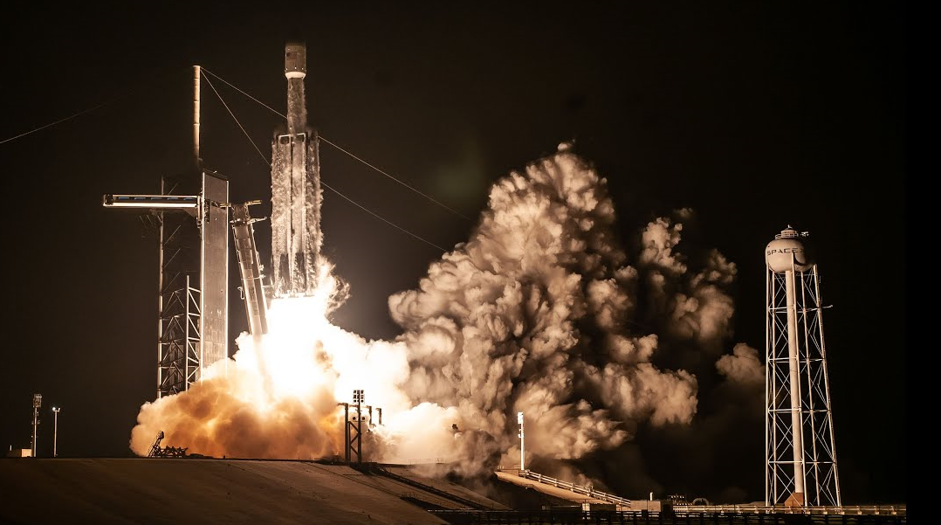
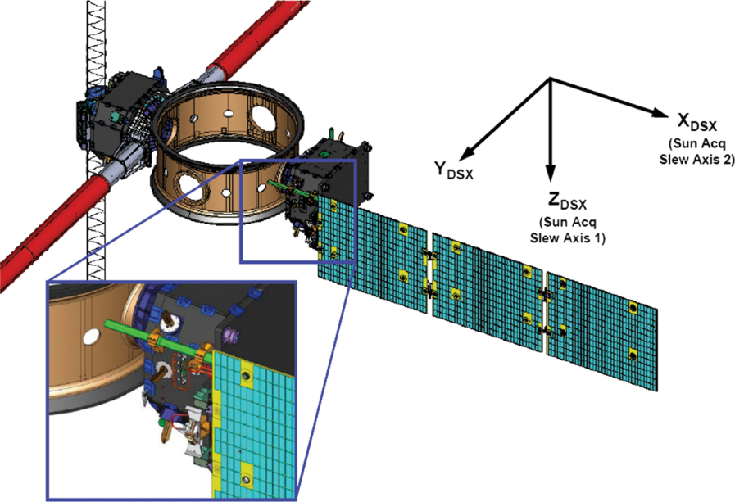

SSL Space Instrumentation
NASA IMAGE satellite:
  Apogee: 8 Re
  Two 500 m long wire antennas
  Low frequency space radar
  Operated for 7 years
Air Force DSX satellite:
  Apogee 5 Re
  80 m long antenna
  High transmission power
  Launched on June 25, 2019 on SpaceX Falcon Heavy
Dr. James Green
Director
NASA Planetary Science
April 4, 2019 at UML SSL

Slide 4
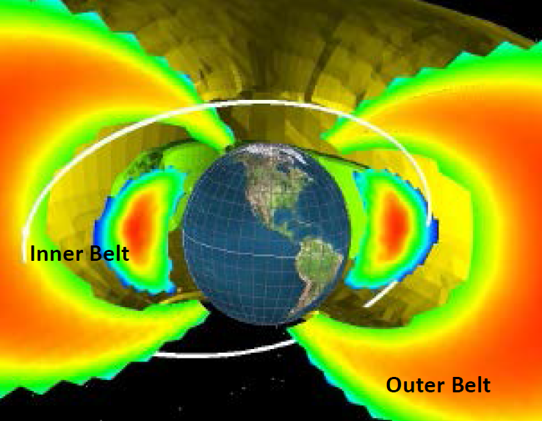
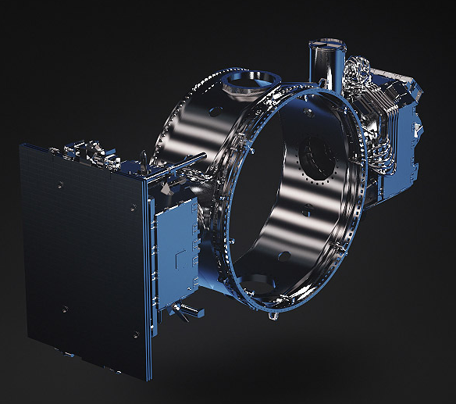
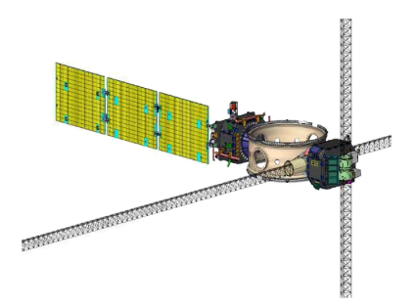
DSX WPx Experiment
UML-designed High Power VLF Transmitter
  The Wave Particle Interaction Experiment (WPIx) will investigate the influence of very-low frequency (VLF) radio waves on dynamics of particles trapped within the Earth radiation belts
  The VLF antenna onboard DSX offers a rare opportunity to study the behavior of such an antenna in-situ and characterize its far-field radiation pattern and WPI efficiency
  Purely scientific USAF mission to study MEO region and aide in the design of future flight experiments that may transverse this region

Slide 5
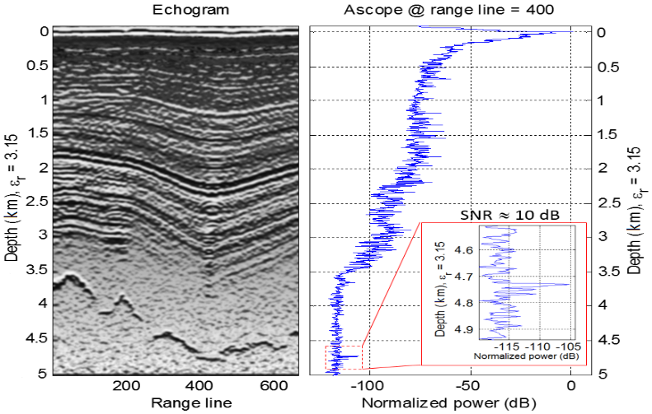
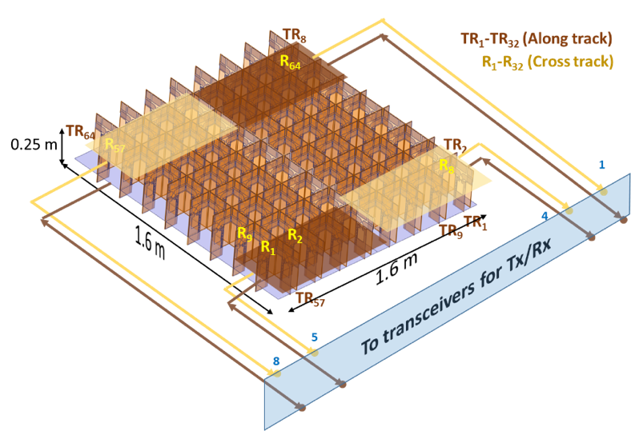
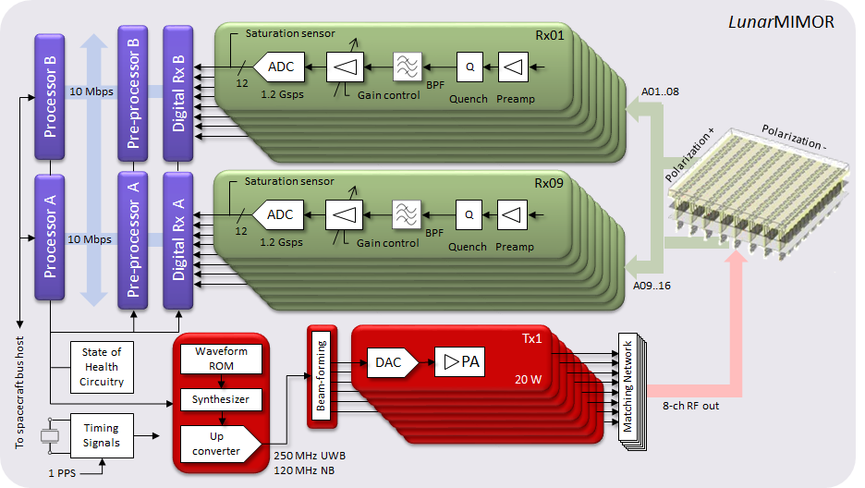
Space-borne
Ground Penetrating Radar
For planetary applications: Moon, Mars, Icy moons of Jupiter (Europa) and Saturn (Titan)
Ultra-wideband (UWB), MIMO technologies
Tightly-Coupled Dipole Arrays

Slide 6
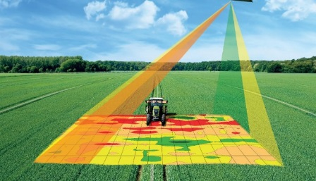
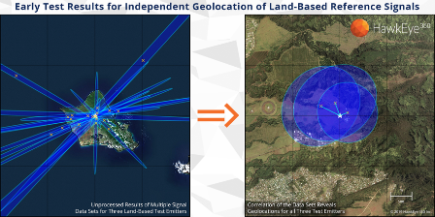
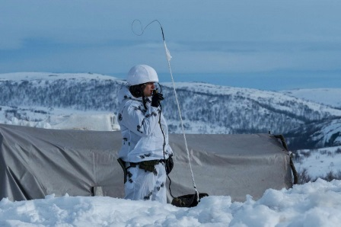
Motivation for Ionospheric Weather Nowcast and Forecast
New space weather requirements are emerging
  Unprecedented need for high accuracy, global coverage, and real time
    PPP (precise point positioning) applications of GNSS
      TID as a “Silent Killer of PPP Accuracy”
      Problem more acute than GNSS scintillation/loss-of-lock
    HF Geolocation of Uncooperative Transmitters
      “Short-range Catastrophe” : a devastating impact on geolocation (10s km)
    Human exploration of new territories
      Arctic in particular
  Ionosphere is regarded as modern-day “major operational nuisance”
  Academy is tasked to provide new understanding and accurate specification of the ionospheric dynamics

Slide 7


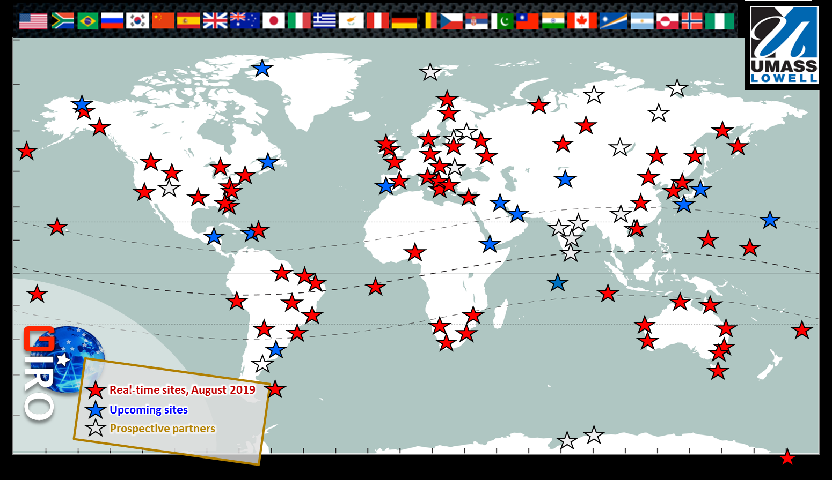
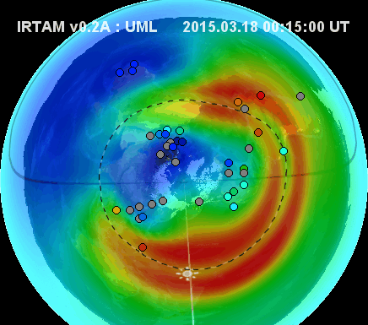
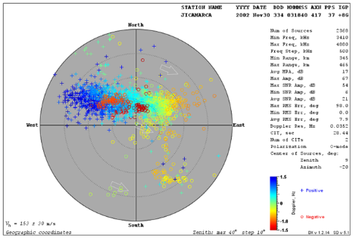
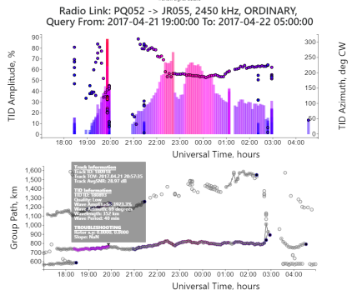
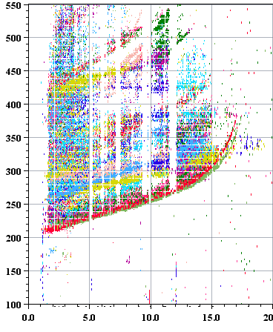

UML Realistic Ionosphere
RION
RION is member of United Nations Space Weather Initiative
http://www.iswi-secretariat.org/
GIRO
IRTAM 3D
SkyLITE
TID Explorer
IDI
Disturbance
Indicator
Measurements
Global Model
Plasma Drifts
TID Warnings

Slide 8
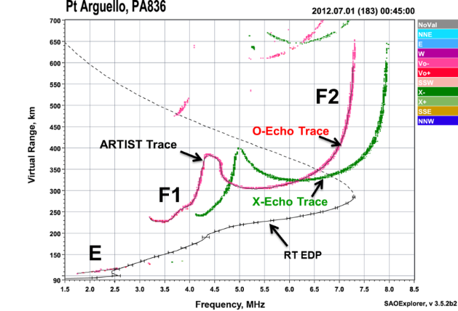
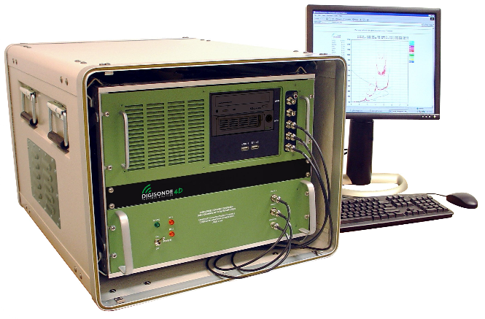
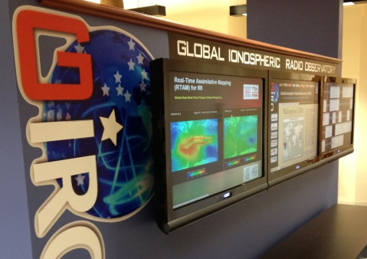
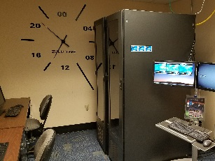
HF Ionosonde
24/7 workhorse of ionosphere diagnostics
First ionogram: Jan 11, 1931
1936: five ionosondes in the world
1957: 150 ionosondes in the world
1969: First Lowell Digisonde built
2019: <unknown> ionosondes in the world, but
  231 ionosondes registered in NOAA (1942..current)
  171 Lowell Digisondes
Latency below 7 min (2017): real-time nowcast
  Lower latency expected as GIRO upgrades its park

Slide 9
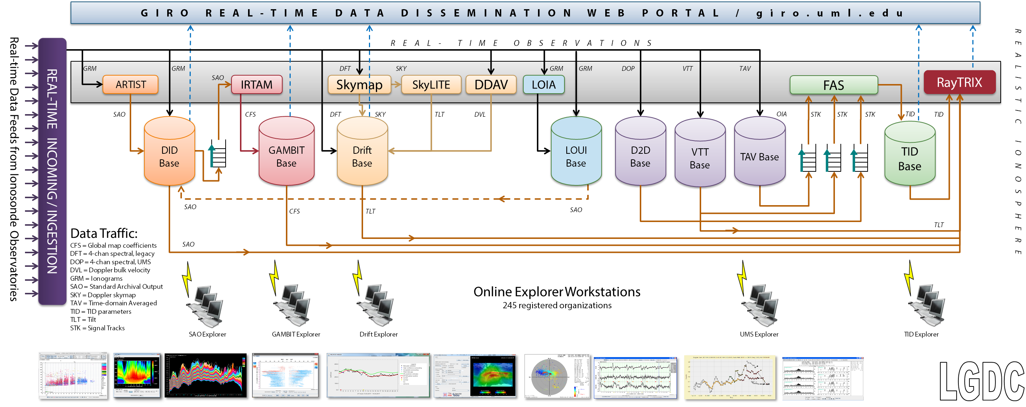
LGDC: 600+ Mil records
Lowell GIRO Data Center

Slide 10
Collaboration with MITRE
Arctic and beyond
Solar Flare IMPACTS
[Q]: Communications in remote territories
  High Frequency (HF) for Beyond Line of Sight (BLOS)
  BLOS HF channel modeling
    Replacement to old climate models
    Support of real-time nowcast and disturbance warning systems
[A]: UML IRTAM global nowcast and GAMBIT repository
[Q]: Model and evaluate impact of X-ray solar flares on lower ionosphere
[A]: D-region absorption and density profile evaluation using Digisonde HF signal performance

Slide 11
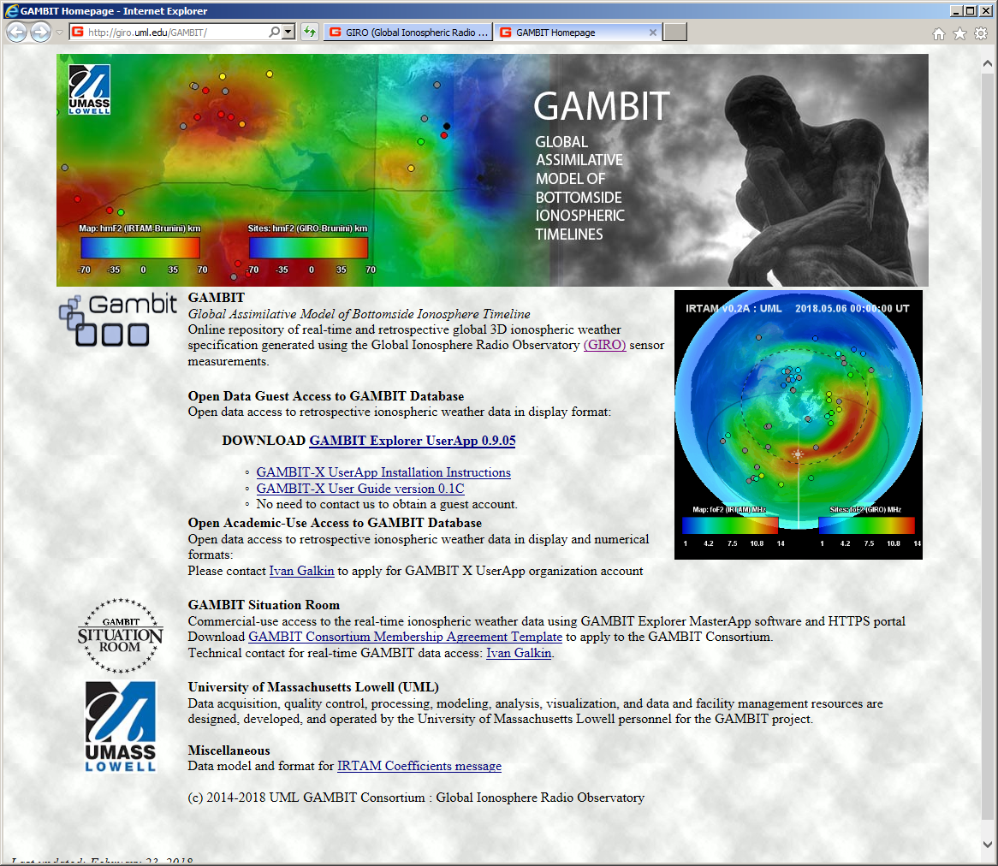
GAMBIT
Access to ionospheric weather data
Free for academic and research use
Download at giro.uml.edu
GAMBIT Situation Room: join Consortium

Slide 12
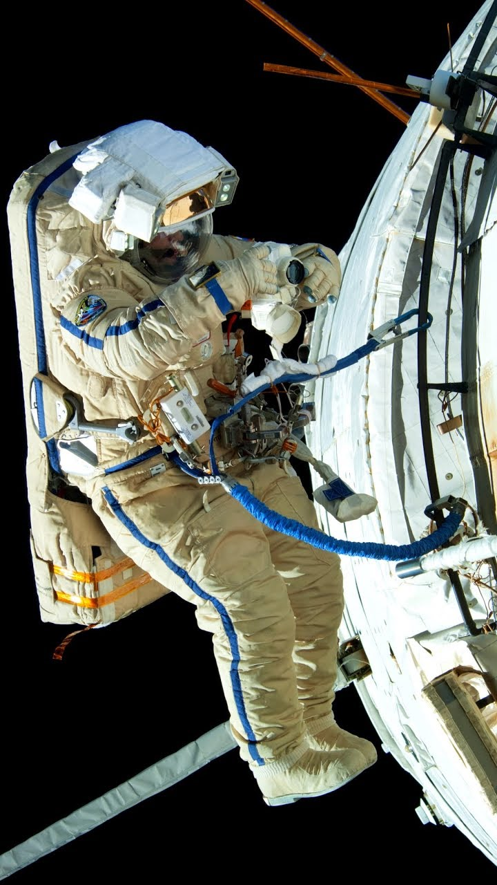
UML RION for spacewalk planning
Boeing Corp., member of GAMBIT Consortium
International Space Station: hazards of electric shock from accumulated charge on ISS frame
IRTAM nowcast is a backup system for aging onboard plasma sensor

Slide 13
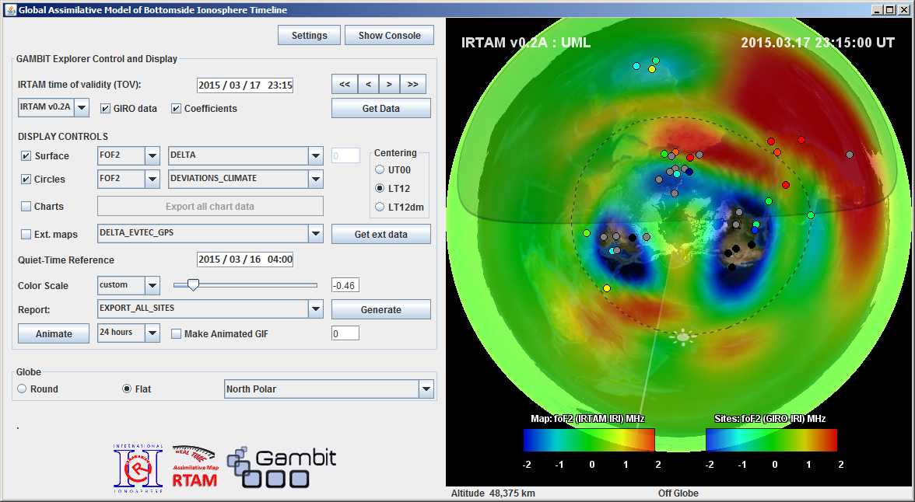
GAMBIT EXPLORER
Free for academic use: GAMBIT Explorer 0.9.05
Download from http://giro.uml.edu/GAMBIT/
IRTAM results from 2000 to “now”- 3 days
Access to IRTAM data
Global ΔfoF2 map
Nighttime Super-fountain
Dayside Depression
St. Patrick storm
March 17-18, 2015

Slide 14
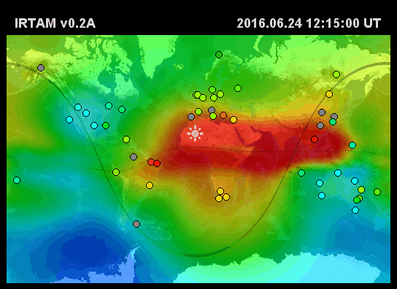
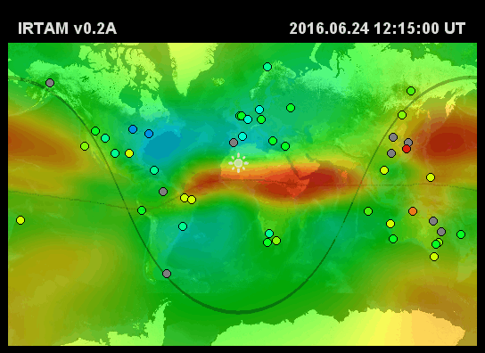
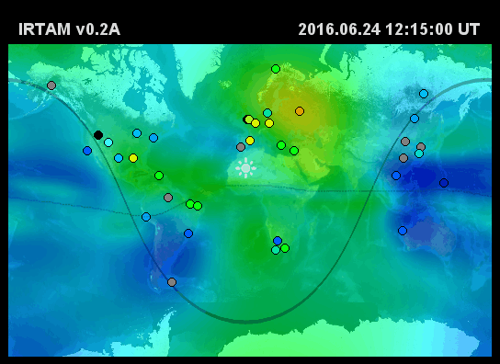
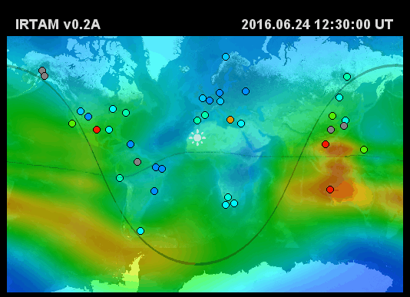
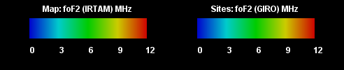
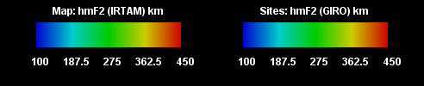
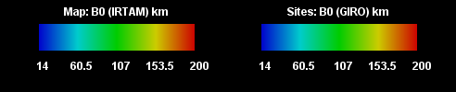
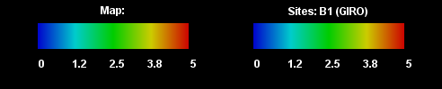
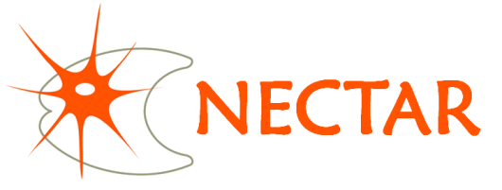
IRTAM 24-hour Animations
f_{o}F2
h_{m}F2
B0
B1
Used as input drivers to IRI density profile for 3D specification

Slide 15
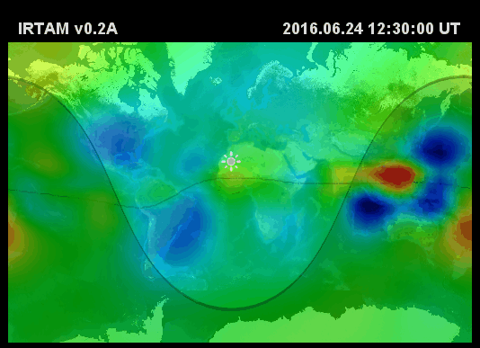
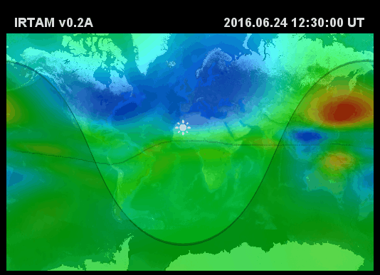
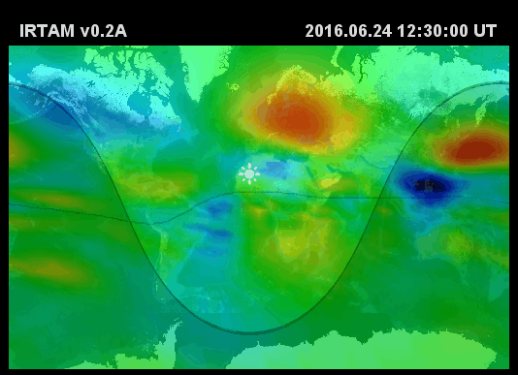
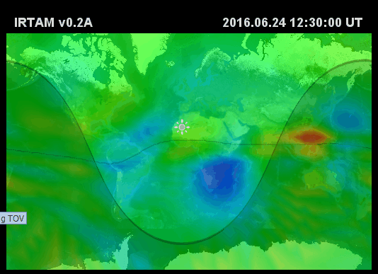
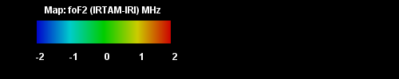
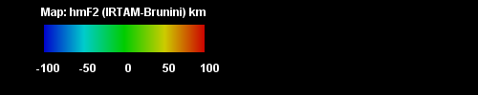
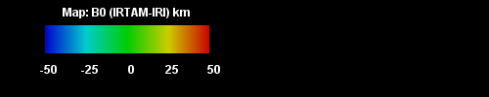
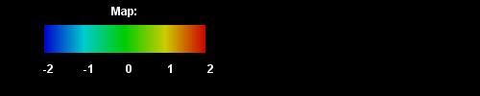
IRTAM Deviation Maps
HOW IONOSPHERE IS DIFFERENT FROM ITS QUIET-TIME STATE
Δf_{o}F2
Δh_{m}F2
ΔB0
ΔB1

Slide 16
Data from space platforms for IRTAM
Just launched: COSMIC-II mission
  Radio occultation
  GIRO in cooperation with NCAR
  R&D at UML is needed to support assimilation
Upcoming instruments: DPTIS
  Topside sounder
  LDI Phase II complete

Slide 17
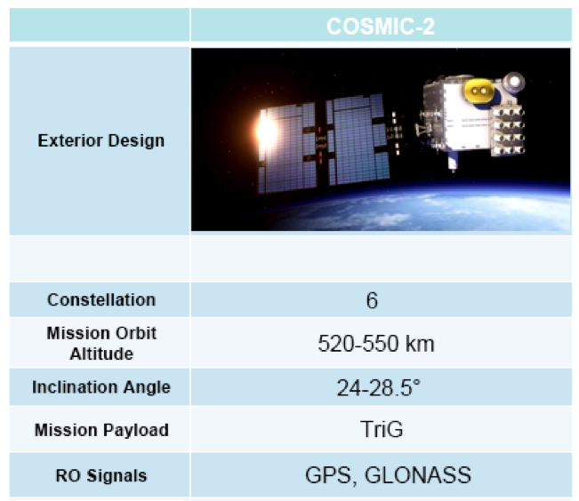
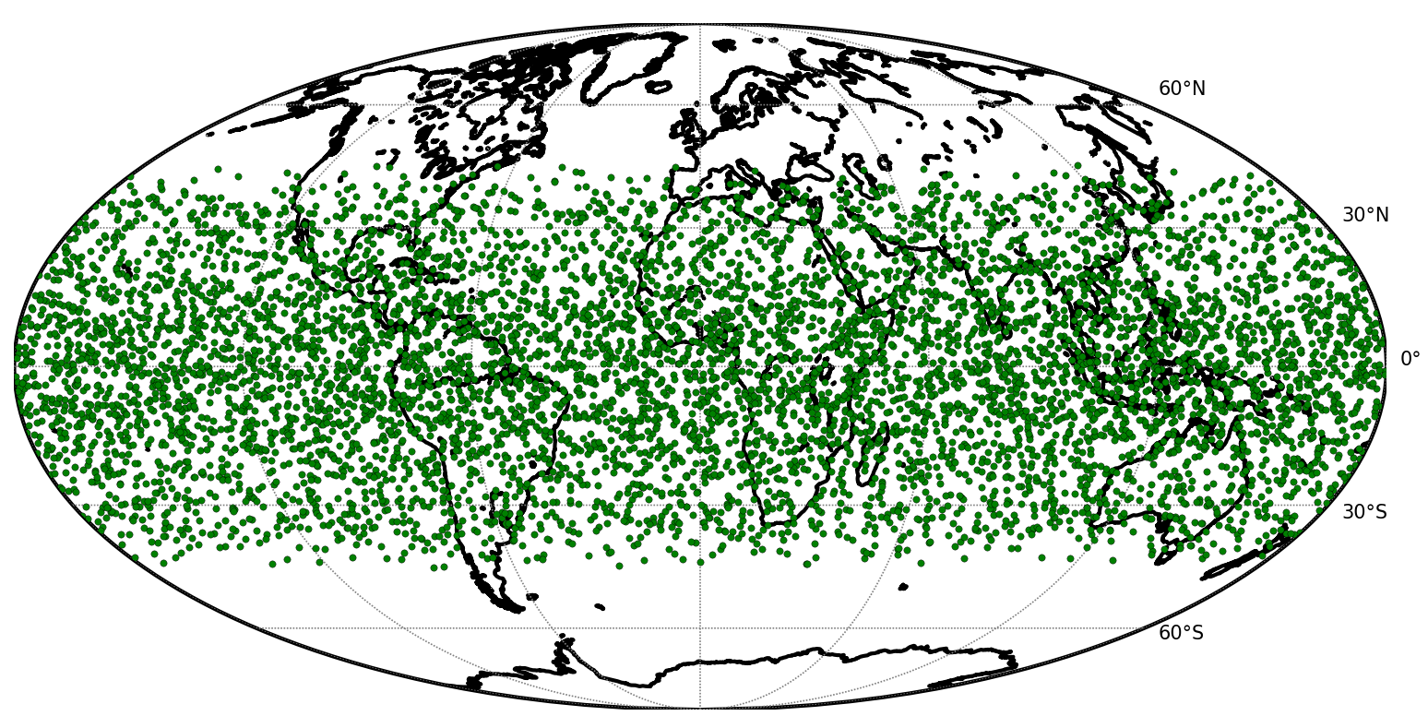
COSMIC II and IRTAM
Up to 10000 occultation per day
Equatorial region coverage
Low latency data stream

Slide 18
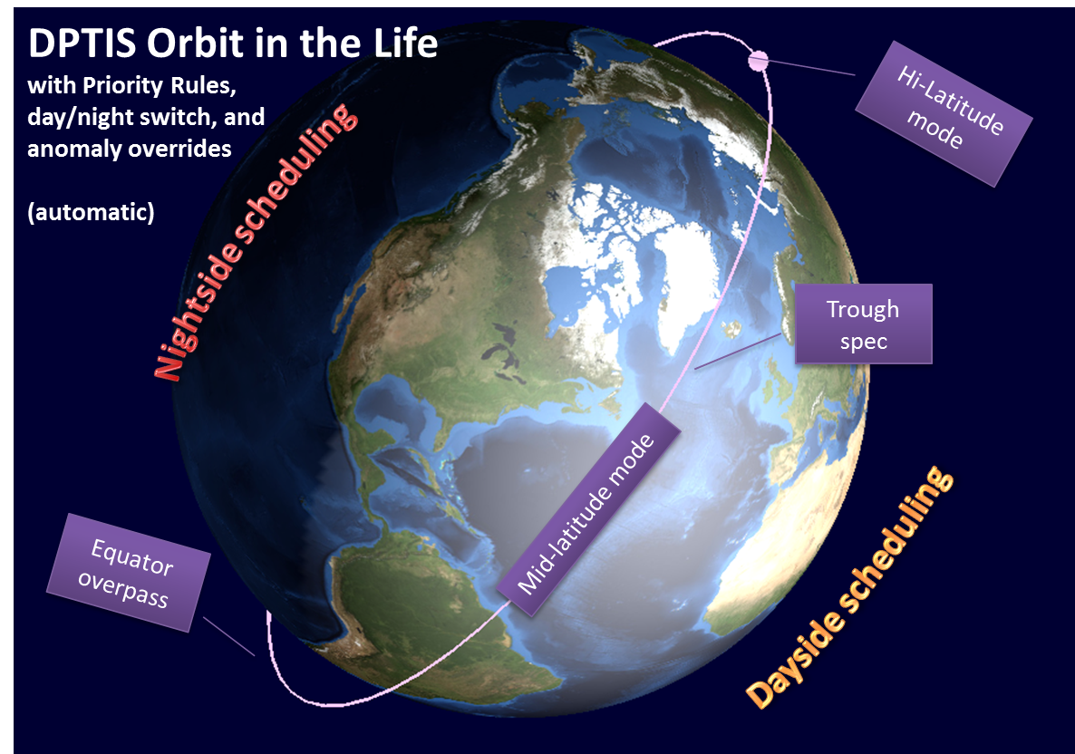
DPTIS and IRTAM
Spatial Resolution | Ionogram Cadence
100 km | 13 s
75 km | 10 s
300 km | 40 s
at 750 km S/C altitude
Amounts to ~400-500 ionograms per orbit
Autoscaling is a must
Low-rate real-time link: GlobalStar simplex (60% of 9600 baud, daily capacity of 46 MB)

Slide 19
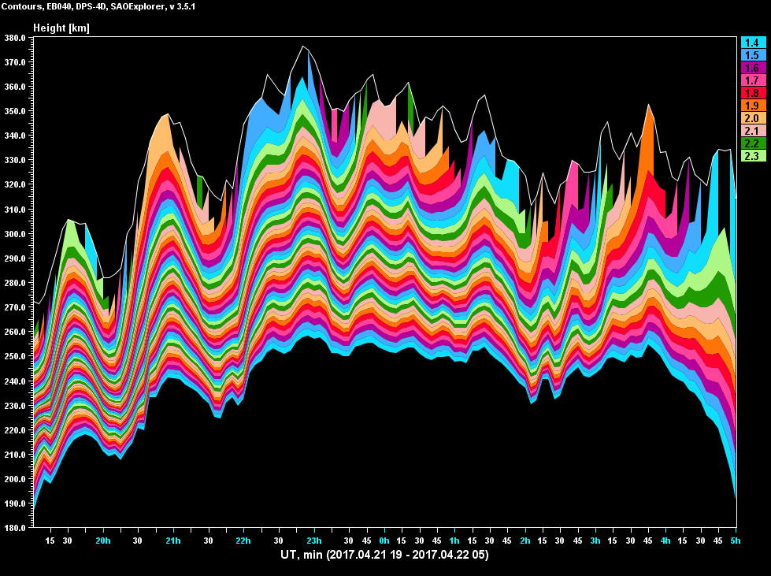
“EGU Opening” TID Event
Ebro Observatory, Roquetes
70% 135 min
hmF2
40%
90 min
1.4 MHz
20%
75 min
April 21-22, 2017

Slide 20


“EGU Opening” TID: April 21, 2017 19:00 UT
Pruhonice to Juliusruh link (513 km)
Multi-path separation at work
2F2L
Group Path
1F2L
Pruhonice to Juliusruh
21-Apr-2017
17:45 UT
1E
40% TID
  40% TID, 410 m/s
  2500 km, 100 min
  245° azimuth CW
Doppler
Accuracy sufficient for a warning system

Slide 21


Slide 22


Slide 23
Background and Solar Flare Absorption
Boulder, CO
17 – 27 Aug. 2005

Slide 24
Outlook
Realistic Ionosphere eXplorer (RIX) on the Web
Components available at http://giro.uml.edu
Collaboration opportunities for real-time and historic specifications of ionospheric weather

