Slide 1
Space, Science and Society
Howard J. Singer, NOAA Space Weather Prediction Center
Chris Russell Celebration Los Angeles, CA
May 8-9, 2012

Slide 2
Space, Science and Society
Purpose of Presentation
To celebrate Chris Russell’s work by exploring links between space science basic research and space weather applications
Historic and Recent Events
Societal Needs and National Interests
Models and Observations
Conclusions
Acknowledgments: Biesecker, Evans, Kunches, Millward, Murtagh, Pizzo
Howard J. Singer, NOAA Space Weather Prediction Center
Chris Russell Celebration Los Angeles, CA
May 8-9, 2012

Slide 3
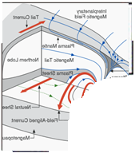
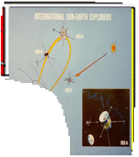
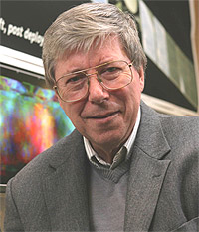
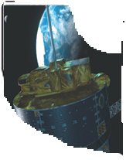
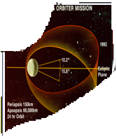
Russell Family
Coat of Arms
Old Coat of Arms
Revised Coat of Arms
ISEE
1 and 2
Satellites
Magnetosphere
Pioneer Venus Orbiter
Polar
Satellite
And more…
Much more…

Slide 4
Space Weather: Societal and Economic Impact
March 25, 1940
Large Geomagnetic Storm
Western Union set up emergency circuits to re-route messages as regular lines went dead.
Telegraph lines went haywire.
Geospace models in operations will help to protect similar, but modern, vital services
Life Magazine, vol 8, no 15, page 38, April 8, 1940.

Slide 5
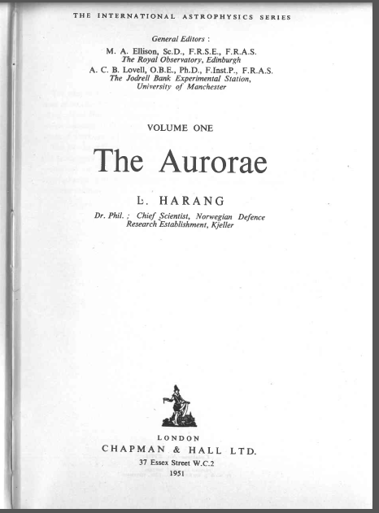
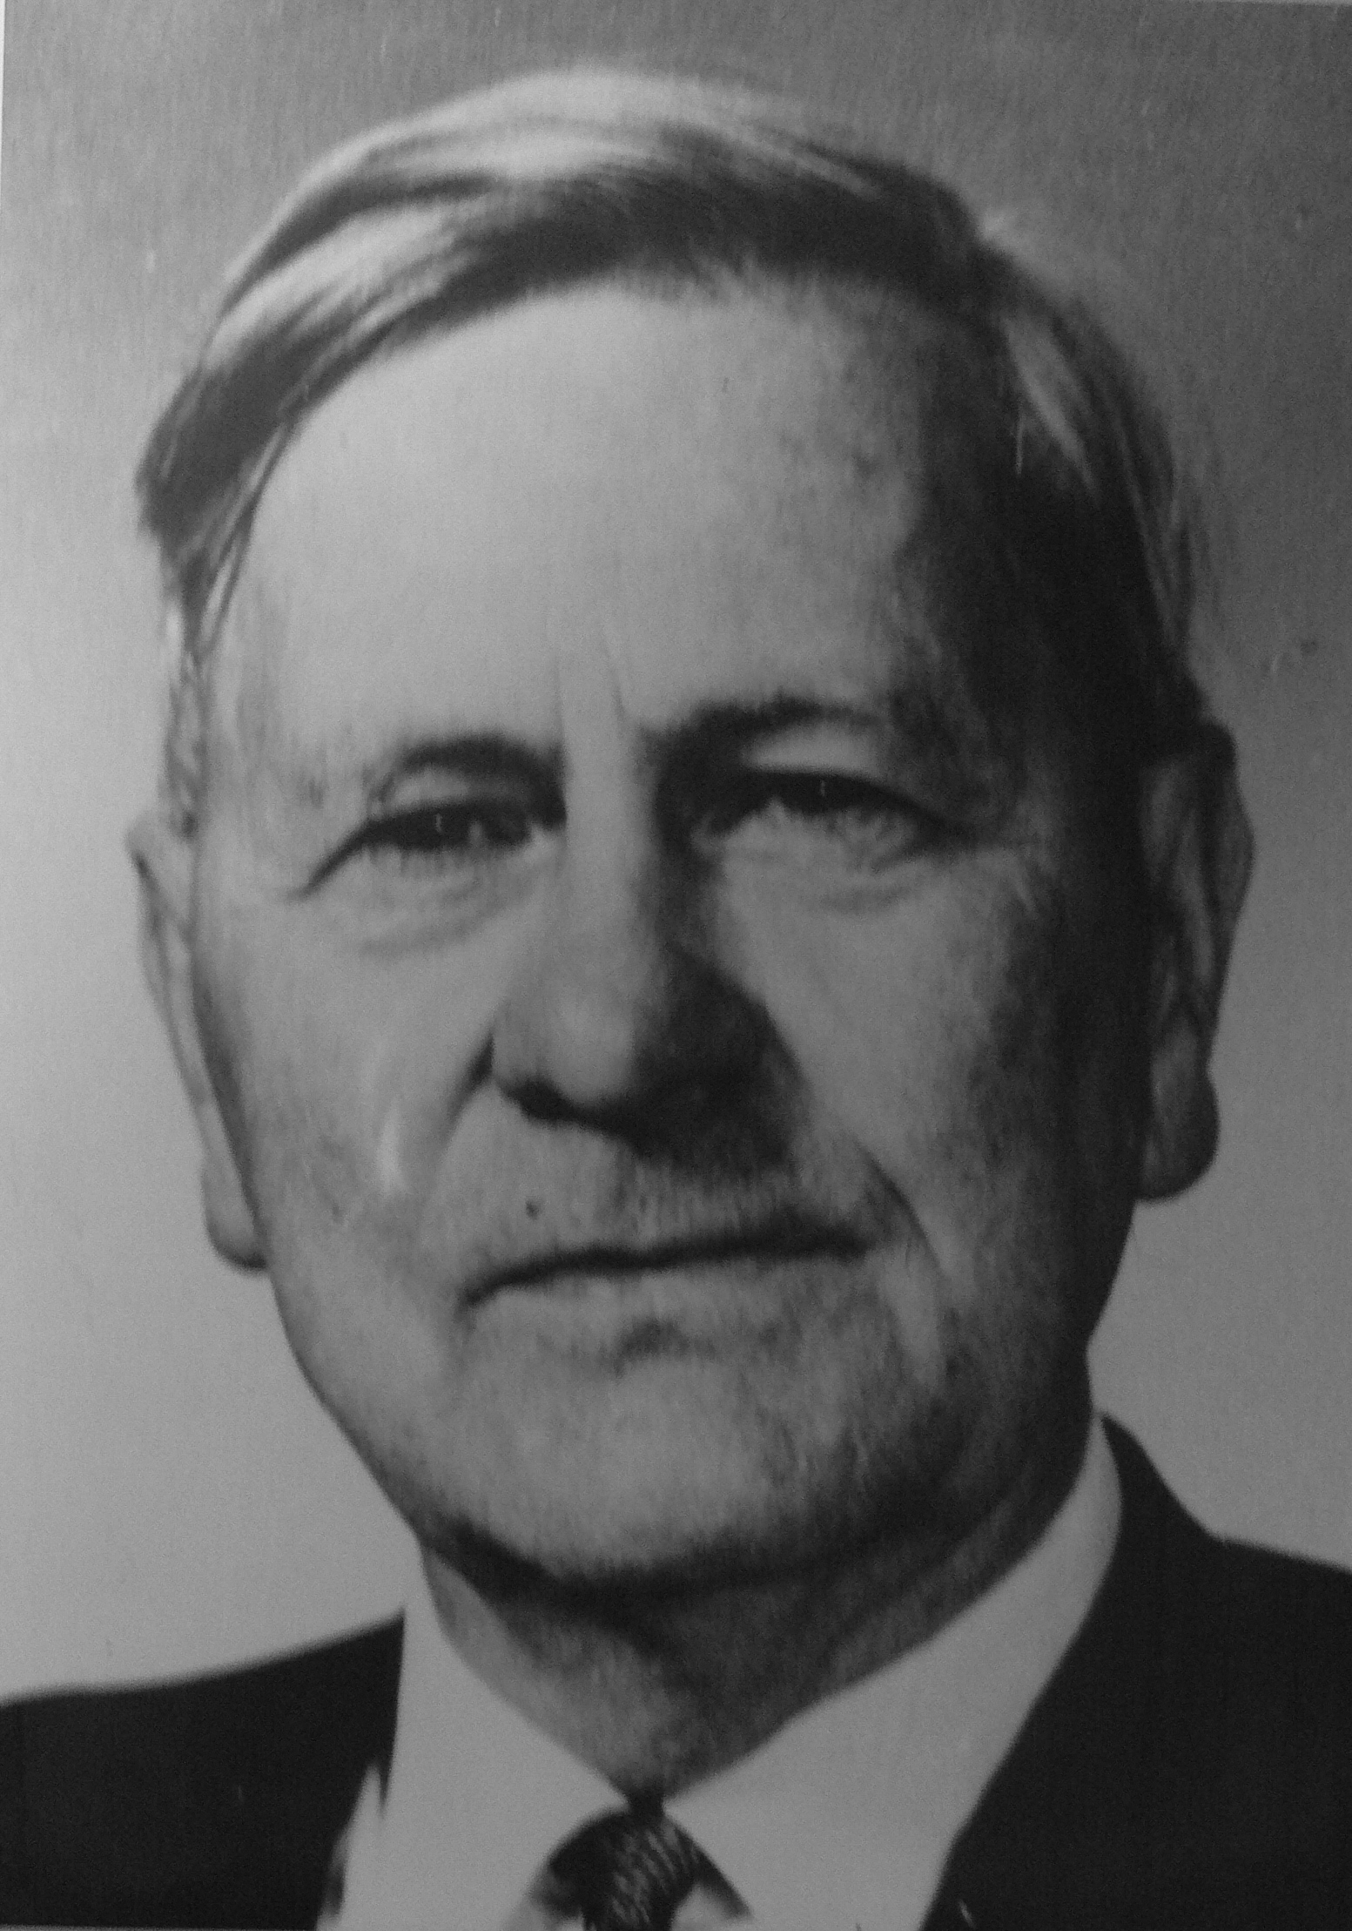
Space Weather:
Societal and Economic Impact
"On the lines to Syltefjord and Makkaur all fuses (4 amp.) burnt through. Sparks and permanent arcs were formed in the coupling racks and watch had to be kept during the night to prevent fire from breaking out”
Log of the Vardø Station
Norwegian Telegraph Service
24 March, 1940
The Aurorea, Leiv Harang, 1951.
Brought to my attention by D. Evans

Slide 6
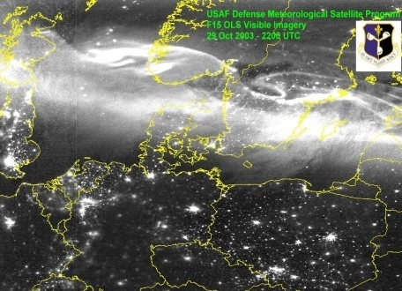
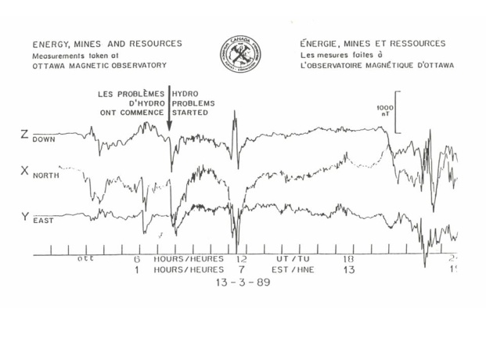
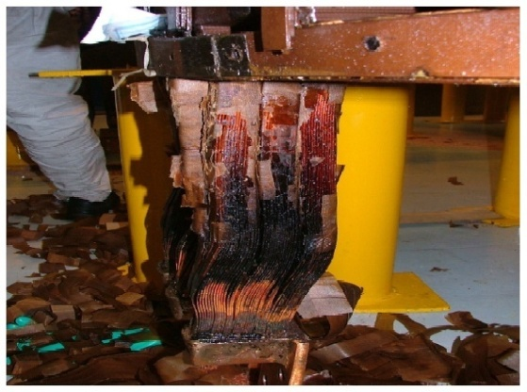
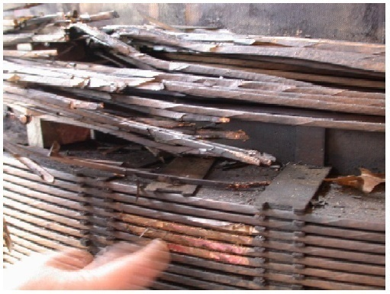
Significant grid problems have occurred…
Information Notice No. 90-42:
FAILURE OF ELECTRICAL POWER EQUIPMENT
DUE TO SOLAR MAGNETIC DISTURBANCES
Specific events occurred at the Three Mile Island
Unit 1, Hope Creek Unit 1, and Salem Unit 1
nuclear power plants. …inspection of the generator
step-up transformer… severe overheating, melted low
-voltage service connections in phases A and C,
and insulation discoloration in phase B. On
September 19, at Salem Unit 2 nuclear power
plant, a second solar storm damaged the generator
step-up transformer. Sep 1990
October 31 - Sun storm causes problems for Swedish power system. The solar storm has caused technical glitches in Sweden's power system in the past few days and may be to blame for a blackout that affected 50,000 people on Thursday, October 30.
Transformer winding failure
Transformer exit-lead overheating

Slide 7
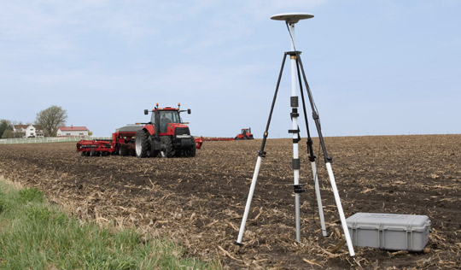
Precision Farming - optimize returns on inputs and preserve resources while reducing environmental risks
“I work with a John Deere Dealer group in North Dakota. We encounter many problems with our GPS Auto Steer etc. when K-Indexes are high and I have signed up for alerts from you. We are working to set up a mass text message system that will go out to all our customers warning them of when problems
will arise. This would save us
many problems, headaches,
and probably 1000+ phone
calls per day companywide
with our GPS technicians.”
- Apr 2012

Slide 8
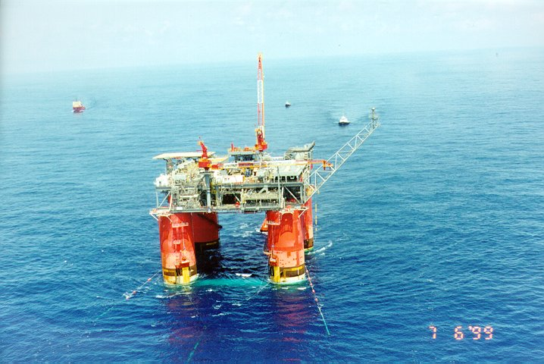
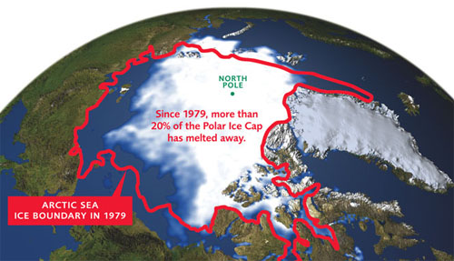
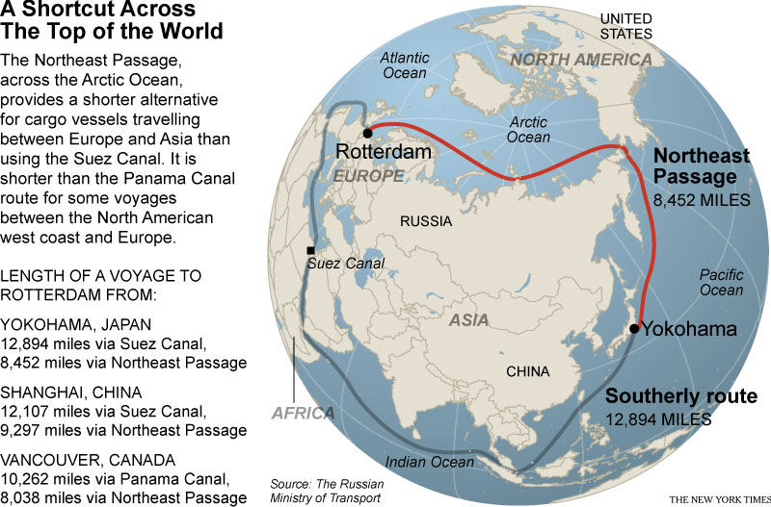
High-Latitude Geophysical Exploration, Navigation and Communication

Slide 9
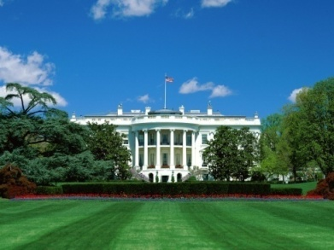
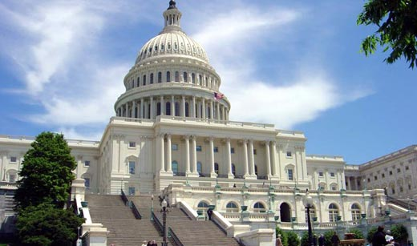
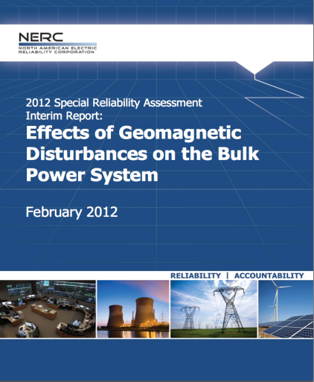
High-level government response…
Coordinating on ways forward to develop and implement mitigation strategies to safeguard critical infrastructure from the impacts of severe space weather.
The Shield Act (H.R. 668) (Feb 2011)
To amend the Federal Power Act to protect the electric infrastructure geomagnetic storm (and EMP)
Meeting at White House with National
Security Staff and OSTP (18 Feb)
Op Ed in NY Times on space weather
by Holdren and Beddington (10 Mar)
Electric Infrastructure Security Summit
(EISS) in Washington D.C. (11 Apr)
Effects of Geomagnetic Disturbances on the
Bulk Power System (NERC, 2012)

Slide 10
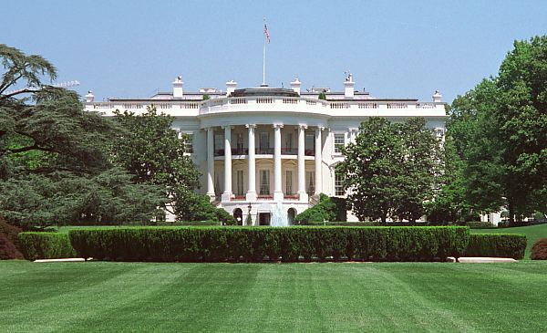
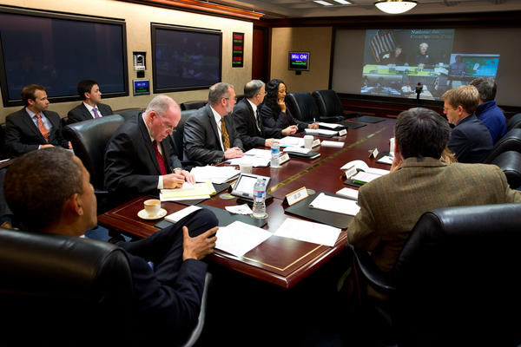
Executive Office of the President
Geomagnetically Induced Currents
Interagency Working Group
Formed by Office of Science and
Technology Policy to address space
weather threat.
Membership includes NOAA, USGS,
NASA, NSF, DoD, DOE, DHS, NRC, FERC
White House wants action….gets updates during
space weather outbreaks.

Slide 11
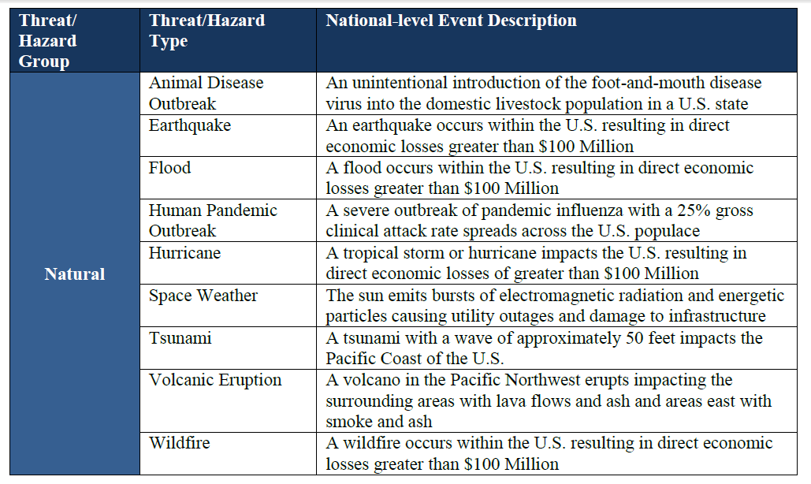
Strategic National Risk Assessment
Executed in support of Presidential Policy Directive 8 (PPD-8): Identifies incidents that pose greatest threat to the Nation’s security

Slide 12
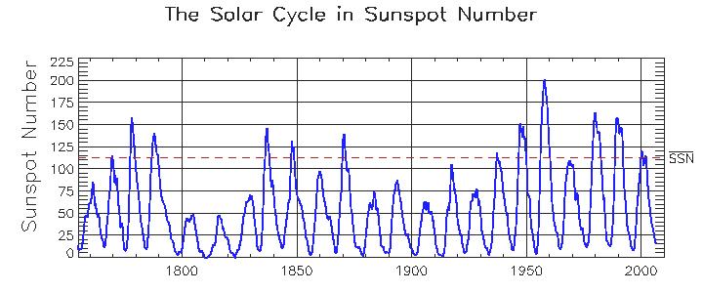
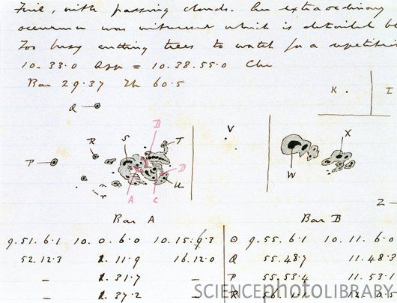
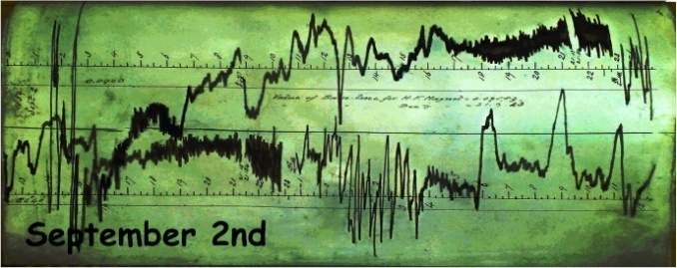
Large geomagnetic storms can occur with smaller cycles
The largest geomagnetic storms on record occurred during smaller than average cycles
1859 Storm
1921 Storm

Slide 13
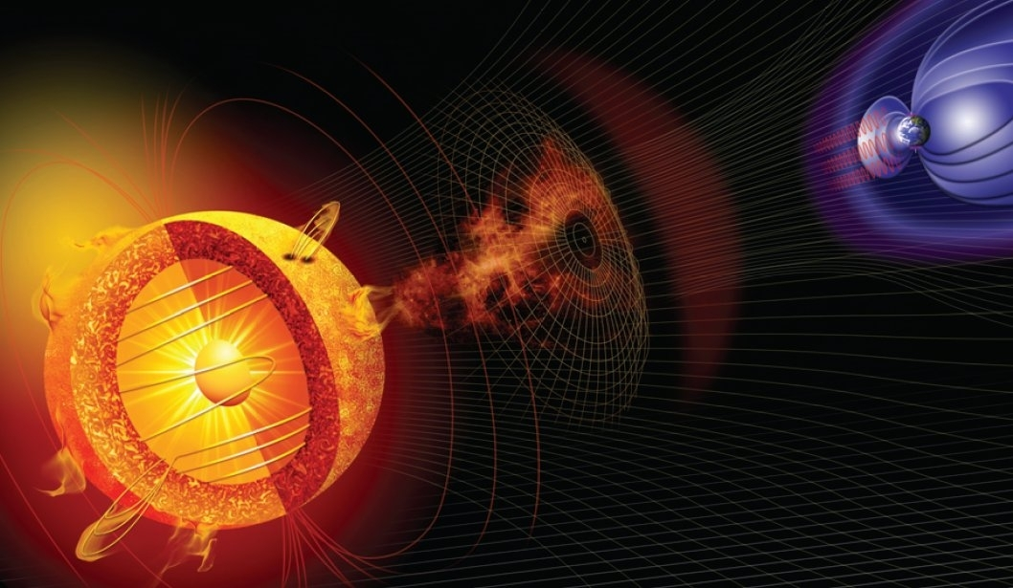
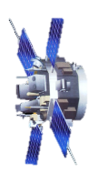
NOAA SPACE WEATHER PREDICTION CENTER
Geomagnetic Storm Warning issued upon detection of CME at L1 on ACE
15-45 MIN forecast
L1
Geomagnetic Storm Alert issued upon onset of geomagnetic storm using USGS magnetometers
Current condition
Geomagnetic Storm Watch issued upon detection of Earth-directed coronal mass ejection (CME) on SOHO LASCO and STEREO coronagraphs
1-3 day forecast
CME measurements from SOHO and STEREO drive the Enlil model which predicts arrival time

Slide 14
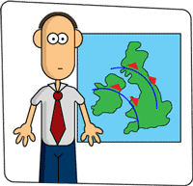
Today’s Forecast
“The forecast is for rain, somewhere on Earth, sometime today.”
www.ruralwellbeing.org.uk/ images/weatherman.gif
Is this an analogy to geomagnetic disturbance products today?
Perhaps a slight exaggeration, nevertheless there is a need for regional forecasts with longer lead time.

Slide 15
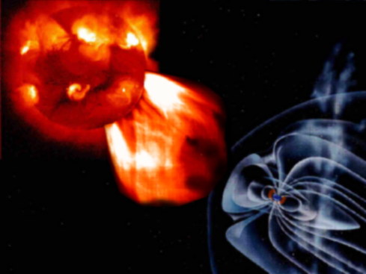
Geospace Models: Transition to Operations
Goal: Evaluate Geospace models (MHD and empirical) to determine which model(s) are ready for transition to operations
Focus: Regional K and dB/dt (important to electric utilities)
Partnership: Evaluation at NASA/Goddard CCMC working with SWPC, modelers and science community
Select Models and Events
Establish Metrics
Model-Data Comparisons
CCMC Reports to SWPC
Model(s) selection (FY13) by SWPC based on CCMC reports, internal and external advice, and following considerations:
Strategic Importance
Operational Significance
Implementation Readiness
Cost to Operate, Maintain, and Improve
Solar Influences on Geospace Predicted with Geospace Models using Solar Wind Input

Slide 16
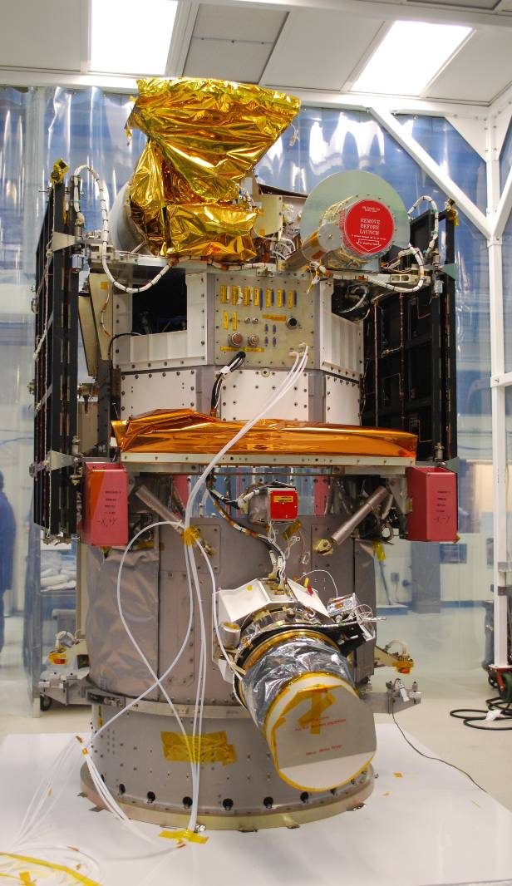
Deep Space Climate Observatory (DSCOVR) Solar Wind Mission Operational Space Weather Data from L1
The DSCOVR spacecraft is being refurbished and readied for launch Nov 2014
Satellite and sensors transferred to NOAA from NASA
Refurbishment of satellite and Plasma-Mag sensors is nearing completion at NASA/GSFC under reimbursement by NOAA
USAF plans on a Space-X Falcon 9 launch (co-manifested with Sunjammer)
All data will be downlinked to the Real Time Solar Wind Network (RTSWnet)
Activities to validate instrument performance are in process
NOAA has been investigating long-term commercial solutions for solar wind observations
Safeguarding Our Nation’s Advanced Technologies

Slide 17
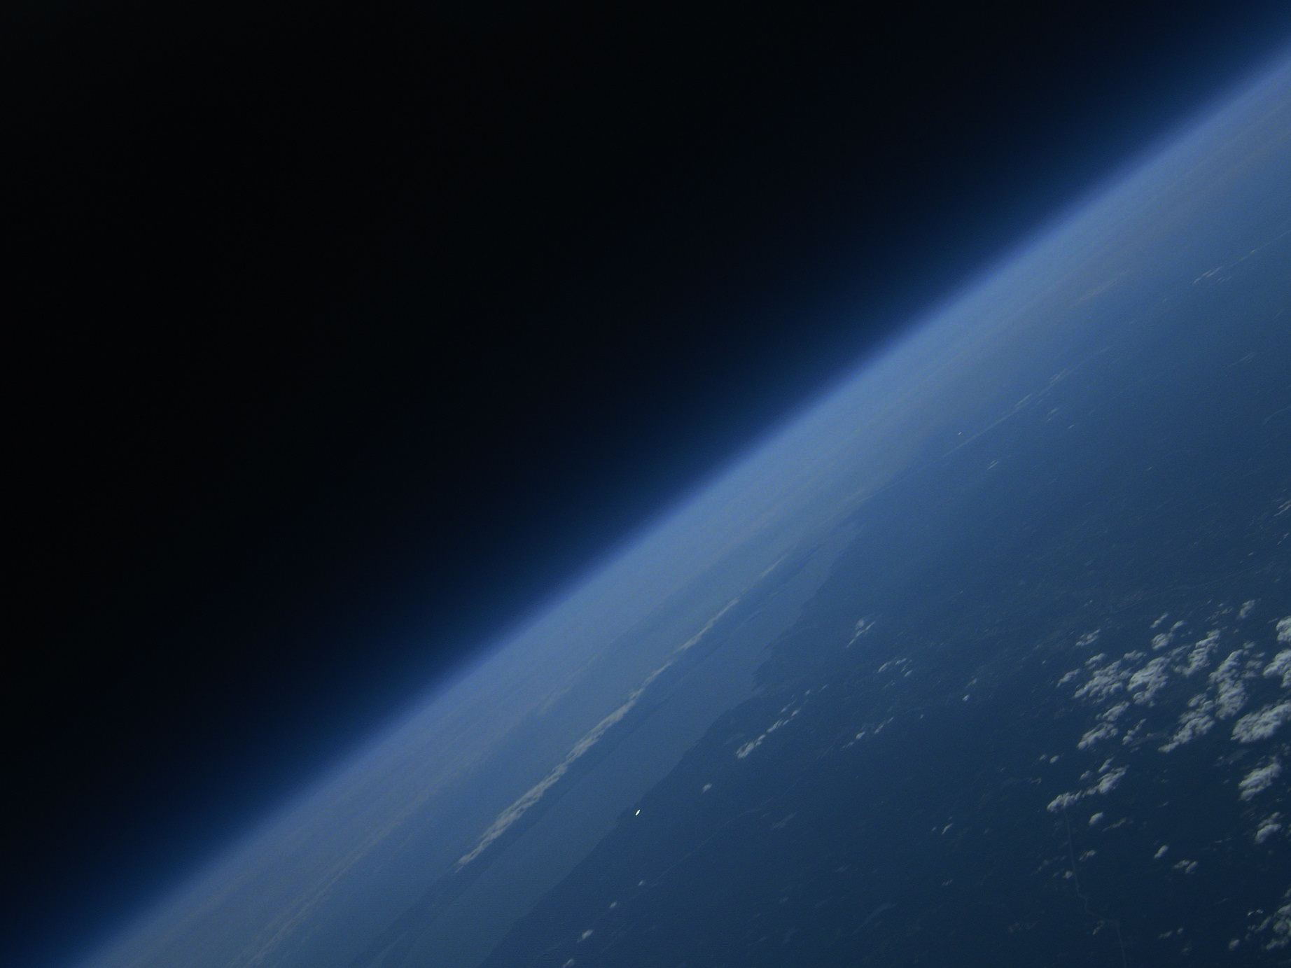
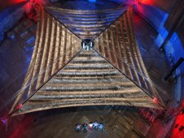
Visions of the Future…
Sailing on sunlight!
Sunjammer Solar Sail Technology
Demonstration Mission (TDM)
NASA mission to prove the viability and value of the solar sail technology (launch ~2014); 2 x L1 and then out of ecliptic
NOAA working with UK partners and NASA arranged for: Particle Spectrometer (MSSL) and Magnetometer (Imperial College)
Potential game-changer!! Add hours to warning leadtime of geomagnetic storms!
40 m x 40 m

Slide 18
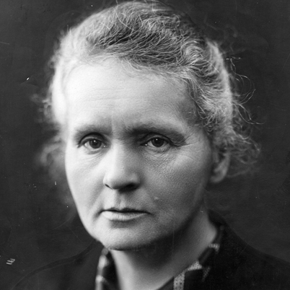
From Basic Research
to Societal Benefit
“We must not forget that when radium was discovered no one knew that it would prove useful in hospitals. The work was one of pure science. And this is a proof that scientific work must not be considered from the point of view of the direct usefulness of it. It must be done for itself, for the beauty of science, and then there is always the chance that a scientific discovery may become like the radium a benefit for humanity.”
Marie Curie, Lecture at Vassar College, May 14, 1921
French (Polish-born) chemist & physicist (1867 - 1934)

Slide 19
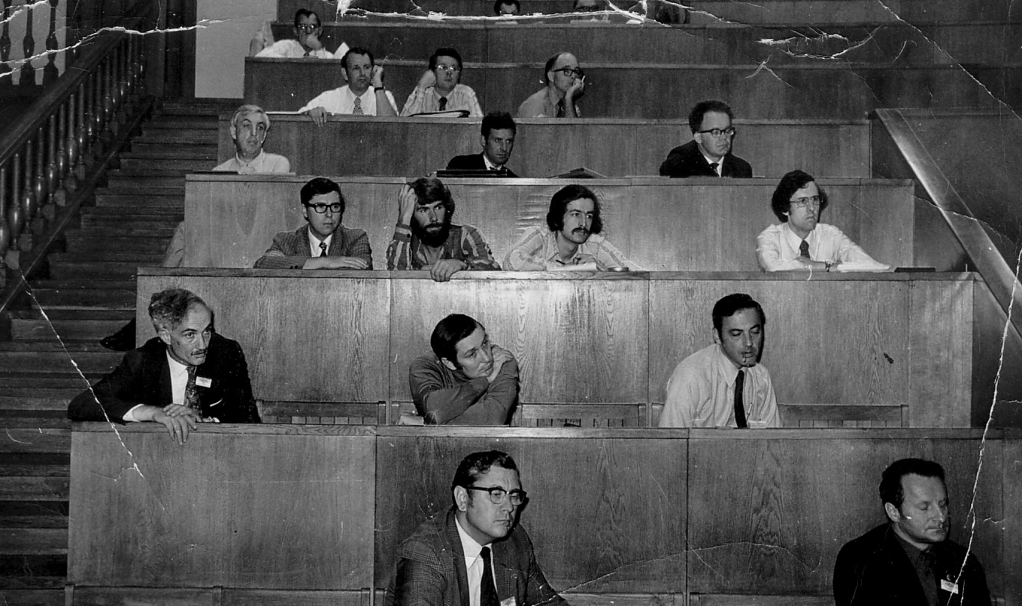
URSI Meeting – 1972 Warsaw
Guess who?
3rd row up: Russell, Thorne, Southwood, Fraser
2nd row up: Dungey first on left
Provided by Brian Fraser

