Slide 1
Dynamic Coupling of Magnetosphere and Ionosphere/Thermosphere
P. Song and J. Tu
University of Massachusetts Lowell
Acknowledgments: V. M. Vasyliūnas
Conventional M-I-T Coupling: E-J paradigm
New M-I-T Coupling: B-V paradigm
Physical differences
2-D simulations
Summary

Slide 2
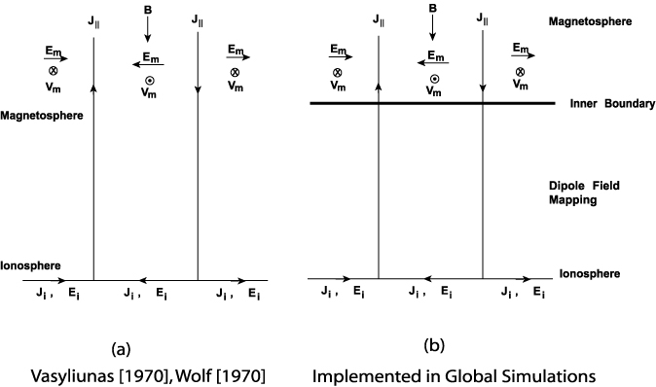
Field-aligned Current Coupling Models
Full dynamics
Electrostatic
Steady state
(density and neutrals time varying)
coupled via field-aligned current, closed with Pedersen current
Ohm’s law gives the electric field and Hall current
electric drift gives the ion motion

Slide 3
M-I Coupling
Explain the observed ionospheric responses to solar wind condition/changes, substorms and auroras etc. and feedback to the magnetosphere (not to simply couple codes)
Conventional: E-J paradigm:
Electric potential (mostly measured from velocity!)
Electric potential mapping
ExB drift (but V should be derived from momentum equation!)
Field-aligned current (mostly measured from magnetic perturbations!)
Pedersen currents
Hall currents (inferred from magnetic field variations on ground)
New concepts: B-V paradigm:
Convection: velocity, V, dV
Magnetic perturbation: B, dB
Magnetic tension force
Poynting flux, wave propagation/reflection
Alfven wave, fast mode wave
The two descriptions are identical in steady state

Slide 4
Theoretical Basis for Conventional Coupling Models
B₀ >>δB and B₀ is treated as time independent in the approach, and δB is produced to compare with observations
not a bad approximation
questionable for short time scales: dynamics
questionable for short time scales
BUT
Time scale to reach quasi-steady state δt~δLδB/δE
given δL, from the magnetopause to ionosphere, 20 Re
δB, in the ionosphere, 1000 nT
δE, in the ionosphere, for V~1 km/s, 6x10⁻² V/m
δt ~ 2000 sec, 30 min, substorm time scale!
Conventional theory is not applicable to substorms, auroral brightening!

Slide 5
The success of the E-J paradigm in description of slow processes (quasi-steady state) has been used to justify the E-J approach and generalize to dynamic processes For dynamic processes-- substorms, auroral brightening-– the E-J paradigm cannot describe the overshoot processes and the substorms have been the leading outstanding problem in magnetospheric physics Time scale for “fast” <30 min
Eugene Parker (2007):
“It is here that a fundamental misunderstanding has become widely accepted, mistaking the electric current j and electric field E to be fundamental physical entities… Magnetospheric physics has suffered severely from this misdirection…”

Slide 6
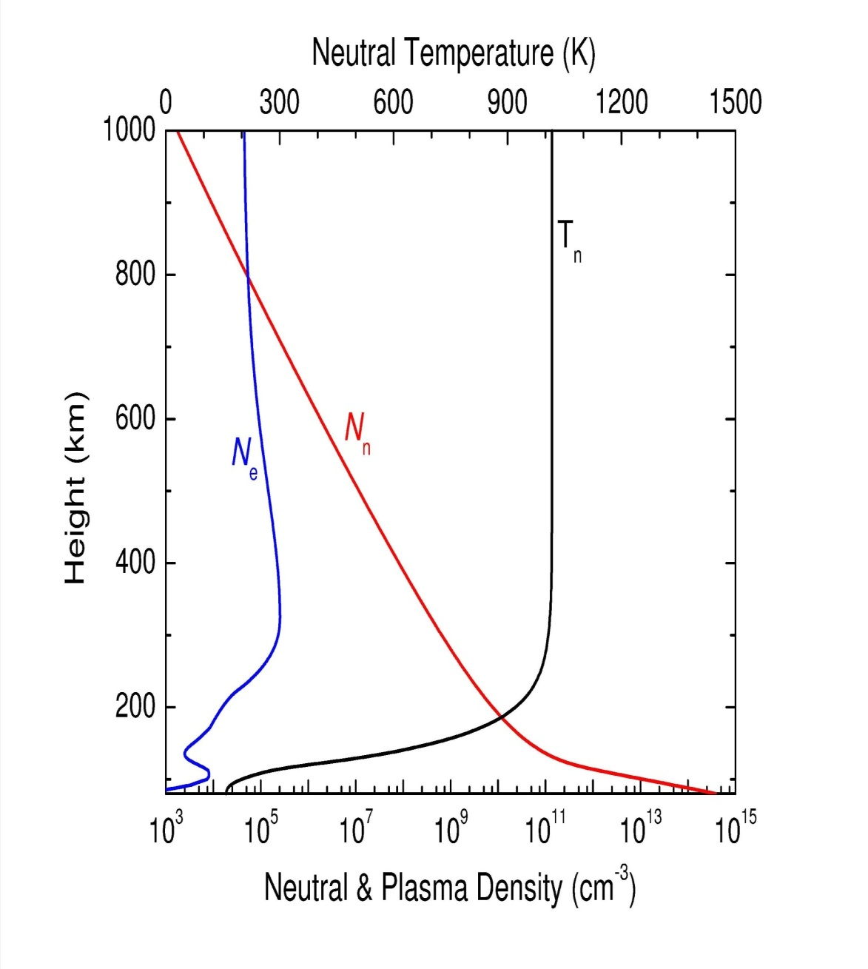
North Pole, Winter Solstice

Slide 7
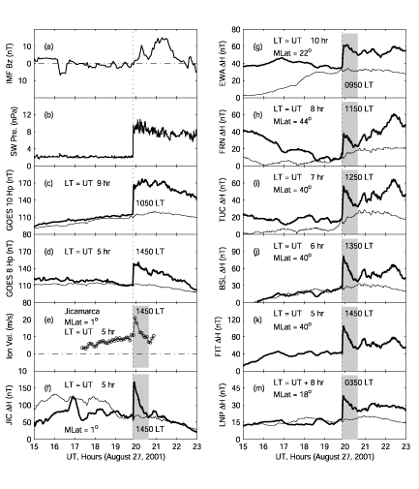
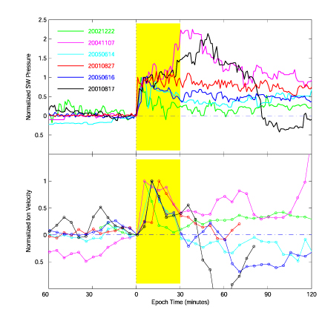
Ionospheric Dynamic Processes
Epoch analysis showing on average an overshoot in ionospheric velocity for 30 min.
An overshoot lasting 40 min was seen on ground but not in geosynchronous orbits;
indicating the overshoot is related to the ionospheric processes
Huang et al, 2009

Slide 8
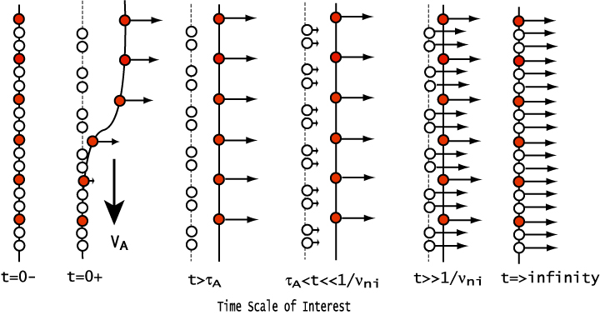
Ion-neutral Interaction
Magnetic field is frozen-in with electrons
Plasma (red dots) is driven with the magnetic field (solid line) perturbation from above
Neutrals do not directly feel the perturbation while plasma moves
Ion-neutral collisions accelerate neutrals (open circles), strong friction/heating
Longer than the neutral-ion collision time, the plasma and neutrals move nearly together with a small slippage. Weak friction/heating
On very long time scales, the plasma and neutrals move together: no collision/no heating

Slide 9
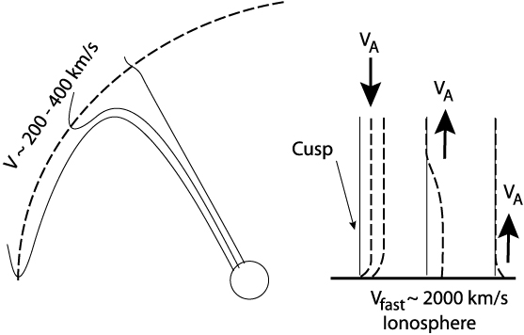
Ionosphere Reaction to Magnetospheric Motion
Slow down wave propagation (neutral inertia loading)
Partial reflection
Drive ionosphere convection
Large distance at the magnetopause corresponds to small distance in the ionosphere
In the ionosphere, horizontal perturbations propagate in fast mode speed
Ionospheric convection
modifies magnetospheric
convection
(true 2-way coupling)

Slide 10
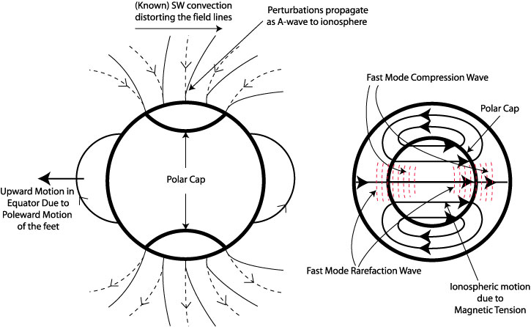
Global Consequence of A Poleward Motion
Antisunward motion of open field line in the open-closed boundary creates
a high pressure region in the open field region (compressional wave), and
a low pressure region in the closed field region (rarefaction wave)
Continuity requirement produces convection cells through fast mode waves in the ionosphere and motion in closed field regions.
Poleward motion of the feet of the flux tube propagates to equator and produces upward motion in the equator.
Ionospheric convection will drive/modify magnetospheric convection

Slide 11
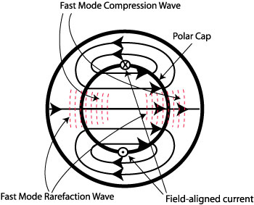
Expected Heating Distribution
sun
For uniform conductivity, velocity pattern coincides with the magnetic perturbation.
FAC forms at the center of the convection cells
Poynting flux is proportional to V², weakest at the center of convection cells
Neglecting the heating from precipitation particles,
Conventional model (EJ paradigm) predicts heating, J²/Σp, is highest at the FAC
New model (BV paradigm) predicts heating, ν_{in}ρ_{i}V², is highest at compression region of dayside and nightside cusps and strong along the noon-midnight meridian

Slide 12
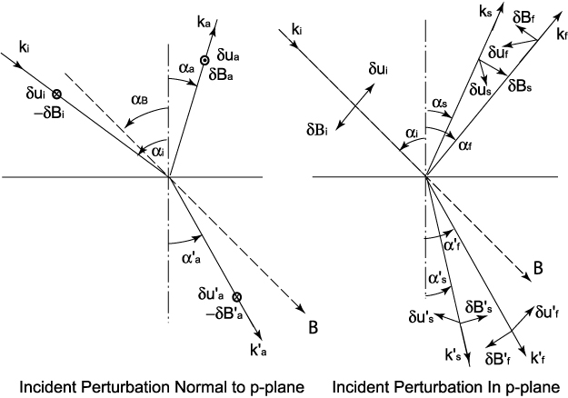
M-I Coupling via Waves (Perturbations)
The interface between magnetosphere and ionosphere can be idealized as a contact discontinuity with possible small deformation as the wave oscillates
Magnetospheric (fast/Alfvenic) perturbation incident onto the ionospheric interface
For a field-aligned fast/Alfvenic incidence (for example on cusp ionosphere)
δB ⊥ k, B₀ : δB in a plane normal to k (2 possible components)
Polarizations (reflected and transmitted)
(noon-midnight meridian)
Alfven mode
(toroidal mode)
δB,δu ⊥ k-B₀ plane
Fast/slow modes
(poloidal mode)
δB,δu in k-B₀ plane
Antisunward ionospheric motion
=>fast/slow modes (poloidal)
=> NOT Alfven mode (toroidal)
Magnetosphere
Ionosphere

Slide 13
Amplification of Magnetic Perturbation at the Ionosphere
At the magnetosphere-ionosphere boundary, the boundary conditions are maintained by the incident, reflected and transmitted perturbations.
The reflected perturbations have a phase reversal between dB and dV from the incident.
The inertia of the ionospheric plasma minimizes the velocity change across the boundary
The magnetic perturbation nearly doubles across the boundary => forming a strong current

Slide 14
Comparison of Steady-state Coupling with Dynamic Coupling
Coupling speed V_{phase}
Steady-state Coupling
Original model (Vasyliunas, 1970, Wolf, 1970): not specific, presumed to be V_{A}
Implemented in simulations: ∞ (instantaneously)
Dynamic Coupling: V_{phase} ~ α^{1/2} V_{A} (α is neutral inertia loading factor)
Coupling time δt
Steady-state Coupling
Original model: not specified,
Implemented in simulations: ~0
Dynamic Coupling:
1~2 min (Alfvén transient)
30 min (M-I equilibrium)
1~3 hours (neutral acceleration)

Slide 15
Comparison of Steady-state Coupling with Dynamic Coupling, cont.
Reflection
Steady-state Coupling
Original model: Multiple reflections assumed, V,B = final result, (depends on ionospheric conductivity)
Implemented in simulations: No reflection,
E=E_{inc}, V and δB are derived
Dynamic Coupling: Total=I+R for both δB and V
Reflection coefficient γ: depends on gradient (height) and frequency (time lapse);
Reflection may be produced continuously over height
Incident perturbation may consist of a spectrum: dispersion effect
A phase delay φ due to propagation to and from the reflection point

Slide 16
Basic Equations
Continuity equations
Momentum equations
Temperature equations
Faraday’s Law and Ampere's Law (E-field is derived from steady state electron momentum equation)
s = e, i or n, and e_{s} = -e, e or 0
Field-aligned flow allowed

Slide 17
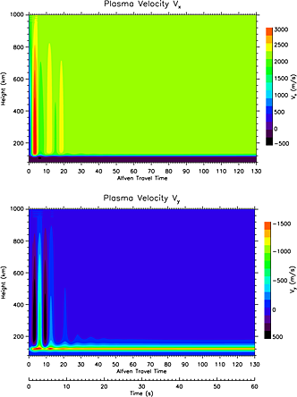
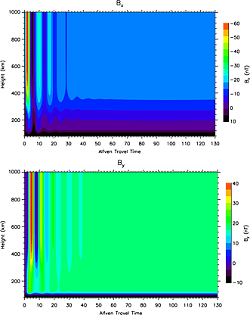
1-D Simulation Along Northern Pole
The noon-midnight and dawn-dusk components of the perturbation magnetic field, B_{x} and B_{y.}. Tu et al., 2014
The noon-midnight and dawn-dusk components of the plasma velocity V_{x} and V_{y}. Tu et al., 2014

Slide 18
Heating rate q as function of Alfvén travel time and height. The heating rate at each height becomes a constant after about 30 Alfvén travel times. The Alfvén time is the time normalized by t_{A}, which is defined as
If the driver is at the magnetopause, the Alfvén time is about 1 min.
Height variations of frictional heating rate and true Joule heating rate at a selected time. The Joule heating rate is negligibly small. The heating is essentially frictional in nature.
Tu et al., 2011

Slide 19
Heating rate divided by total mass density (neutral mass density plus plasma mass density) as function of Alfvén travel time and height. The heating rate per unit mass is peaked in the F layer of the ionosphere, around about 300 km in this case.
Time variation of height integrated heating rate. After about 30 Alfvén travel times, the heating rate reaches a constant. This steady-state heating rate is equivalent to the steady-state heating rate calculated using conventional Joule heating rate J∙(E+u_{n}xB) defined in the frame moving with the neutral wind. In the transition period, the heating rate can be two times larger than the steady-state heating rate.
Tu et al., 2011

Slide 20
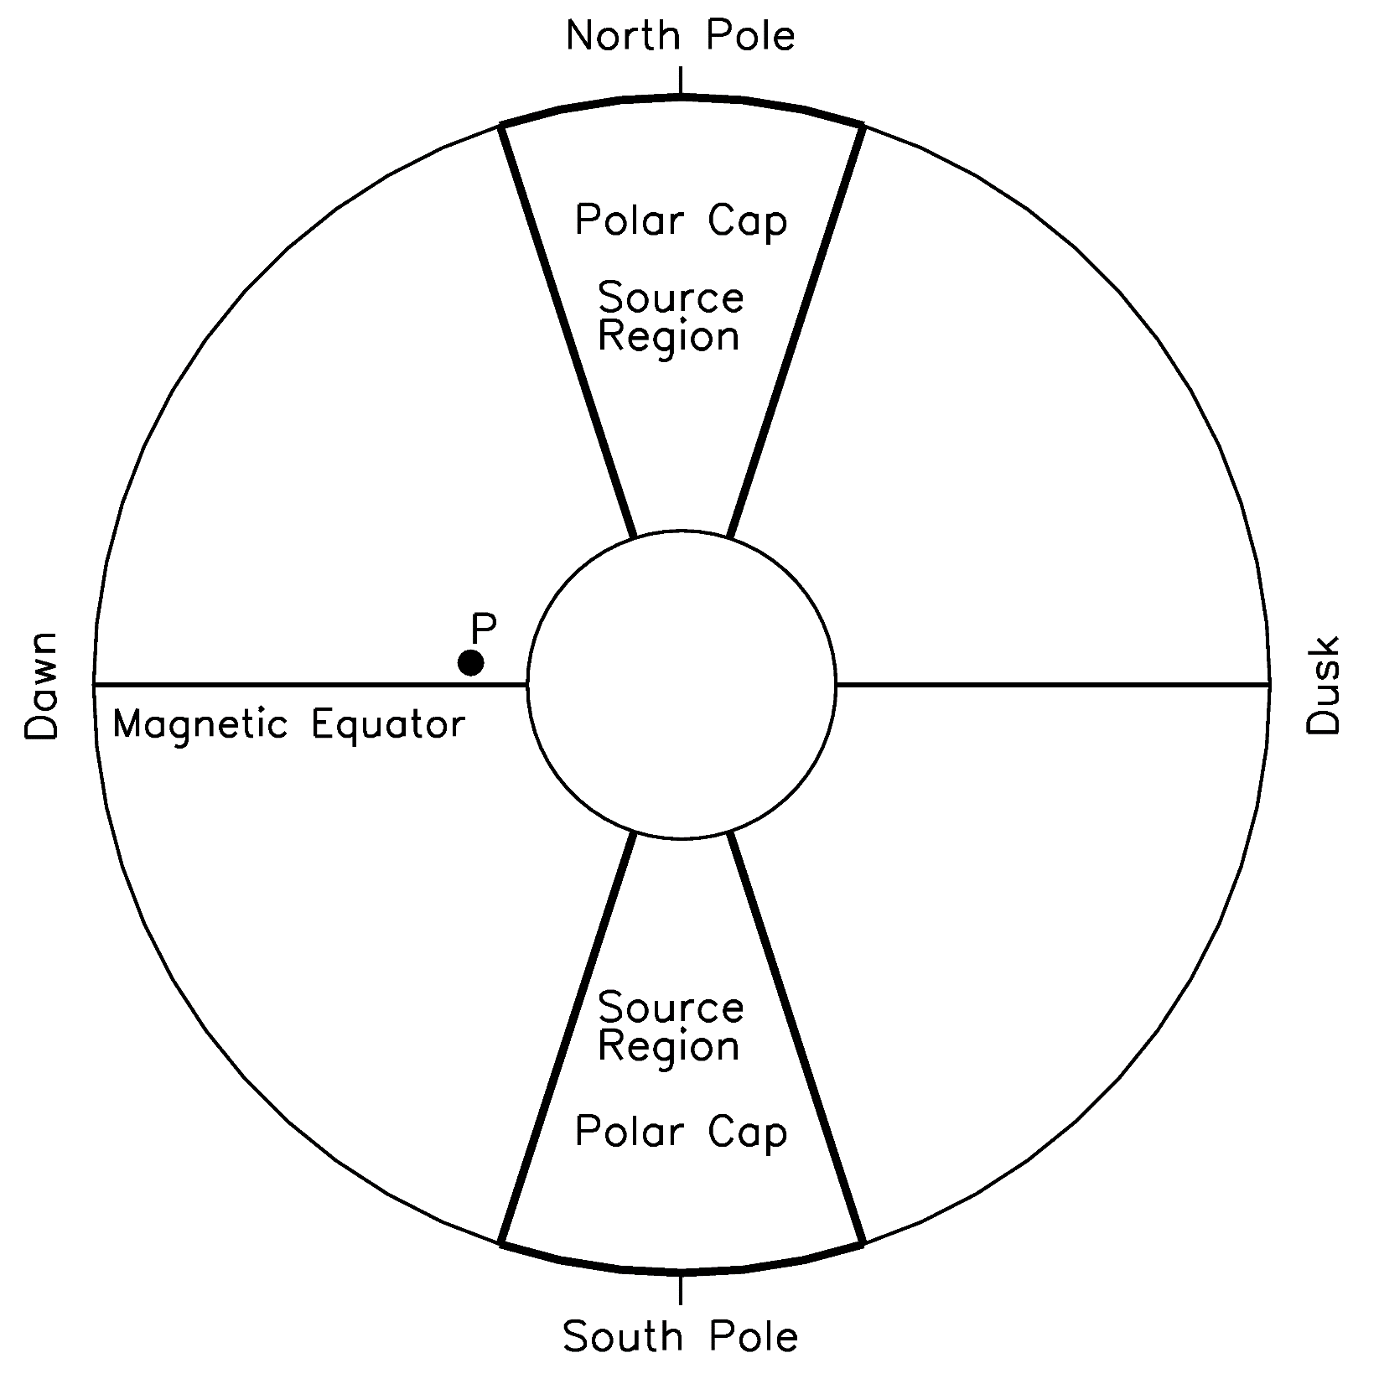
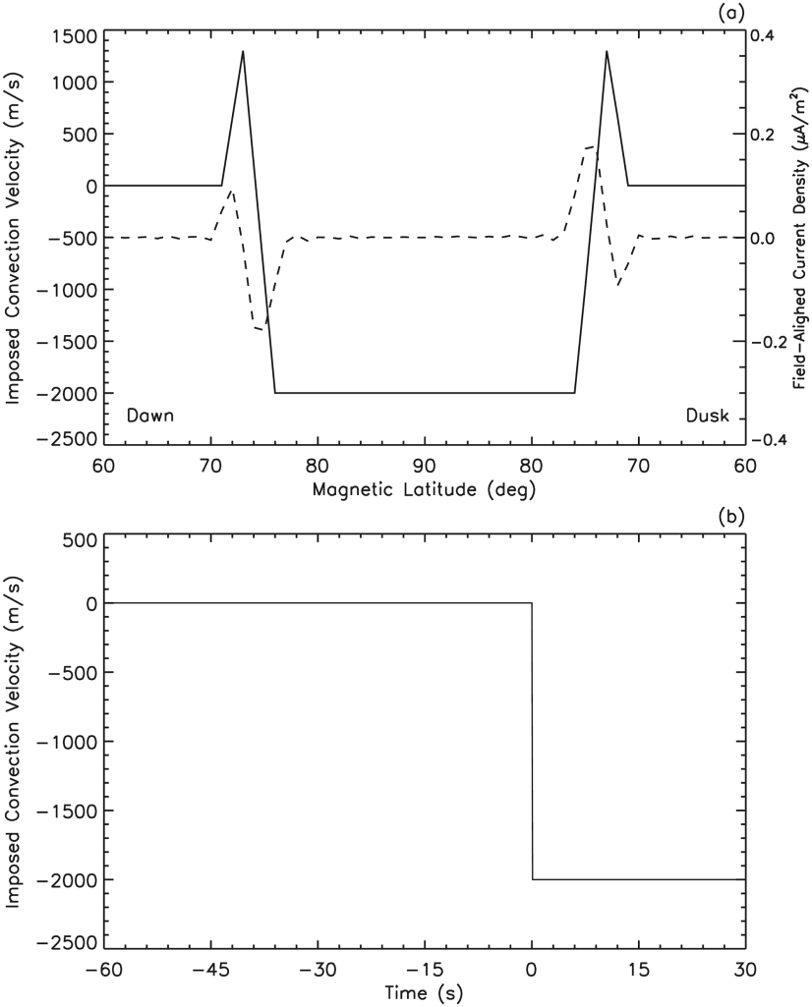
2-D Simulation of the Dawn-Dusk Meridian Plane

Slide 21
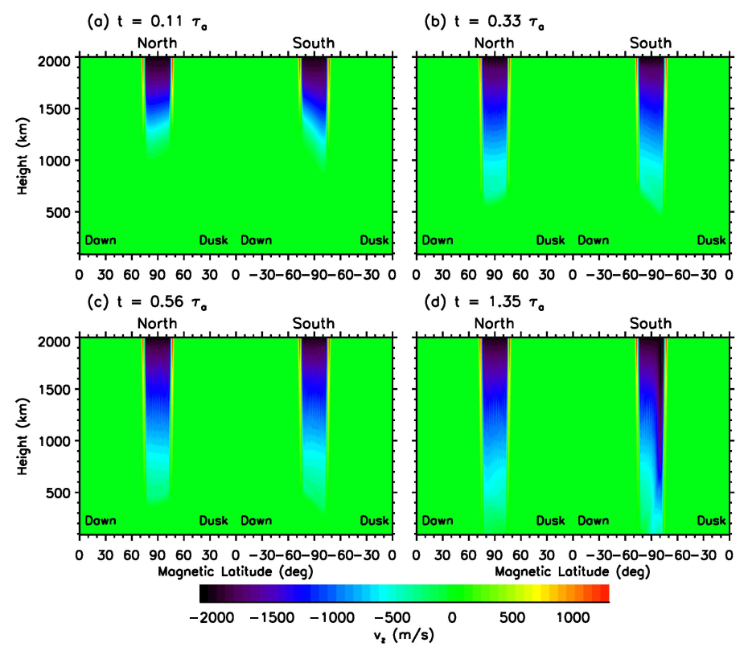
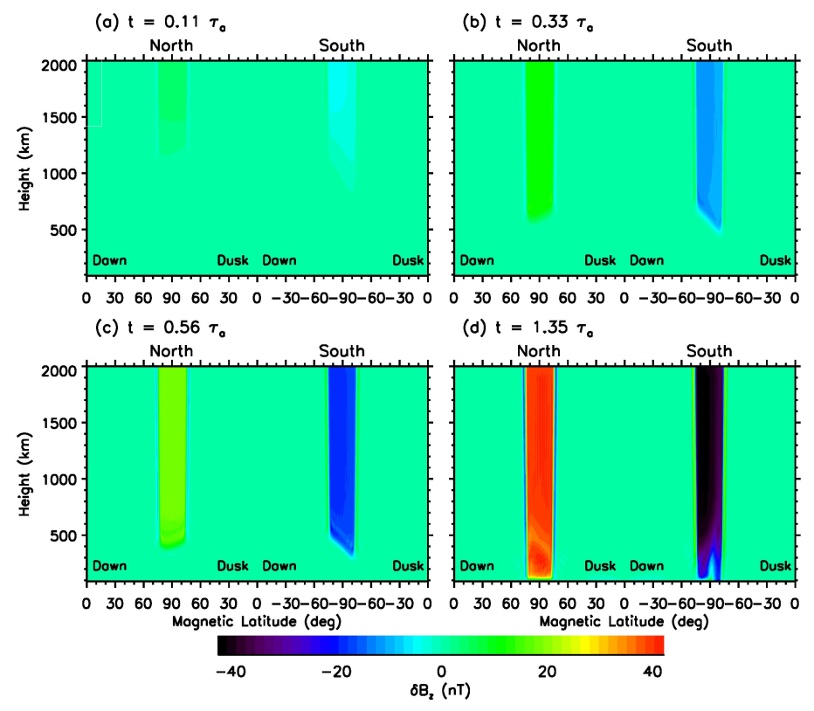
Alfven Wave Propagation
Imposed antisunward velocity drives downward propagating velocity and magnetic field perturbations. Both propagate with the Alfven speed.
Velocity perturbation in the polar cap in both hemispheres is antisunward and reverse direction at lower latitudes
Magnetic field perturbation in the two hemisphere has opposite directions

Slide 22
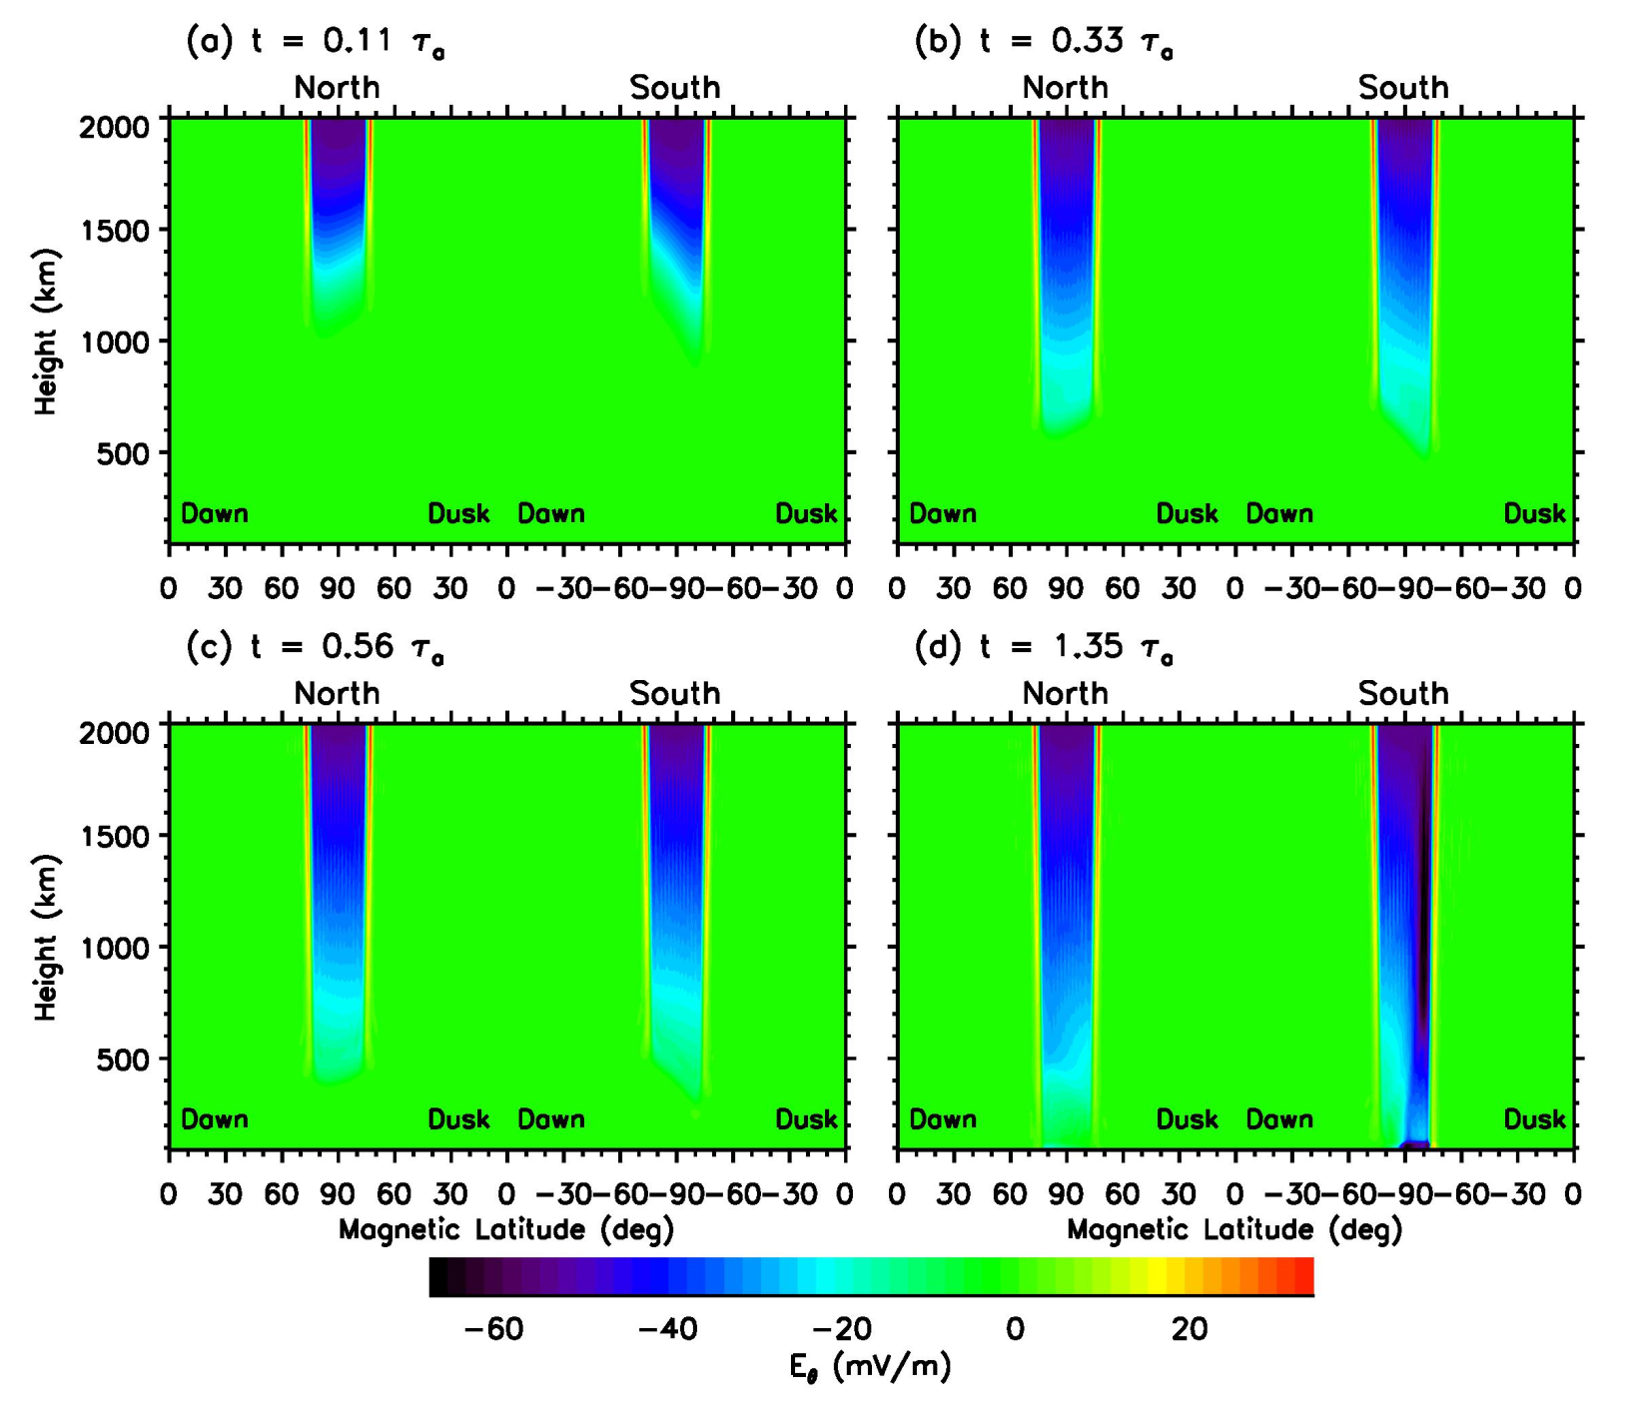
Dawn-Dusk Electric Field
Dawn-dusk electric field as a function of magnetic latitude and altitude for the Northern Hemisphere at selected times. Negative values are duskward. Tu and Song, 2016.

Slide 23
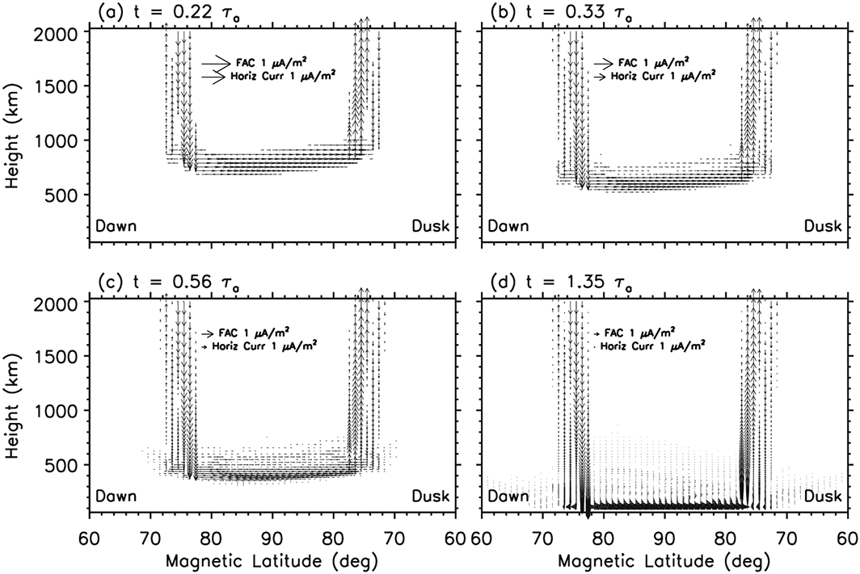
Field-Aligned and Closure Currents
Region 1 and 2 FACs evolve with the Alfven waves
At the front of FACs there are horizontal closure currents
Pedersen currents form when the FACs reach ~100 - 120 km
Has important implication to substorm current wedge
Tu and Song, 2016

Slide 24
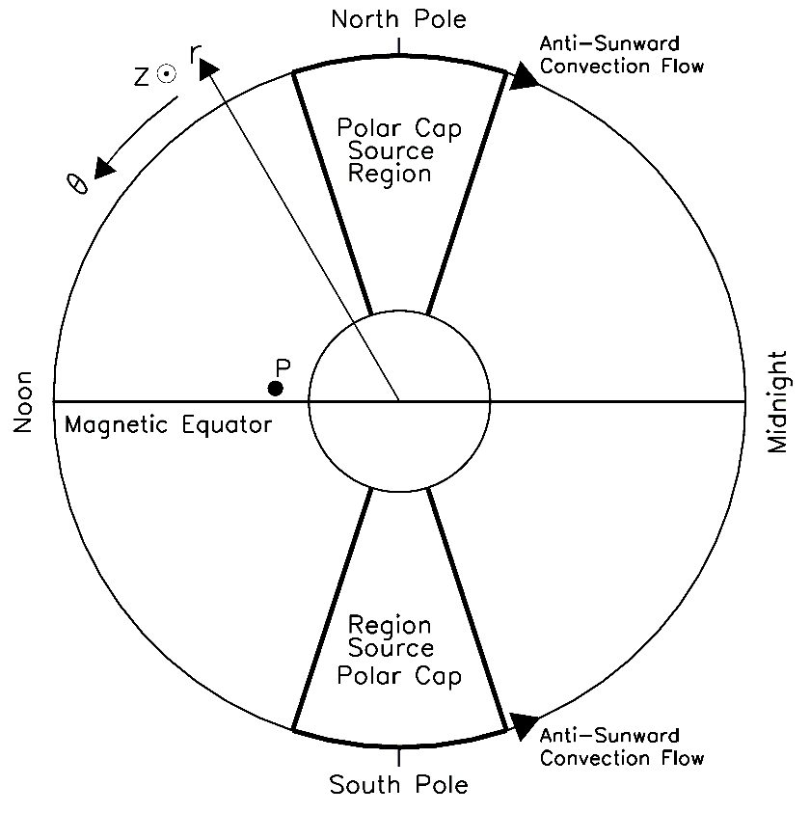
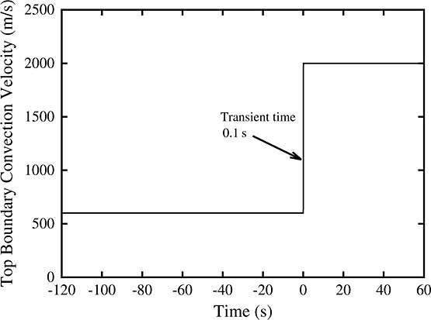
2-D Simulation of the Noon-Midnight Meridian Plane
2000 m/s
200 m/s
T=120 s
Driver in the polar cap

Slide 25
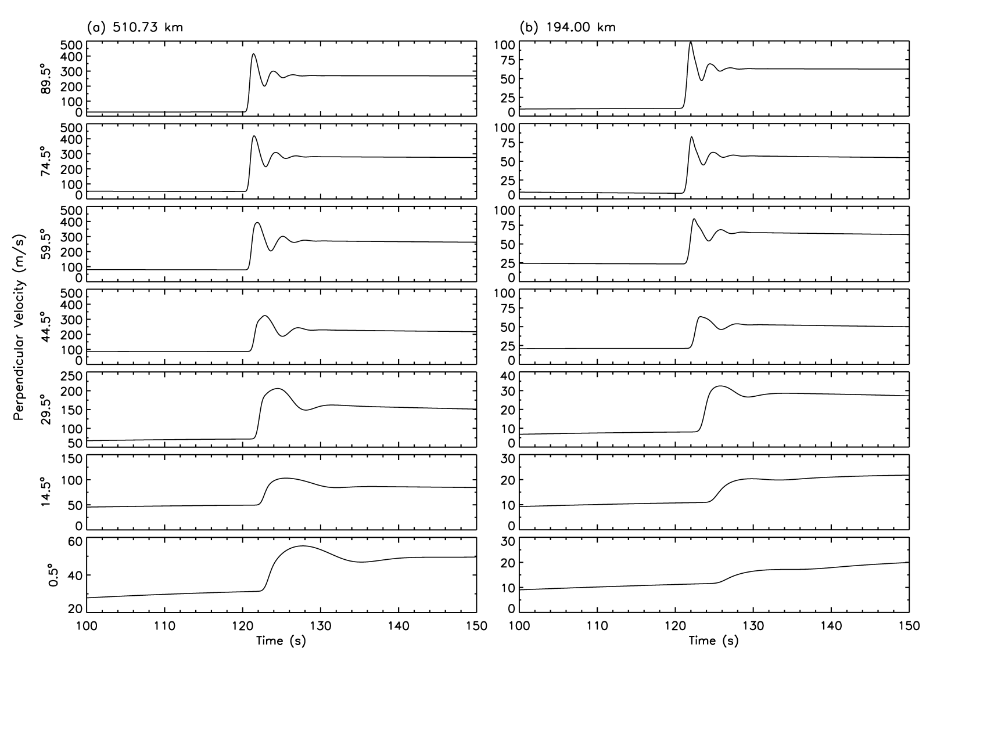
High to Low Latitude Ionosphere Coupling
Time variation of the average ion velocity component within the noon-midnight magnetic meridian and perpendicular to the magnetic field for several magnetic altitudes at 510.73 km (panel a) and 194 km (panel b). Positive values represent poleward (at high and middle latitudes) or upward (at low and equatorial latitudes) velocities

Slide 26
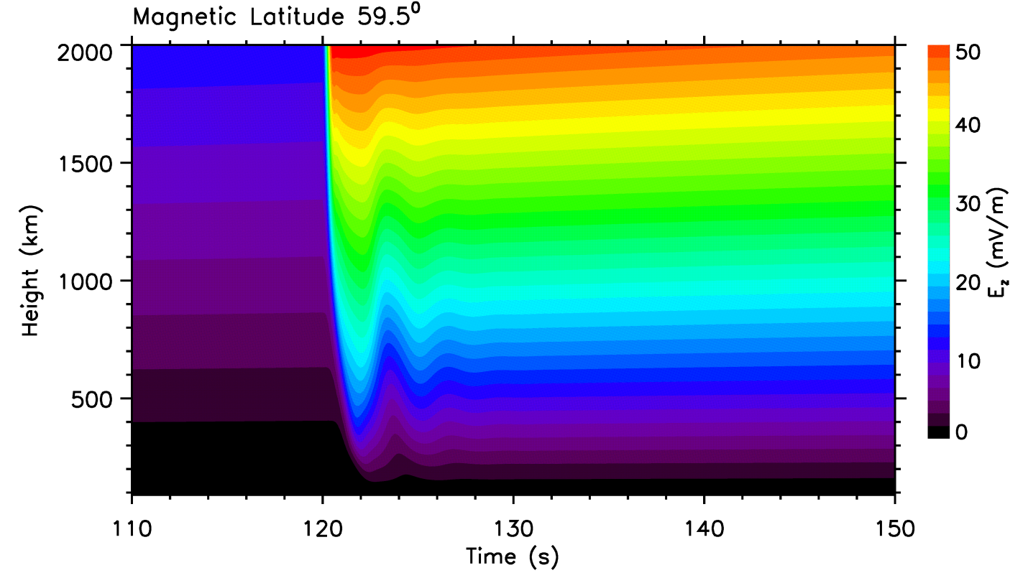
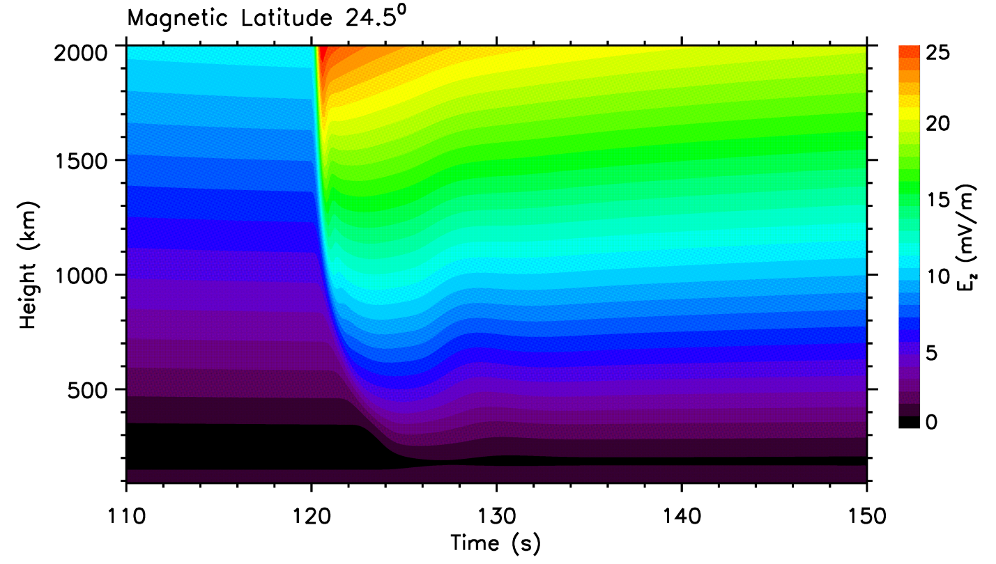
Eastward (normal to the noon-midnight meridian plane) electric field as a function of time and height. Upper panel for magnetic latitude of 59.5˚ and bottom panel for 24.5˚. The increase of the electric field is delayed toward the lower altitude. The oscillation frequency of the electric field is higher at higher latitudes, showing that the ionosphere is a low pass filter for the MHD wave propagation.

Slide 27
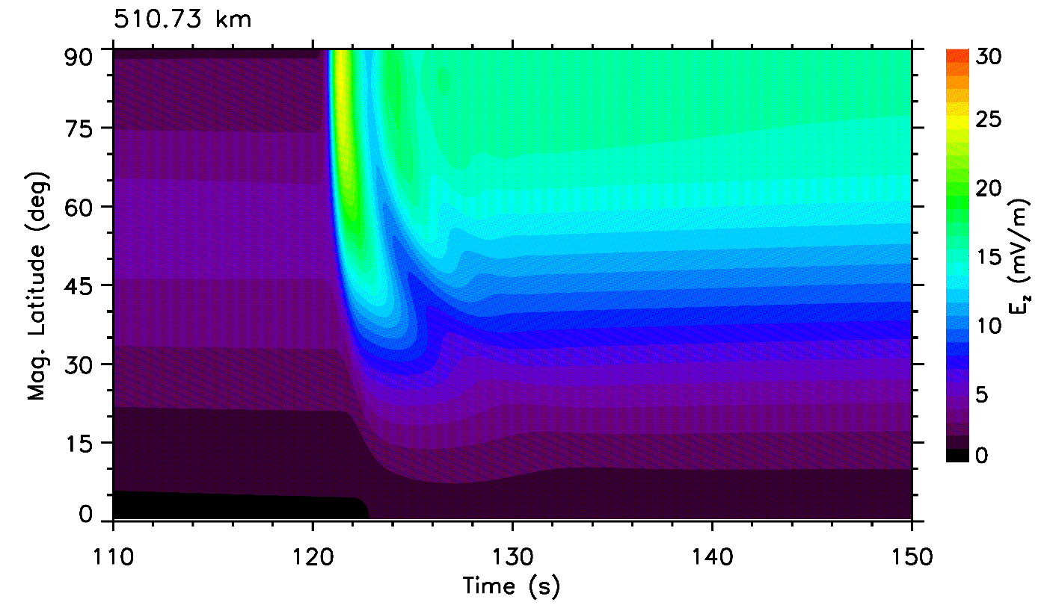
Eastward electric field as a function of time and magnetic latitude. Upper panel for height of 510.73 km and bottom panel for 194 km. The arrival of the electric field perturbations is delayed toward the low latitudes and the high frequency oscillation of the perturbations almost completely disappears.

Slide 28
Summary
In MHD limit, low frequency, E and J do not evolve by themselves. They are secondary derived quantities
B and V becomes primary quantities determining the evolution of a system
In steady state, E, J, B, and V are mutually self-consistently determined: no causual relation.
A magnetosphere-ionosphere-thermosphere coupling model
Including continuity, momentum equation, and energy equation for each species of multi fluids
Including Maxwell’s equations
Including photochemistry
No imposed E-field is necessary, and no imposed field-aligned current is necessary
There are 4 major differences between the dynamic (and inductive) coupling and the steady-state coupling
Transient time for M-I equilibrium: not Alfvén travel time, but 10-20 × t_{A} ~ 20-30 min.
Reflection effect: enhanced Poynting flux and heating rate during the dynamic transient period can be a factor of 1.5 greater than that given in of steady-state coupling
Plasma inertia effect: velocity, magnetic field, and electric field perturbations depend on density profile during the transition period
Field-aligned upflow allowed
The field-aligned currents and Pedersen currents are carried down by the Alfven wave and enhanced by reflection.
Along the noon-midnight plane, field-aligned perturbations become fast mode in the ionosphere and can propagate to the equator
The global dawn-dusk electric field is formed by the fast mode propagation, as required by the continuity condition.

