Slide 1
Inductive-Dynamic Modeling of Magnetosphere-Ionosphere Coupling
P. Song and J. Tu
University of Massachusetts Lowell
Acknowledgments: V. M. Vasyliūnas
Physical problem: a self-consistent coupling from a fully ionized collisionless magnetized plasma (ideal MHD) to a weakly ionized collisional medium (collisional partially ionized MHD)
Implicit scheme solutions of coupled multi-species plasma and neutral equations with Maxwell’s equations
1-D simulation
2-D simulations
Summary

Slide 2
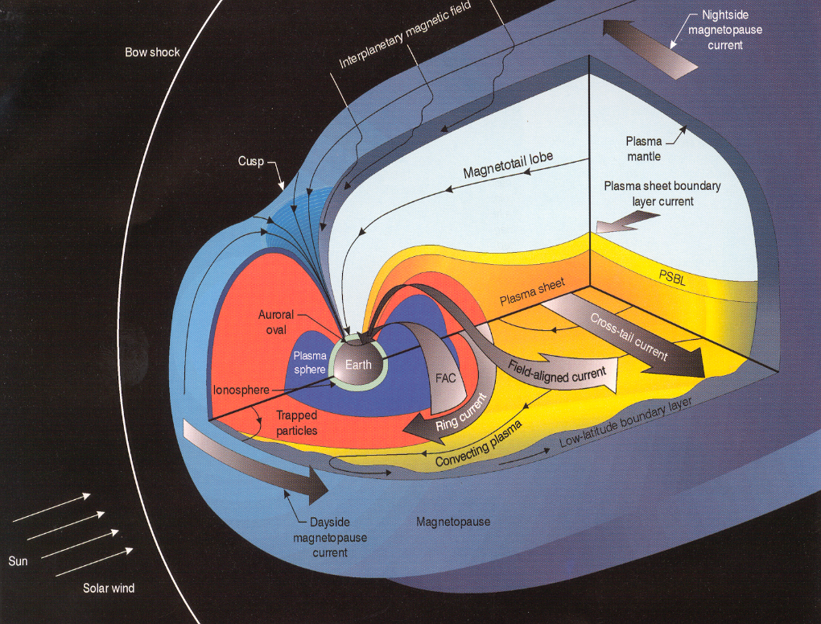
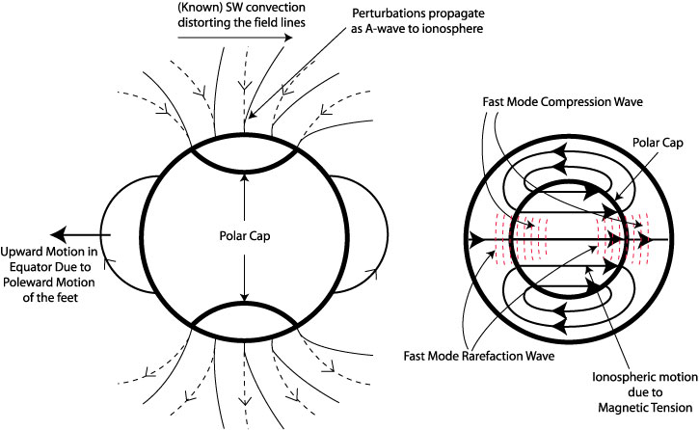
Magnetosphere-ionosphere coupling
Magnetosphere is driven by solar wind momentum and energy
MHD modes carry the magnetospheric momentum to the ionosphere
Ionospheric plasma and magnetic field directly respond to the magnetospheric driver
ionospheric neutrals do not respond directly to the MHD perturbation
Collisions between plasma and neutrals occur to dissipate the momentum
Wave reflection and damping
Solar wind: fully ionized, low temperature, high speed, low density, weak magnetic field
Magnetosphere: fully ionized, high temperature, low speed, low density, strong magnetic field
Ionosphere: partially ionized (1/1000), cold, slow motion, extremely strong magnetic field

Slide 3
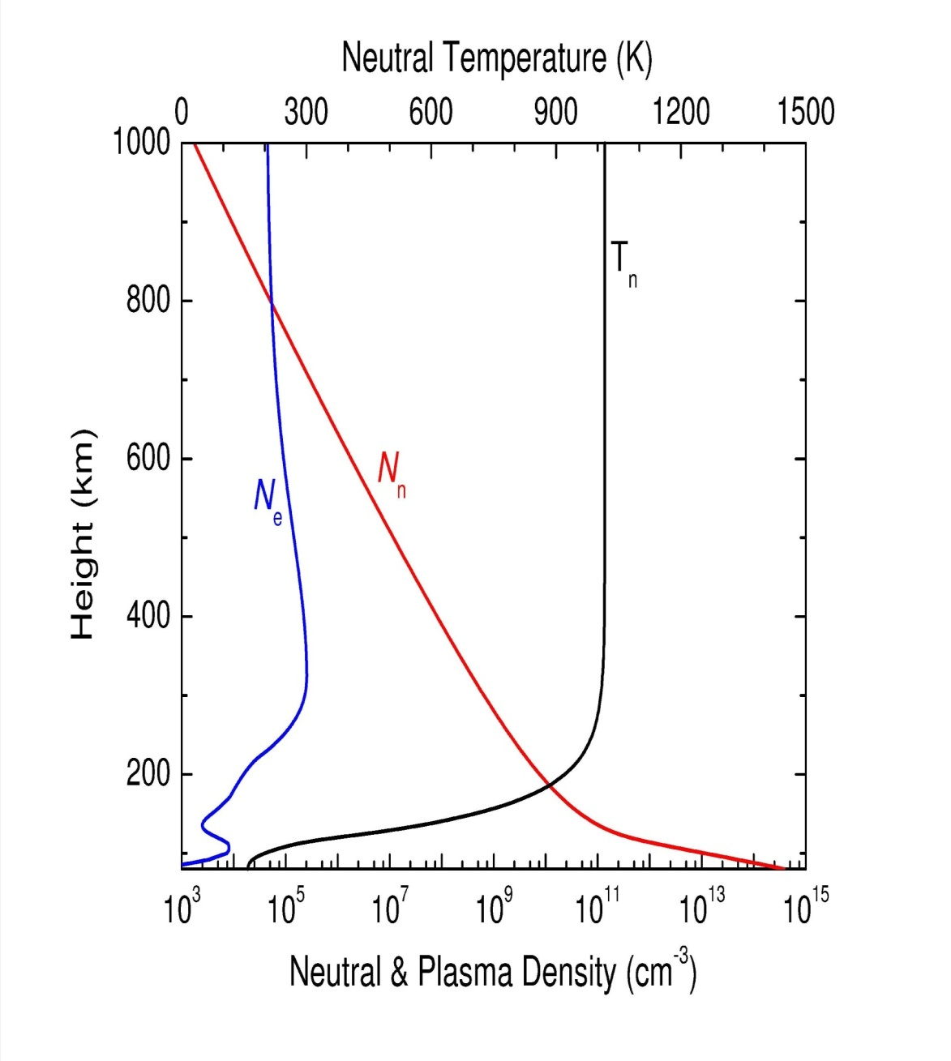
North Pole, Winter Solstice

Slide 4
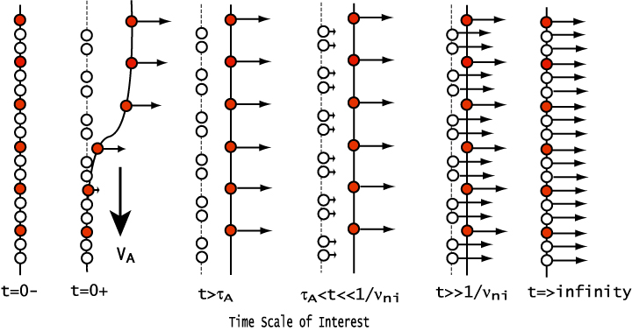
Ion-neutral Interaction
Magnetic field is frozen-in with electrons
Plasma (red dots) is driven with the magnetic field (solid line) perturbation from above
Neutrals do not directly feel the perturbation while plasma moves
Ion-neutral collisions accelerate neutrals (open circles), strong friction/heating
Longer than the neutral-ion collision time, the plasma and neutrals move nearly together with a small slippage. Weak friction/heating
On very long time scales, the plasma and neutrals move together: no collision/no heating

Slide 5
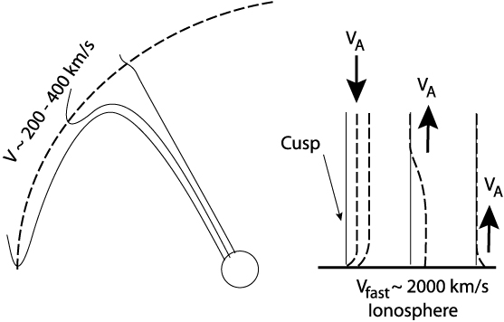
Ionosphere Reaction to Magnetospheric Motion
Slow down wave propagation (neutral inertia loading)
Partial reflection
Drive ionosphere convection
Large distance at the magnetopause corresponds to small distance in the ionosphere
In the ionosphere, horizontal perturbations propagate in fast mode speed
Ionospheric convection
modifies magnetospheric
convection
(true 2-way coupling)

Slide 6
Global Consequence of A Poleward Motion
Antisunward motion of open field line in the open-closed boundary creates
a high pressure region in the open field region (compressional wave), and
a low pressure region in the closed field region (rarefaction wave)
Continuity requirement produces convection cells through fast mode waves in the ionosphere and motion in closed field regions.
Poleward motion of the feet of the flux tube propagates to equator and produces upward motion in the equator.
Ionospheric convection will drive/modify magnetospheric convection

Slide 7
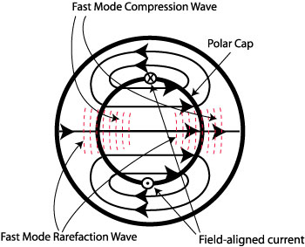
Expected Heating Distribution
sun
For uniform conductivity, velocity pattern coincides with the magnetic perturbation.
FAC forms at the center of the convection cells
Poynting flux is proportional to V², weakest at the center of convection cells
Neglecting the heating from precipitation particles,
Conventional model (EJ paradigm) predicts heating, J²/Σp, is highest at the FAC
New model (BV paradigm) predicts heating, ν_{in}ρ_{i}V², is highest at compression region of dayside and nightside cusps and strong along the noon-midnight meridian

Slide 8
Basic Equations
Continuity equations
Momentum equations
Temperature equations
Faraday’s Law and Ampere's Law (E-field is derived from steady state electron momentum equation)
s = e, i or n, and e_{s} = -e, e or 0
Field-aligned flow allowed

Slide 9
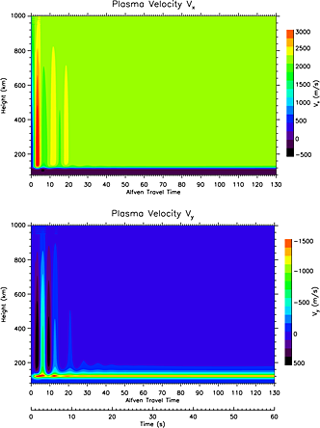
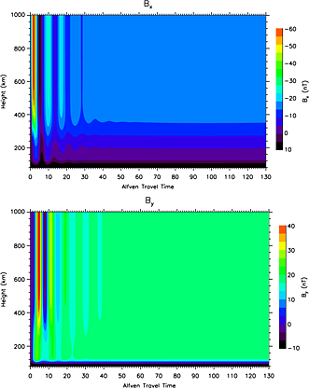
1-D Simulation Along Northern Pole
The noon-midnight and dawn-dusk components of the perturbation magnetic field, B_{x} and B_{y.}. Tu et al., 2014
The noon-midnight and dawn-dusk components of the plasma velocity V_{x} and V_{y}. Tu et al., 2014

Slide 10
Heating rate q as function of Alfvén travel time and height. The heating rate at each height becomes a constant after about 30 Alfvén travel times. The Alfvén time is the time normalized by t_{A}, which is defined as
If the driver is at the magnetopause, the Alfvén time is about 1 min.
Height variations of frictional heating rate and true Joule heating rate at a selected time. The Joule heating rate is negligibly small. The heating is essentially frictional in nature.
Tu et al., 2011

Slide 11
Heating rate divided by total mass density (neutral mass density plus plasma mass density) as function of Alfvén travel time and height. The heating rate per unit mass is peaked in the F layer of the ionosphere, around about 300 km in this case.
Time variation of height integrated heating rate. After about 30 Alfvén travel times, the heating rate reaches a constant. This steady-state heating rate is equivalent to the steady-state heating rate calculated using conventional Joule heating rate J∙(E+u_{n}xB) defined in the frame moving with the neutral wind. In the transition period, the heating rate can be two times larger than the steady-state heating rate.
Tu et al., 2011

Slide 12
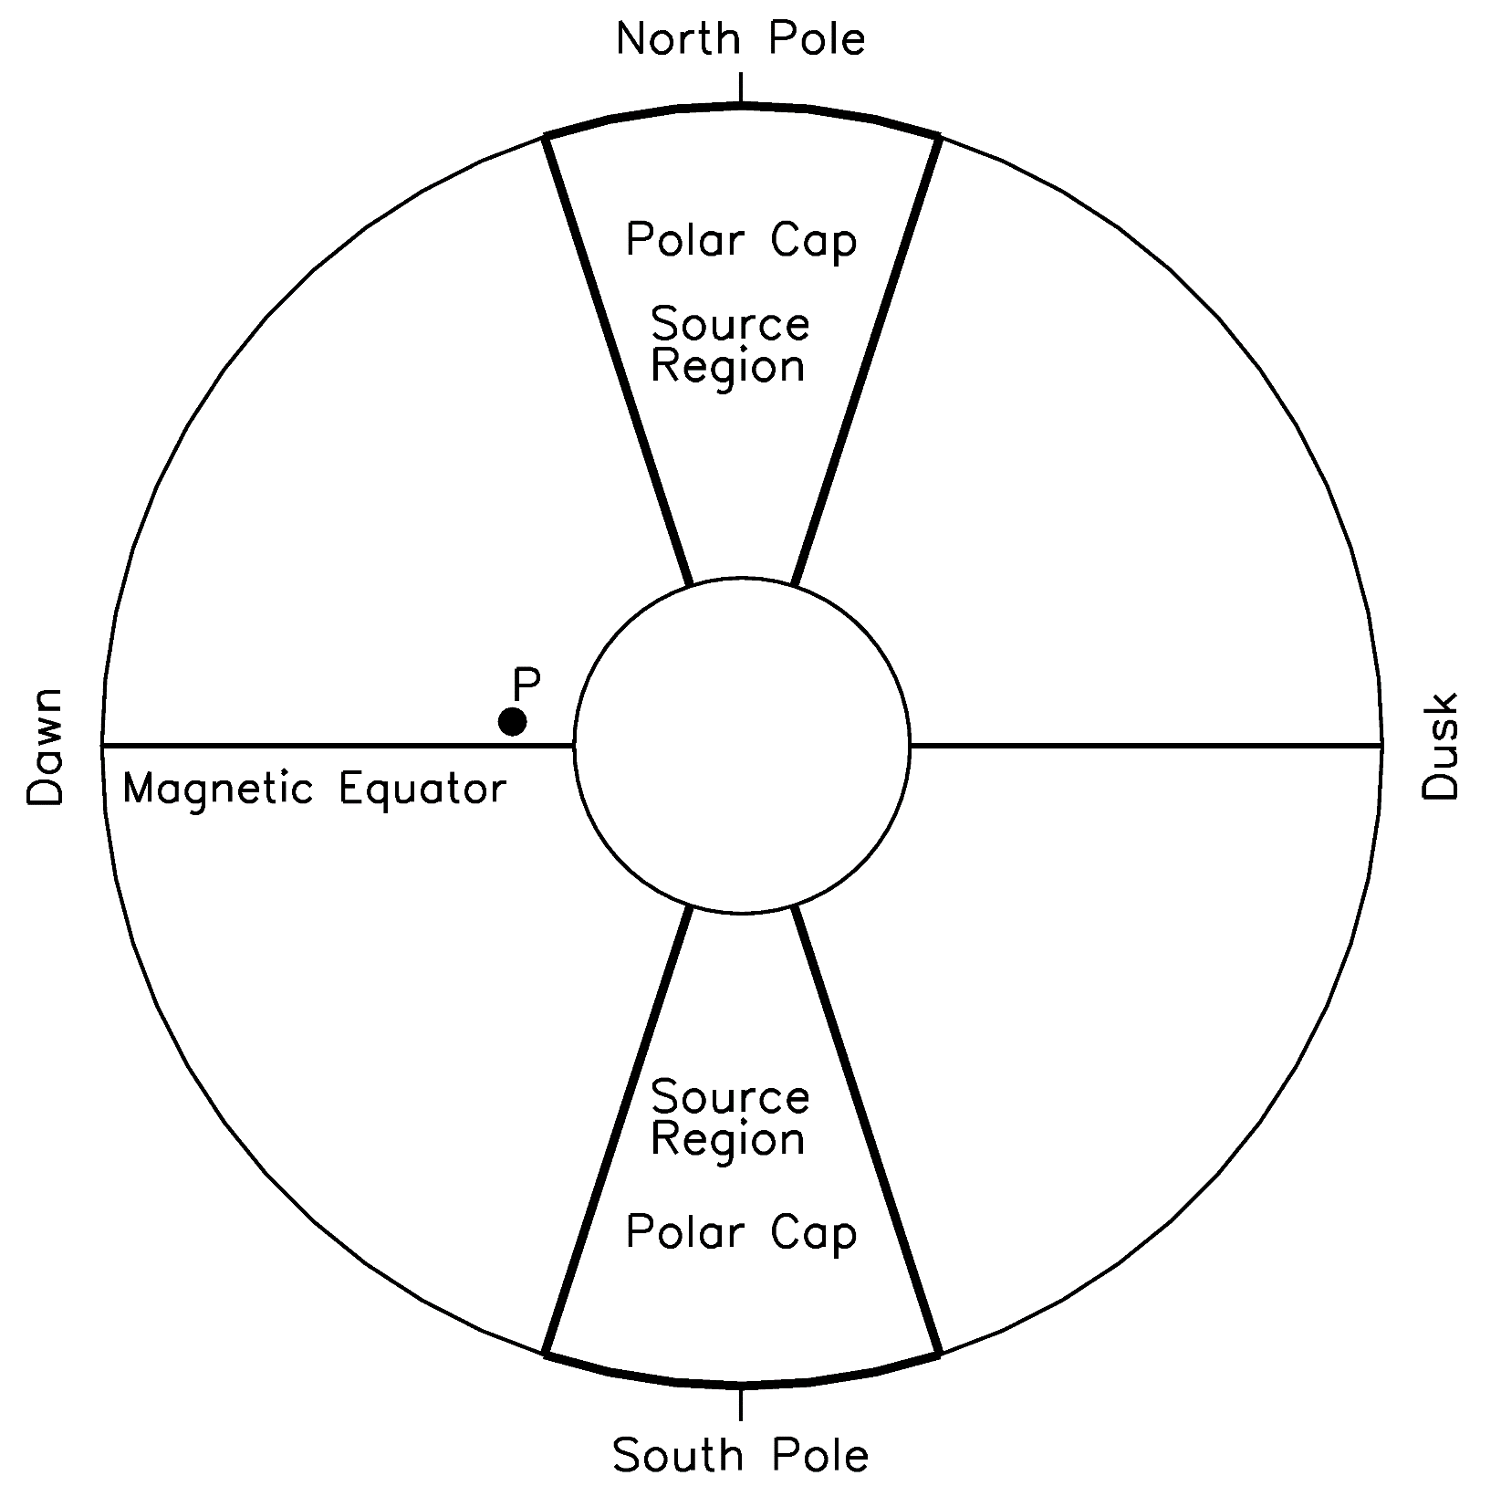
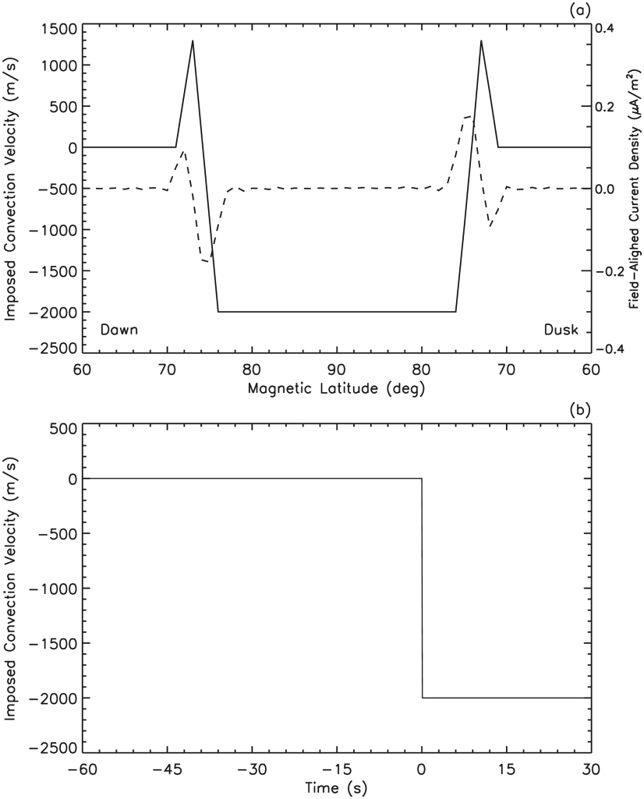
2-D Simulation of the Dawn-Dusk Meridian Plane

Slide 13
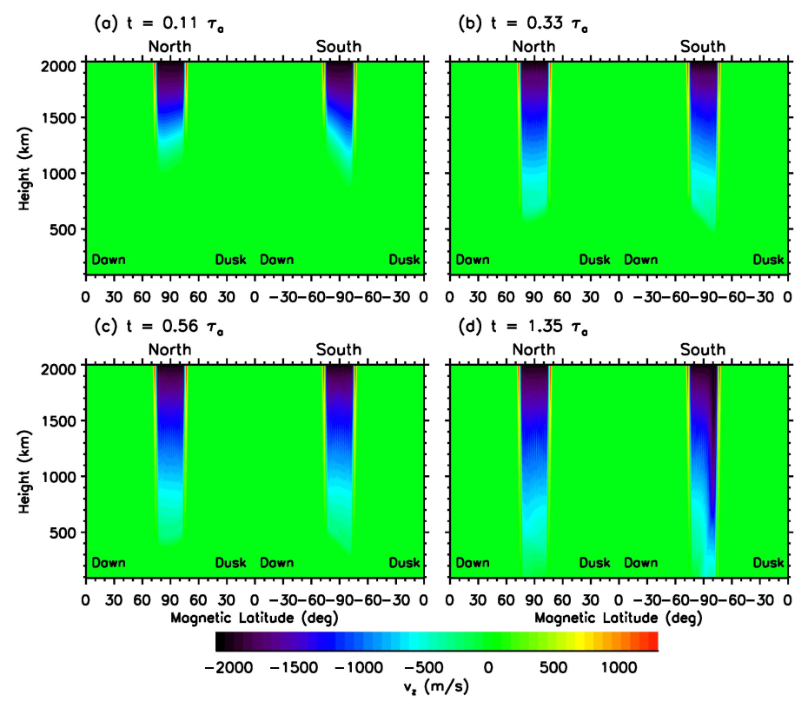
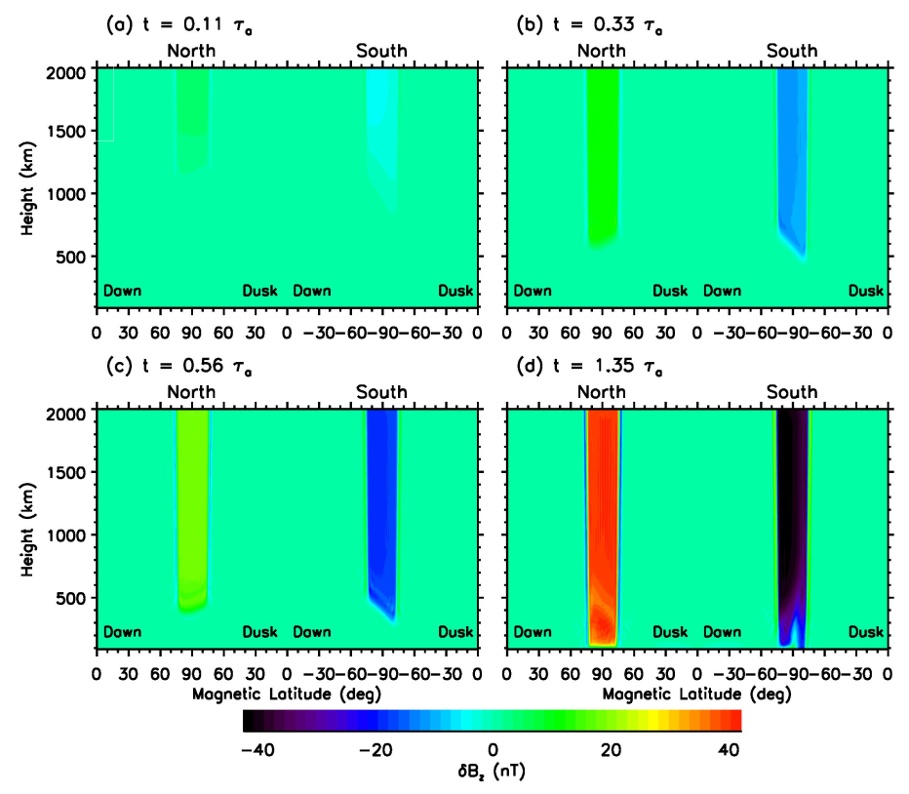
Alfven Wave Propagation
Imposed antisunward velocity drives downward propagating velocity and magnetic field perturbations. Both propagate with the Alfven speed.
Velocity perturbation in the polar cap in both hemispheres is antisunward and reverse direction at lower latitudes
Magnetic field perturbation in the two hemisphere has opposite directions

Slide 14
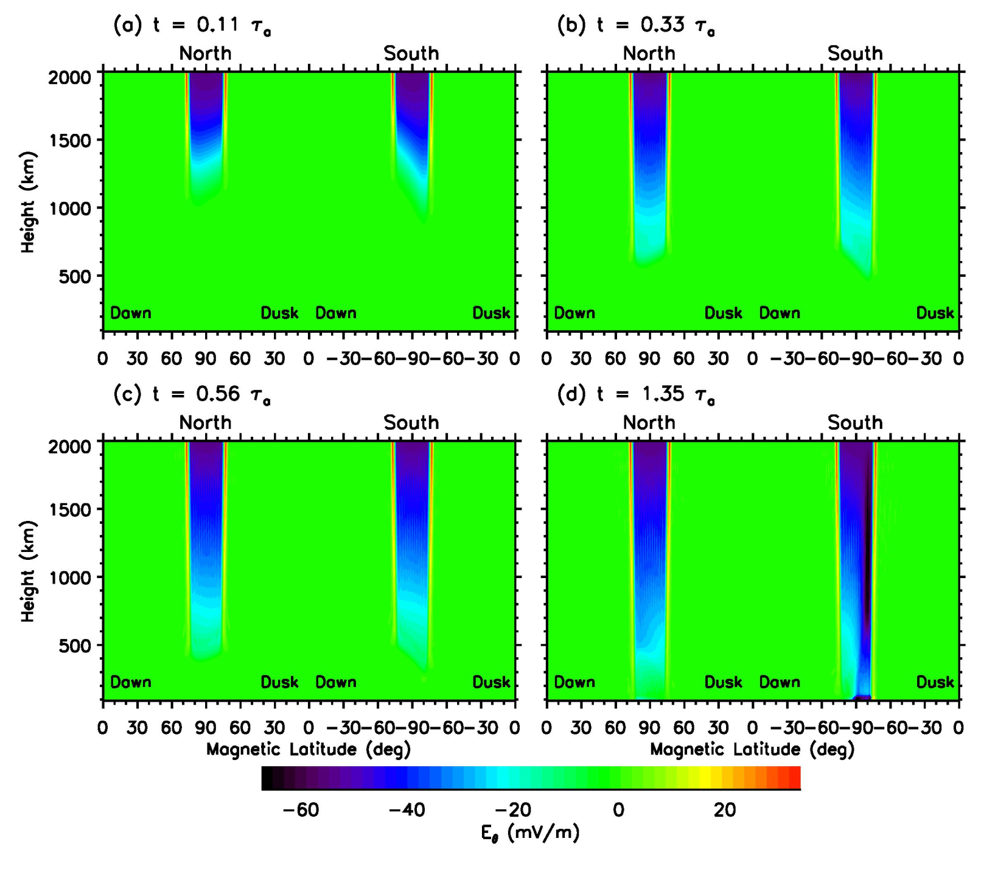
Dawn-Dusk Electric Field
Dawn-dusk electric field as a function of magnetic latitude and altitude for the Northern Hemisphere at selected times. Negative values are duskward. Tu and Song, 2016.

Slide 15
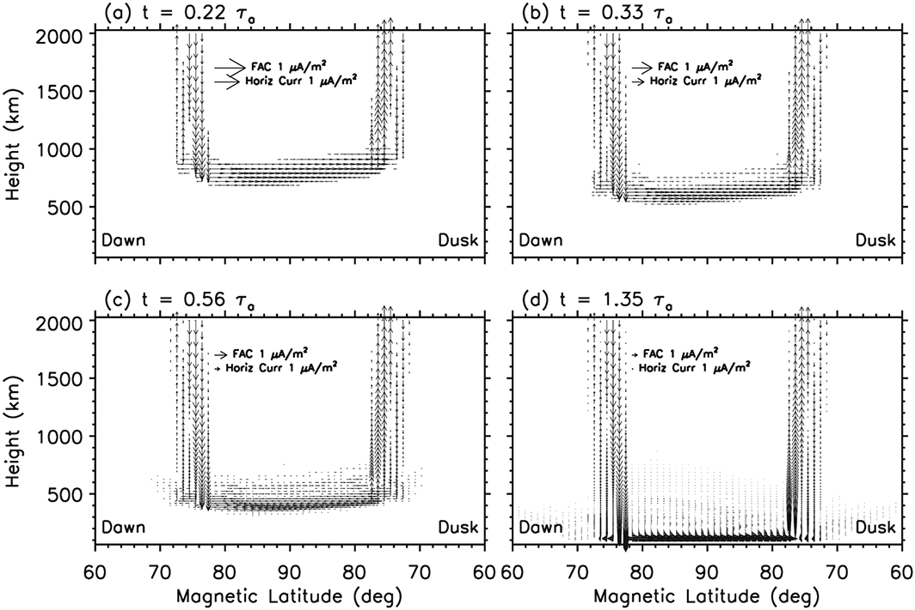
Field-Aligned and Closure Currents
Region 1 and 2 FACs evolve with the Alfven waves
At the front of FACs there are horizontal closure currents
Pedersen currents form when the FACs reach ~100 - 120 km
Has important implication to substorm current wedge
Tu and Song, 2016

Slide 16
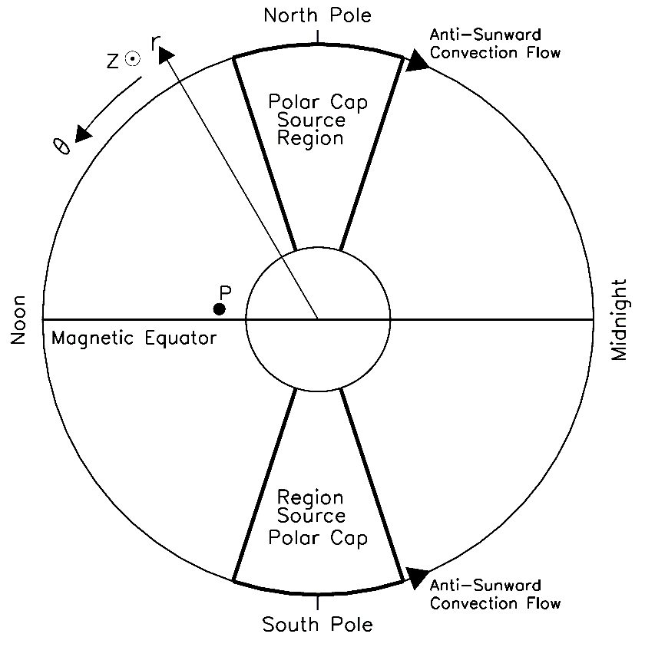
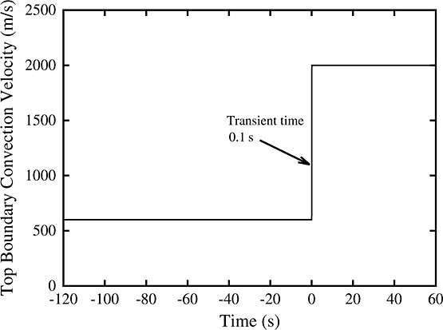
2-D Simulation of the Noon-Midnight Meridian Plane
2000 m/s
200 m/s
T=120 s
Driver in the polar cap

Slide 17
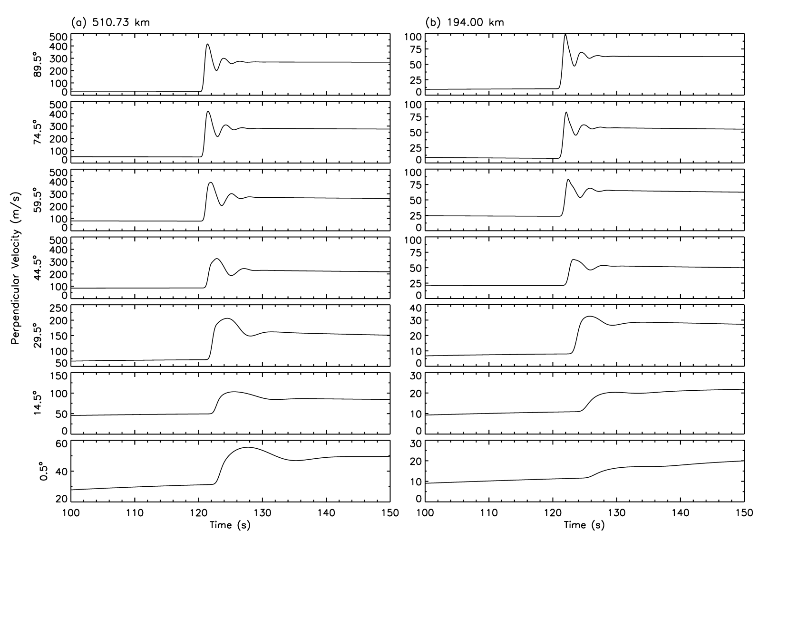
High to Low Latitude Ionosphere Coupling
Time variation of the average ion velocity component within the noon-midnight magnetic meridian and perpendicular to the magnetic field for several magnetic altitudes at 510.73 km (panel a) and 194 km (panel b). Positive values represent poleward (at high and middle latitudes) or upward (at low and equatorial latitudes) velocities

Slide 18
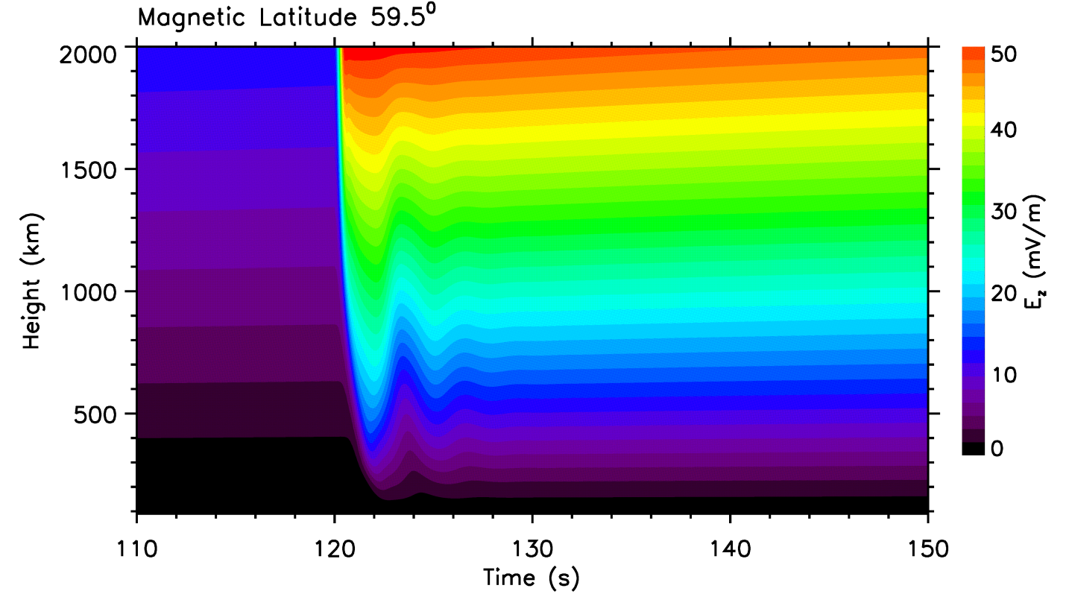
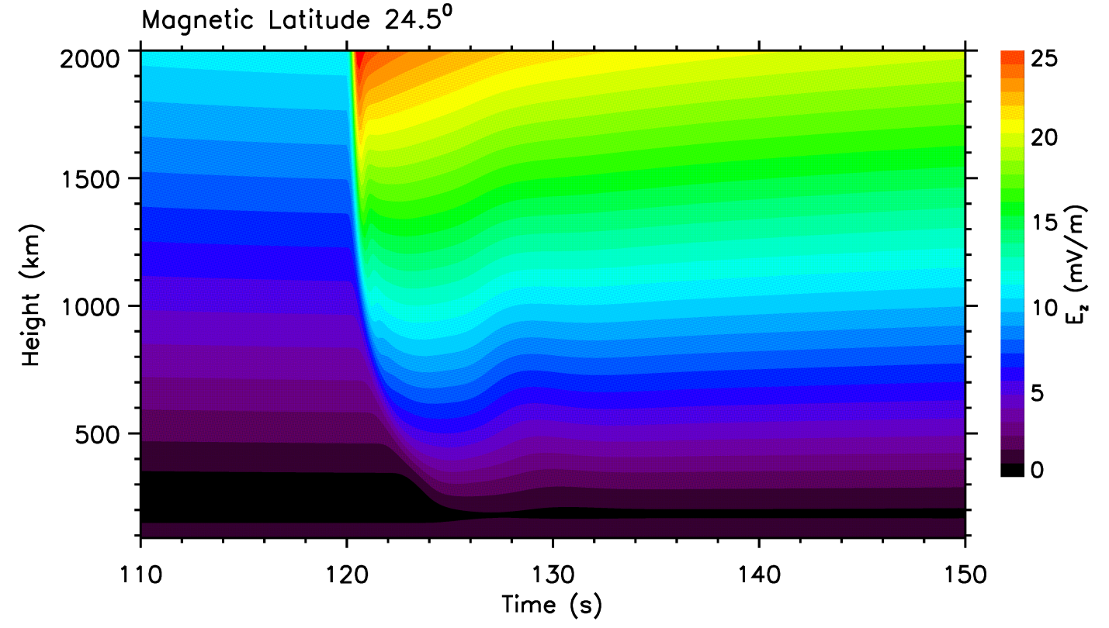
Eastward (normal to the noon-midnight meridian plane) electric field as a function of time and height. Upper panel for magnetic latitude of 59.5˚ and bottom panel for 24.5˚. The increase of the electric field is delayed toward the lower altitude. The oscillation frequency of the electric field is higher at higher latitudes, showing that the ionosphere is a low pass filter for the MHD wave propagation.

Slide 19
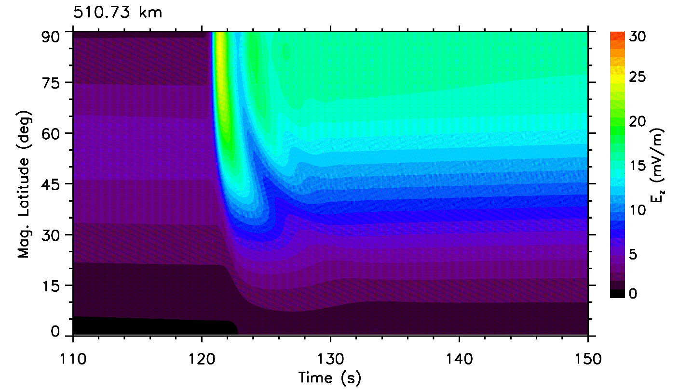
Eastward electric field as a function of time and magnetic latitude. Upper panel for height of 510.73 km and bottom panel for 194 km. The arrival of the electric field perturbations is delayed toward the low latitudes and the high frequency oscillation of the perturbations almost completely disappears.

Slide 20
Summary
An implicit scheme has been developed to solve
Multi-fluid mass, momentum, and energy equations for multiple species of ions and neutrals with Maxwell’s equations,
Ionization and recombination and photochemistry
Collisional momentum and energy transfer among species
Field-aligned flow allowed
The code has been tested
1-D and 2-D magnetosphere-ionosphere coupling
1-D single species solar chromosphere
Magnetosphere-ionosphere-thermosphere coupling
1-D
Transient time for M-I equilibrium: not Alfvén travel time, but 10-20 × t_{A} ~ 20-30 min.
Reflection effect: enhanced Poynting flux and heating rate during the dynamic transient period can be a factor of 1.5 greater than that given in of steady-state coupling
Plasma inertia effect: velocity, magnetic field, and electric field perturbations depend on density profile during the transition period
2-D dawn-dusk plane
No imposed E-field is necessary, and no imposed field-aligned current is necessary
The field-aligned currents, associated with the flow reversal, and Pedersen currents are carried down by the Alfven wave and enhanced by reflection
2-D noon-midnight plane
Field-aligned perturbations become fast mode in the ionosphere and can propagate to the equator
The global dawn-dusk electric field is formed by the fast mode propagation, as required by the continuity condition.

