Slide 1
General Information
No homework (I assume you are self-motivated)
Two term-papers (to demonstrate you have learned something)
Reading beyond lecture notes and textbook is strongly encouraged although not required
A discussion session after every 4 lectures
You need: participation in the class and discussion sessions
This is not a conventional class (we are challenging the author of the textbook)
What you learn: scientific reasoning/thinking (is there another place you learned about it)
You need to pay attention to everything around you in your everyday life (not only in the classroom)
Lecture notes make no effort to attract your attention but lines of logic/reasoning and key points to remember (no distraction)
A-H core requirement: a form to be filled

Slide 2
For students who want Arts & Humanities credit for the Core Curriculum: mid-semester contact one of the Honors advisors,
Erin Maitland or Megan Hadley, and request they submit an exception form.
Questions about the process, feel free to reach out to
Dr. Kevin Petersen
Kevin_Petersen@uml.edu
O’Leary 500F

Slide 3
Questions to Start With
What is truth? (how to know earth is not flat but a sphere?)
What is reality? (how to know not virtual reality)
What is knowledge? (is knowledge all true?)
What is science?
What is scientific research?
Is there a scientific method? (hypothetico-deductive model)
How do you know science, as people often assume, will give you correct answers?
How to get it right?
How to know you are not wrong?
What is philosophy?
What is a Ph.D.?

Slide 4
Paradox of the Ravens
Observed many black ravens (empiricism)
Assume “all ravens are black” (inductive inference)
It is equal to => non-black body is non-raven
Find a white swan: true for non-black-non-raven => used it as evidence for the assumption
Every non-black and non-raven thing can be used as evidence for “all ravens are black” => assumption has a lot of supporting evidence => justified.
Search for all black things and find ravens among them => confirm the assumption,
Every step is rigorous deductive logic.
Assumption is proved.
But there are non-black ravens (Albinism)
Where is the flaw in the proof?

Slide 5
Geocentric Versus Heliocentric
Ptolemy (100-170 AD): geocentric--earth is at the center of the universe, other bodies circle around the earth
Copernicus: heliocentric--planets circle around the sun
If heliocentric theory is true, earth is moving at about 30 km/s around the sun
Is there any evidence for the high speed of the earth movement?
Galileo’s famous free-fall experiment in the Pisa tower did not show evidence for the earth’s movement
If you were a scientist at the time, which theory would you believe? (not mentioning that geocentric model predicts the location of planets more accurately at the time because Copernicus assumed the planetary orbits are circles.)
Now, how do you know what you read/heard about is correct?
In Science (physics): both correct, but we “take” heliocentric as better one (in philosophy, geocentric is wrong: see the difference between scientists and philosophers)

Slide 6
What is Philosophy?
Encyclopedia Britannica: “the rational, abstract, and methodical consideration of reality as a whole or of fundamental dimensions of human existence and experience”.
  General enough but too abstract
Wikipedia: Philosophy-- Love of wisdom. “study of general and fundamental problems concerning matters such as existence, knowledge, values, reason, mind, and language”.
  A laundry list but lost focus
By a philosopher: “philosophy is the art of asking questions that come naturally to children, using methods that come naturally to lawyers”.
  An interesting perspective, but unique?

Slide 7
Philosophy
In Greek, Sophist: wise man; Sophia: wisdom
  Philosophy (love of wisdom) (wannabe?)
The first philosophers: Thales (624 -546 BC) and Pythagoras (570-495 BC)
The most influential philosophers: Socrates (470-399 BC), Plato, and Aristotle
  Philosophy (love of wisdom) (wannabe?)
  I am not a wise man, but I love wisdom
  does not intend to answer any practical questions
  but looks for the possibility of “getting it right”.
  What is right is not a concern, although “right” may sometimes mean bad news.
In other civilizations, such as Indian and Chinese, philosophies also started their evolution during similar time period.
Notes:
Sophists: taught rhetorical, public speech
Philosophy was a different “practice”. They did not claim to be wise, but pursuing wisdom.
If you look at what philosophy has been often arguing about, too much is about “I am right or I am a wise man’, other than how to get it right.
Thales is the one everyone attribute to as the first philosopher and Pythagoras was the one who first claim to be a philosopher, he was interested in natural phenomena, this could be a distinguisher from sophists
Pythagoras who, 580-500BC, discovered the musical scale, musical harmonies, and Pythagorean theorem of right-angle triangle,
These people did not claim to be wise, but “love” to be wise. This is not about knowledge but about how to get knowledge.
Socrates (470-399 BC) was one of the most influential philosopher “An unexamined life is not worth living”
The School of Athens (1509–1511) by Raphael, depicting famous classical Greek philosophers in an idealized setting inspired by ancient Greek architecture
Plato and Aristotle systemized and further developed the many key ideas of Socrates.
One can say these three men popularized concept of philosophy.

Slide 8
Plato-Socrates
  Republic
  Justice
  Form of government: philosopher king
  Allegory of the Cave (metaphor)
  virtue
Aristotle, more explicit to natural science/natural philosophy
  Ethics and politics: political animal
  Laws and republic
  Happiness
  Moral virtues
  Friendship: good, pleasant, useful
  Physics, astronomy, geology, biology, psychology
  Metaphysics

Slide 9
Method of Inquiry
Central difference between philosophy and sophism is the philosophical method: called Socratic, or, dialectical method of inquiry (gadfly, learn virtues, cloud, an unexamined life is not worth living)
  Not about the subjects of study
  Not about a particular view on a subject or who is right
  It is criticism, self-criticism
  Philosophy developed in Chinese and Indian also used the same method
Notes:
Socrates was the most influential person in developing the method of critical inquiry.
He claimed that he was a gadfly, possessed no wisdom but to pursue it. he challenged effectively many sophists in his time.
Knowledge is deterministic, against it often leads to death.
Here we are interested in how to get it right but not specific on exactly what knowledge is about.
Conduct: when you have choices. Personal taste, judgement/bias can be involved, your action may affect others.
Governance becomes an issue when a lot of people living closely and sharing some resources

Slide 10
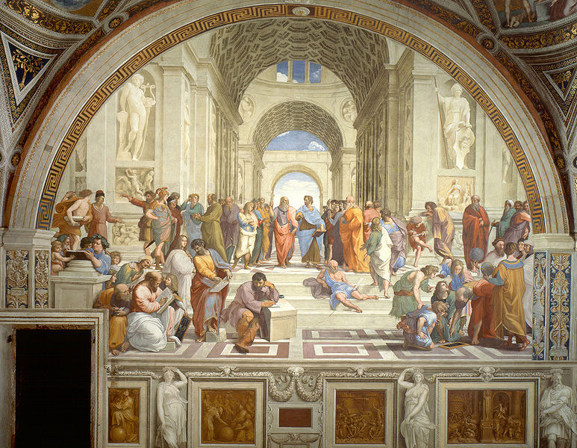
Raphael (1510-1511): School of Athens

Slide 11
Why Scientists Need to Learn Philosophy?
Albert Einstein: “So many people today—and even professional scientists—seem to me like somebody who has seen thousands of trees but has never seen a forest... This independence [from prejudices] created by philosophical insight is—in my opinion—the mark of distinction between a mere artisan or specialist and a real seeker after truth."
Philosophy separates a scientist from an “artisan” or “specialist”.
Research involves very complicated and intertwined problems and technical issues,
Sometimes, most importantly, no one knows prior what the correct answer should be or even if there is an answer at all
How can a scientist know what to do or whether a result obtained is correct or not?
It is this general view on science and scientific research mentioned by Einstein that is most useful in philosophy of science which is less covered in the textbooks and by philosophers of philosophy of science.

Slide 12
Is Philosophy of Science Useful?
Richard Feynman, a famous physicist, once said “philosophy of science is as useful to scientists as ornithology is to birds.”
Why did a scientist think philosophy of science is not useful for scientists?
Many of the theories in Philosophy of Science were developed based on misconception and misunderstanding of scientists and scientific research although many of the concepts are useful.
In that sense, part or significant part of “philosophy of science” may be irrelevant or not useful to scientists.
Many theories are reconstructed after a process, but scientists need theories to help them decide what to do
We are trying to develop a new system of philosophy of science in this course that is relevant to scientists and scientific research while providing guidelines to the concerns raised by Einstein.

Slide 13
Topics of Philosophy
Philosophy concerns roughly 3 problems
  Problem of knowledge: How knowledge can be acquired/gained, more deterministic
  Problem of conduct: What is right/wrong, good/bad, beautiful/ugly
  Problem of governance: what is the best form of a government
The 3 problems may be understood as in-step with development of civilization
Epistemology: concerning how to gain knowledge (gain vs acquire)
Metaphysics: questions about what drives the physical world
Ontology (being): materialism and idealism
Scientists are more concerned about the problem of knowledge
Notes:
Socrates was the most influential person in developing the method of critical inquiry.
He claimed that he was a gadfly, possessed no wisdom but to pursue it. he challenged effectively many sophists in his time.
Knowledge is deterministic, against it often leads to death.
Here we are interested in how to get it right but not specific on exactly what knowledge is about.
Conduct: when you have choices. Personal taste, judgement/bias can be involved, your action may affect others.
Governance becomes an issue when a lot of people living closely and sharing some resources

Slide 14
Question
Explain a theory of philosophy you like

Slide 15
Philosophy of Science
Philosophy of science: investigation of philosophical questions that arise from reflecting on science
  Questions cannot be specific down to a subfield of science
  Answers cannot be only specifically for only a subfield
  A new subfield of philosophy started by positivism (1920-60) that separates science from metaphysics
The central questions concern how to gain knowledge, while not be fooled (by others as well as by ourselves)?
  concerned with the foundations, methods, and implications of science.
  what qualifies as science, the reliability of scientific theories, relationship between science and truth, and the ultimate purpose of science.
Two systematic ways to gain knowledge
  Observations (including experiments: planned and controlled)
  Conceptualization
Reasoning is needed to link the two and within each
Notes:
For scientific research we are often only able to prove “most” real, not knowledge yet, but close. Knowledge eventually be a collection of many such proofs.
A scientist should equally emphasize both observation and conceptualization. Physics is based on observations/experiments.
If theory is inconsistent with observations, the observation has an upper hand. All physicists should be absolutely firm on this.
Conceptualization is the one that lead to understanding and can guide new observational tests, e.g. without conceptualization, there is no understanding.
Reasoning concerns how we derive our knowledge, i.e. our methods of scientific justification.
Parsimony: spareness. Razor: to shave away unnecessary assumptions or cutting apart two similar conclusions.
One way to argue for the rule is the probability. Each assumption has a probability to be true and the total probability is multiplication of these probabilities.
The simplicity is an “argument” to me, sometimes referred to as a “rule”, not a law in scientific research, because a counter argument could be a single assumption of existence of a god that can explain everything.
An example, When studying the motion of planets, one can base on the universal law of gravitation to write the momentum equation for each planet.
The law and the momentum equations are independent of frame of reference, and can be in either a frame rest with sun or earth.
Therefore, it is possible to study the motion of the planets in a geocentric or heliocentric description.
We like heliocentric description better (note this is a “choice”) because it is simpler (although the number of assumptions are the same), but this choice does not say earth centric is wrong as it also describes the motion correctly. Of course, historically, Copernicus heliocentric theory was not justified based on the Occam’s razor.
Another example is the BV and EJ paradigms in M-I coupling. In theory EJ and BV are two equivalent descriptions of MHD systems. But Parker has shown that the EJ paradigm is not mathematically trackable while BV is.

Slide 16
Science
Science: Latin word “scientia”, for result of logical demonstration that revealed general and necessary truth
In the textbook it is defined as
  A general understanding of how humans gain knowledge (of the world), and
  An understanding of what makes the work descended from the science revolution different from other kinds of innovation
What is science: (one of the major arguments in POS)
  Testing hypotheses vs playing ballgames
  Determined by subjects? Physics, Psychology, economics, anthropology, archaeology, mathematics
  Determined by methods? Farming, architecture, technologies
  Is “interpretation-only” a science, descriptive vs normative
  Is math essential in defining science
  Is polling scientific? IQ tests?, astrology?
  What is necessary and what is sufficient?
Science war: does science deserve the dominating role it has acquired in western culture?
End of science, [John Horgan, 1996]
We will define “science” later in our course

Slide 17
Questions about Knowledge
What is knowledge?
Does knowledge needs to the true?
Is knowing something same as knowledge?
  “I know X, even though X is wrong,”
Where did you and do you find knowledge?
How do you know the knowledge you obtained or found (e.g. on internet) is correct or trustworthy?
Notes:
My classification of knowledge may be different from that of many philosophers, e.g. Some of them consider knowledge-how as knowledge-understanding and the third knowledge as knowledge of a person.
2nd point in Belief: here I am against a view popular in the US high school teaching that science starts with a hypothesis.
Very often you just curious about something and have no hypothesis.

Slide 18
Knowledge
Three types of knowledge:
  Knowledge-that (facts), often pieces are isolated, not connected
  Knowledge-how (skills)
  Knowledge-understanding: not merely recording facts, often relative to other facts, but properly arranging the facts and inferring beyond. this is concerned in science.
    Knowledge may be practical and theoretical.
    Some knowledge can be easily tested for its trueness, but some cannot.
Can knowledge-understanding be a mistake? How to know this is not the case?
We know that the knowledge from ancient time is mostly wrong
But do we know whether 2000 years later people would not say the same thing about what we now call knowledge?
Notes:
My classification of knowledge may be different from that of many philosophers, e.g. Some of them consider knowledge-how as knowledge-understanding and the third knowledge as knowledge of a person.
2nd point in Belief: here I am against a view popular in the US high school teaching that science starts with a hypothesis.
Very often you just curious about something and have no hypothesis.

Slide 19
Truth
Truth: (Wikipedia) is most often used to mean being in accord with fact or reality, or fidelity to an original or standard. Truth is also sometimes defined in modern contexts as an idea of "truth to self", or authenticity. Truth is usually held to be opposite to falsehood
  In philosophy, it is not simply about fact itself, and it has to reflect fact
  Is it person-dependent?
  Is it perspective-dependent?
  Is it objective (observation of measurable facts) or subjective (personal opinions, assumptions, interpretations and beliefs)?
  Is it relative or absolute?
It is external to individual psychological state, something that is known and cannot be false, or belief that corresponds to facts i.e., laws of nature
Common Truth is subjective but agreed widely, could be relative or perspective. Usually it is documented in textbooks or authentic books.
The absolute truth is unknown about its specifics and is the goal for scientific research
Notes:
My classification of knowledge may be different from that of many philosophers, e.g. Some of them consider knowledge-how as knowledge-understanding and the third knowledge as knowledge of a person.
2nd point in Belief: here I am against a view popular in the US high school teaching that science starts with a hypothesis.
Very often you just curious about something and have no hypothesis.

Slide 20
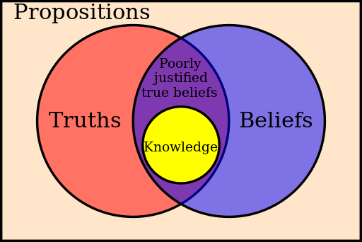
Belief and Justification
Belief: psychological, subjective
  A concept in philosophy, different from everyday life and not about religion
  Truth bearing belief (knowledge).
  A belief does not need to be a theory or hypothesis.
  Belief is personal and can change, important to scientists.
Justification/verification/proof: a process to show that a belief is consistent with truth
  Justification may or may not be relevant to the underlying truth
  Justification may include flaws, or can be falsified
  Justification also depends on personal experience, methods, environmental conditions.

Slide 21
Questions
Explain a theory of philosophy you like
Is the world material or spiritual?
Are we able to understand and describe the natural world?
What is science in your opinion?
What is knowledge?
Does knowledge need to the true?
Where did you and do you find knowledge?
How do you know the knowledge you obtained or found (e.g. on internet) is correct or trustworthy?
What is truth in your opinion? Can you find truth?
What is belief in your opinion?
How important is being rational? more important than passion? (Socrates: an unexamined life is not worth living.)
How important is truth? Is searching for truth more important than life? Very often the truth may not be found any way, why bother?

Slide 22
Knowledge Defined
Knowledge: collection of justified true beliefs that withstand falsification tests and are held by a large fraction of the community
  Knowledge has social attribute: shared and commonly accepted and passed on5 to next generations – individual’s idea/opinion is not knowledge until accepted by others
  Knowledge is based on and/or describes truth but may or may not be the truth itself
  Knowledge is subjective, its current objective form is authentic books (old sayings)
  Unfalsifiable: testable and able to withstand the falsification tests
  Knowledge is beliefs held by a large portion of a community and not only by a few experts (i.e. it is tested by these people to be true), the one held by few experts may be knowledge in science stage which can be modified substantially when becoming real knowledge
  Knowledge best reflects truth at a time (this is what humans can be closest to truth)
  Knowledge can later be falsified
  New knowledge can be added continuously through history
  Knowledge is accumulative: when new knowledge is in conflict with existing knowledge, the new knowledge has to be backward compatible and/or the existing knowledge has to be falsified.
  Such defined knowledge has a time delay from the justification process
  Scientific news is in general not knowledge-understanding

Slide 23
Knowledge Defined
Knowledge: collection of unfalsifiably justified true beliefs held by a large fraction of the community
  Unfalsifiable: testable and able to withstand the falsification tests
  knowledge is based on and/or describes truth but may or may not be the truth itself
  Knowledge is subjective (beliefs), its objective form is authentic books
  Knowledge is beliefs held by a large fraction of a community and not only by a few experts (i.e. it is tested by these people to be true). The one held by few experts may be knowledge in science stage which can be modified substantially when becoming real knowledge
  Knowledge best reflects truth at a time
  Knowledge can later be falsified
  New knowledge can be added continuously through history
  Knowledge is accumulative: when new knowledge is in conflict with existing knowledge, the new knowledge has to be backward compatible and/or the existing knowledge has to be falsified.
  Such defined knowledge has a time delay from the justification process

Slide 24
Science Revolution (1550-1700)
Scholastic worldview: (before science revolution)
  Four natural elements (earth, air, fire, water), plus the 5th element in heavens
  Natural motion (growth of plants)
  Many events happen for some purposes
  Ptolemy ~150 AD: objects in heavens moving in circles.
Nicolaus Copernicus (1473-1543): heliocentric view, made understandable of “retrograde motion”
Galileo Galilei (1564-1642): Free-fall motion, Galilean relativity, telescope
Johannes Kepler (1571-1630): Kepler’s law of planets motion
Rene Descartes (1596-1650): question immaterialness of soul and God, Cartesian coordinates, analytical geometry, “I think therefore I am” (Cartesian skepticism)
Andreas Vesalius and William Harvey (1628): blood circulation and role of heart
Robert Boyle (1627-91): British Royal Society, setting science standard
Isaac Newton (1642-1727): Newton’s laws, understanding free-fall, tidal waves, and planetary motions under the same frame of science, quantitative science with mathematics
Notes:
Kepler's laws of planetary motion are three scientific laws describing the motion of planets around the Sun.
1. The orbit of a planet is an ellipse with the Sun at one of the two foci.
2. A line segment joining a planet and the Sun sweeps out equal areas during equal intervals of time.^{[1]}
3. The square of the orbital period of a planet is directly proportional to the cube of the semi-major axis of its orbit.
"I think, therefore I am” Descartes laid the foundation for 17th-century continental rationalism,
Boyle: relationship between pressure and volume, a founding father of British Royal society of philosophy. In letters in 1646 and 1647, Boyle refers to "our invisible college" or "our philosophical college". The society's common theme was to acquire knowledge through experimental investigation.

Slide 25
Searching for Theories of Science
An example of the process a scientist experiences
  Often a scientist is driven by Curiosity based on or related (maybe indirect) to some (natural and/or intellectual) observations: no existing satisfactory explanation, no belief to justify yet (falling apple, or application of ones’ knowledge)
  Some of the curiosities grow to become Belief, and then the scientist want to test or Justify (or prove, in a scientific term) that the belief is True.
  The scientist tests or justifies a belief with evidence/reasoning/math
  Other scientists may have different ideas/beliefs and they will falsify your new idea/belief with their counter evidence and reasoning
  A theory is successful if it withstands the falsification tests
  It takes a much longer time for a successful theory to eventually become knowledge of a community
  Often a piece of knowledge is formed with a collection of successfully justified true beliefs/theories through abstraction/condensation/reduction
What is the key issue to a theory of science?
    Scientific thinking? Scientific method? Scientific logic? Scientific reasoning?
Sources of knowledge:
  Experience
  Conceptualization, mathematics and (existing) science/knowledge

Slide 26
How Can We Gain Knowledge?
Empiricism vs. Rationalism
Empiricism: the only source of real knowledge about the world is experience
  John Locke, George Berkeley, Dave Hume, John Stuart Mill
  Sensationalism: everything we learn is from sensation and our thought is only to track and respond to patterns in these sensations.
  People may draw different conclusions from the same experience
  Our sensations can be extended by instruments
  Pro-science not religion
Rationalism: pure reasoning can be a route to knowledge that does not depend on experience
  Descartes (I think; therefore I am), Leibniz,
  Something can be known priori (born with it),
  math
Transcendental idealism: interaction between experience and preexisting mental structures that we make sense of experience
  Immanuel Kant (but more empiricism): theory without observation is empty, observation without theory is blinded
  Context of discovery: no method can be followed
  Context of justification: methods can be useful
  Space (3-D), time, causation (based on previous experience)
  Mathematics gives us real knowledge of the world but does not require experience for its justification

Slide 27
Extreme Empiricism: Phenomenalism
“The world consists only of our sensation”
Definition of “world”=?
The proposer insane?
Easiest way to be heard?

Slide 28
Logical Positivism
Motivation: relativity and quantum mechanics questioned the fundamental ideas people had formed about space-time and deterministic nature of science laws
  Newton once said “I frame no hypothesis”: all scientists should follow where the nature leads us to, but his theory is so quantitative and precise in many cases that rational deduction became possible. Relativity casts doubt on it
  Einstein once said: God does not play dice. But quantum mechanics is based on probability
We may need to question the “rational” part of our epistemology and go back to empiricism to reexamine how we gain/acquire our knowledge
“Vienna Circle”: philo-science logicians, linguists;
  Mostly empiricism and against “absolute Idealism” (Hegel: all reality is spirit)
  How to generalize from a single or a limited number of obs. to a lot of (infinite) things
  How to generalize from obs. to something one cannot obs. and from past experience to future
  They assumed that a complicated science justification can be broken down to small logical steps
  Theory of language could make the proper definition of words so that every step can be fully justified.
  Analytic-synthetic distinction
  Analytic sentence: ”All bachelors are unmarried”, carry truth
  Synthetic sentence “All bachelors are bald”, not true.
Logical positivism: analytic-synthetic distinction and verifiability theory of meaning to understand and regulate science (verifiability: showing something true)
Even if this idea may reduce the chances for flaws, it is not clear whether it can bring in new ideas.

Slide 29
Deductive Logic vs. Inductive Logic
Deductive: if the premises of the argument are true, the conclusion is true, from general to specific
  Truth-preserving logic,
  math,
  If all men are mortal and Socrates is a man, Socrates is mortal
Inductive: generalization from limited observations to infinity of observations, (objective of the black raven paradox)
  Interpolation: it is needed because observations are limited, e.g. 1, 2, 3, in theory, but to be useful, we may need to explain infinite number of cases, say between 1 and 2, that have occurred or not occurred yet
  Extrapolation: apply to the parameter range beyond possible observations
  generalization is always non-deductive, one negative case can prove generalization to be false.
Explanatory inference: based on an observation to infer or confirm the cause of it
  Alvarez hypothesis, 1980, extinction of dinosaurs due to an asteroid impact in Yucatan Peninsula 65 mil years ago. In 2010 it is endorsed by science community, in 2013 it is determined to be 66 mil years ago.
  Time is an issue: forward=> deductive prediction
  forward=> inductive prediction
  backward=> abductive: guess the cause of something that has happened
  A loose deductive logic which needs to be strengthened (or abductive if no additional details are provided)

Slide 30
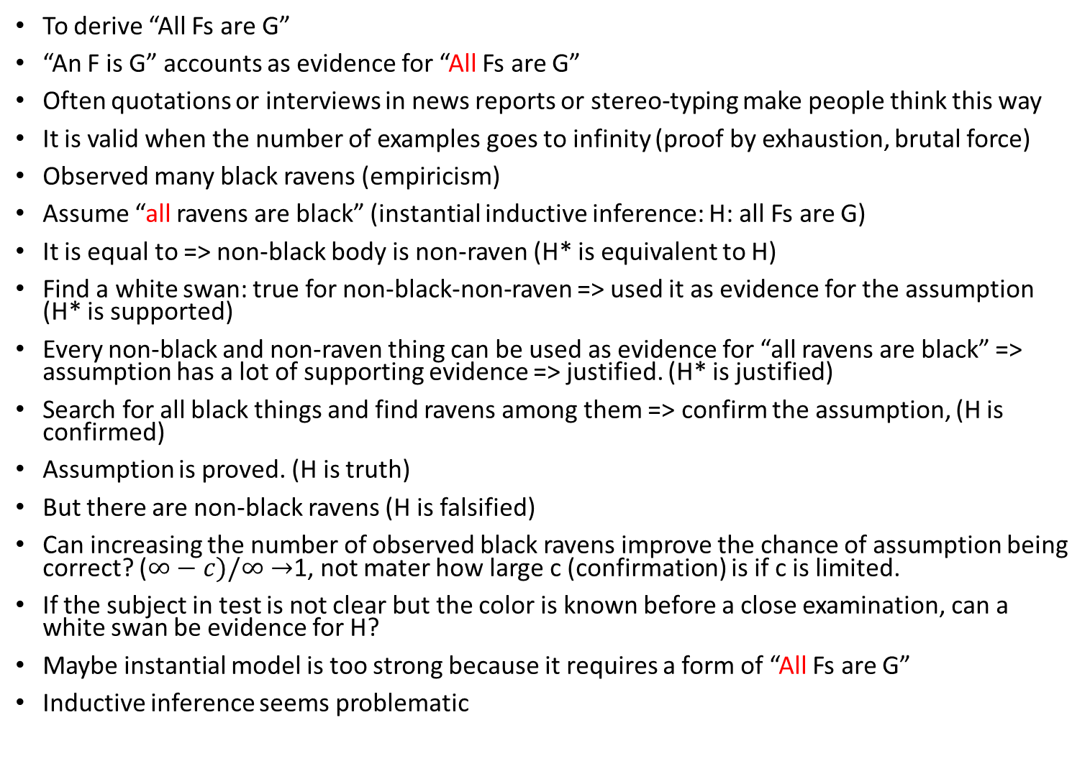
Instantial Model (inductive based on examples)
To derive “All Fs are G”
“An F is G” accounts as evidence for “All Fs are G”
Often quotations or interviews in news reports or stereo-typing make people think this way
It is valid when the number of examples goes to infinity (proof by exhaustion, brutal force)
Observed many black ravens (empiricism)
Assume “all ravens are black” (instantial inductive inference: H: all Fs are G)
It is equal to => non-black body is non-raven (H* is equivalent to H)
Find a white swan: true for non-black-non-raven => used it as evidence for the assumption (H* is supported)
Every non-black and non-raven thing can be used as evidence for “all ravens are black” => assumption has a lot of supporting evidence => justified. (H* is justified)
Search for all black things and find ravens among them => confirm the assumption, (H is confirmed)
Assumption is proved. (H is truth)
But there are non-black ravens (H is falsified)
Can increasing the number of observed black ravens improve the chance of assumption being correct? ($∞−c)/∞→$1, not mater how large c (confirmation) is if c is limited.
If the subject in test is not clear but the color is known before a close examination, can a white swan be evidence for H?
Maybe instantial model is too strong because it requires a form of “All Fs are G”
Inductive inference seems problematic

Slide 31
Hypothetico-deductive (H-D) Model
The objective is to get around “inductive inference”, to make the logic more like deductive logic.
Steps (Wikipedia):
  1. Use your experience: Consider the problem and try to make sense of it. Gather data and look for previous explanations. If this is a new problem to you, then move to step 2.
  2. Form a conjecture (hypothesis): When nothing else is yet known, try to state an explanation, to someone else, or to your notebook.
  3. Deduce predictions from the hypothesis: if you assume 2 is true, what consequences follow?
  4. Test (or experiment): Look for evidence (observations) that conflict with these predictions in order to disprove 2. It is a logical error to seek 3 directly as proof of 2. This formal (deductive) fallacy is called affirming the consequent.
H: “the early bird gets the worm”
Evidence: if early birds weight more, may or may not be conclusive
H: “light is wave”.
Evidence: diffraction (a shade with a small hole), interference (a shade with two slits), can be conclusive although not exclusive
H: all ravens are black
Evidence: no matter how many examples support it, it cannot be conclusive

Slide 32
Selection Task
Which mask(s) do you have to remove to know whether it is true that if there is a circle on the left of a card, there is a circle on the right as well.

Slide 33
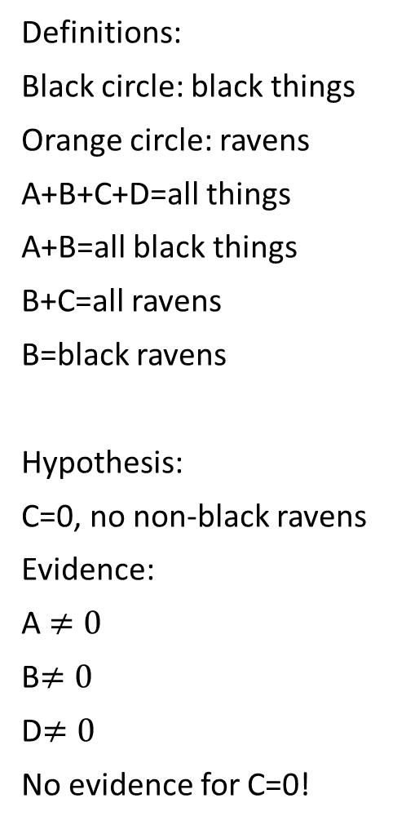
Logic in the Raven Paradox
Definitions:
Black circle: black things
Orange circle: ravens
A+B+C+D=all things
A+B=all black things
B+C=all ravens
B=black ravens
Hypothesis:
C=0, no non-black ravens
Evidence:
A $≠0$
B$≠0$
D$≠0$
No evidence for C=0!
D
Non-black things
Ravens
A
B
C
Black things

Slide 34
Problem with Positivism
Positivists: ”Rational reconstruction” of science results according to theory of language– nothing new is introduced
According to Positivists, science includes: context of discovery and context of justification
Positivists encountered problem in “context of justification: Inductive inference problem”
Positivism has difficulty to predict future
  Hume: you have no reason to believe that the sun will rise tomorrow
  Russell: chicken food problem, kill all? Without survivors? The knowledge chain is cut
  Pavlov experiments, does bell-ring without occur only once? Or it also occurs later?
  Either positivism or inductive logic fails.
No deductive justification of induction is possible (New riddle)
To oppose the notion that science is to unveil hidden structures of nature, they claimed that “in science there is no depth” (why you can know only what you see)— but they should have said their “knowledge of science has no depth”, Newton’s laws
Their view of philosophy of science is purely logic/linguistic;
In their theory, history and psychology are not related to philosophy of science
In deductive logic a theory needs to be “universal” and absolute, and has the form of “all … or none”– in science most often it is about “some” conditions or times, etc.
All examples are based on knowledge-that.
Pure empiricism (denying the importance of conceptualization) cannot develop “knowledge-understanding”
Without understanding, knowledge-that is not connected
Induction should be based on “conditions” and not on “time” alone.

Slide 35
“New Riddle of Induction”
Argument 1 (in analogy of all man are mortal…)
  All the many emeralds observed, in diverse circumstances, prior to 2019 AD have been green
  All emeralds are green
Argument 2
  All the many emeralds observed, in diverse circumstances, prior to 2019 AD have been grue
  All emeralds are grue*
  * grue is defined as green if it was first observed before 2019 AD or was not first observed before 2019 AD and is blue
Argument 3
  Because arguments 1 and 2 have the same “deductive form”, we have
  All the many E observed, in diverse circumstances, prior to 2019 AD have been G
  All E are G
  But argument 2 is clearly problematic, therefore, it is impossible to make inductive inference deductive
Argument 3 is deeply flawed as it changes definition of color for future categorization while the logic does not change with time, equivalent to call “4” as “fove” (four and five) for “2+2=“ and starting today it is “5” or anything other than 4.
  (it would be correct if the definition of numbers also changes starting today)
Proposer has been focused too much on “form” of the logic
The theory of philosophy of science has gone on a wrong path when people heatedly debate about “grue”

Slide 36
Curve-fitting Problem
Curve-fitting is based on inductive logic by allowing random noise
Those against empiricism think curve-fitting should not be used because one may induce different results
But this conclusion is based on their misunderstanding of the curve-fitting method
Validity of a fit is limited by the range of data
Beyond the range=> extrapolation=>inductive
Within the range => all fits should be similar
Which fit should be used => the one with greater correlation-coefficient (cc)
Fit in linear-linear scales=>linear relation,
b: slope, c: intercept
Fit in linear-log scales=> exponential function
Fit in log-log scales=>power-law
The reason for discussion in section 3.4 is ill founded

Slide 37
Midterm Paper
Due on Oct 22nd
Less than 2 pages long
On a subject that you found/find about which common perception/knowledge is questionable or flawed
You provide evidence/arguments for your view
You do not need to establish what you think right, which is for the final paper (the final paper may be related/built on the mid-term paper, but does not have to).

Slide 38
Summary on Scientific Methods
We learned about deductive and inductive logic, explanatory inference, instantial model, hypothetico-deductive model, new riddle of induction, curve-fitting problem
The objective of the study of scientific method is to streamline scientific research so that science can be done as a production line by people with less science training
It identified some commonly used concepts in science
  Systematic observation and experimentation, isolation of variables
  Inductive and deductive reasoning
  Formation and testing of hypotheses and theories
  But found that we cannot test a single hypothesis or sentence in isolation: Holism (Quine), a test is a test of a network of hypotheses
No unified universal method has been found
  Few scientists agree with the methods or found the method relevant to the reality of scientific research
It remains an interesting topic for education, science policy but can be misleading to students who want to be scientists

Slide 39
Karl Popper: Conjecture and Refutation
Popper is the only philosopher in philosophy of science who is regarded as a hero by many scientists, I agree.
Problem of Demarcation: distinguish science from non/pseudo science
Falsificationism: a hypothesis is scientific if and only if it has the potential to be refuted by some possible observation
Science: Einstein’s relativity
Pseudo-science: Freudian psychology and Marxist views about society and history, Darwinian evolution (later retracted)
(note that in the original examples it is more about a person than theory)
Study of elevator riders vs monkey-music
Scientific theories have to take risks: have to make bold predictions that can be tested, such as nothing is faster than the speed of light.
If a theory takes no risk at all, because it is compatible with every possible observation, then it is not scientific, I agree, e.g. interpretation of dream
Confirmation is a myth, i.e. Hypothesis-deductive method is false: the only thing observational test can do is to show that a theory is false, (black raven)
The trueness of a scientific theory can never be supported by observational evidence, a bold statement that eventually got Popper in trouble.
Popper was an induction skeptic
Fallibilism: we can never be completely certain about factual issues, most people agree, me if every (that you can show) not any, or replace never to usually not

Slide 40
Debates over the Popper’s Theory
“Pseudo science”, such as psychology, history, sociology, business, … because the theory cannot be falsified or can be easily falsified
  Statistics-based disciplines are all pseudo science
  Science is different from knowledge (in conventional PoS, no distinction)
  Knowledge-understanding is truth in a limited and relative sense and is not absolute Truth
When a theory passes more observational tests, is it more likely true? If no theory can be proven true, what is science doing?
  A fundamental misunderstanding by philosophers is to think scientists like work-bees, dog, chicken: many of the problems exist only in philosophers’ mind
  Using “universal” statement as a requirement for a science theory is fundamentally wrong because science is never all-or-none problem (the reason why many philosophers of science could not find a theory that works under most situations)
  Science is more about “under what conditions something happen”. Elevator riders
Can we measure progress with more positive tests?
  “corroborated” vs “confirmation”, ~ transcript vs recommendation letter or swapped
  Corroborate: “to confirm with additional evidence”
Should we continue to falsify a theory? Or should we stop if the costs too high?
  Pragmatism is not for science but for business or engineering
  A scientist never stops questioning the trueness of a law while working with it
How do we know we have found the “Holy Grail”, the grail that glows forever, vs. other grails that may glow for a while?
  Searching for Holy Grail is a bad analogy: science is never a yes-no question, because knowledge is accumulative, through out the development of civilization
  Better theories can result from flawed theories, grails connected, not throw away

Slide 41
Debates over the Popper’s Theory, cont.
Confusion on no-attempt to falsify with withstand falsification
  Tested vs untested/partly tested but withstood attempts of falsification: bridge design based on existing bridges vs new design
  There is a time delay from the announcement of a falsifiable hypothesis to the initial attempt of falsification
  During this time, the hypothesis is not considered withstanding falsification, no one would build a bridge without a review process which is a falsification process
Can we trust a falsification/falsifier? When personality is involved, difficult to separate science from personal biases
  Proposer and falsifier do not like each other or they are friends
  Falsifiers are defending their old theories and refuse to accept new ideas
How to determine if a theory or a part of a theory is falsified:
  Holism: a falsification may involve a network of assumptions
  An observational result may have 100 interpretations
  Philosophers of science should not have worried about these details
  In science there are ways to handle the uncertainties in interpretations, systematic, isolation, etc., but most importantly, openness in interpretation
Who decides if an observation falsifies a theory? (a free decision?)
  A observation result is subject to different interpretation (no single decision)
  The decision is not free, the peer review process, a natural selection process
  A single decision does not determine an interpretation or the fate of a theory
  The proposer has the right to defend a theory, e.g. alternative interpretation
  The proposer can look for better evidence or improved version of the theory

Slide 42
Science Revolution (1550-1700)
Scholastic worldview: (before science revolution)
  Four natural elements (earth, air, fire, water), plus the 5th element in heavens
  Natural motion (growth of plants)
  Many events happen for some purposes
  Ptolemy ~150 AD: objects in heavens moving in circles.
Nicolaus Copernicus (1473-1543): heliocentric view, made understandable of “retrograde motion”
Galileo Galilei (1564-1642): Free-fall motion, Galilean relativity, telescope
Johannes Kepler (1571-1630): Kepler’s law of planets motion
Rene Descartes (1596-1650): question immaterialness of soul and God, Cartesian coordinates, “I think therefore I am”, analytical geometry
Andreas Vesalius and William Harvey (1628): blood circulation and role of heart
Robert Boyle (1627-91): British Royal Society, setting science standard
Isaac Newton (1642-1727): Newton’s laws, understanding free-fall, tidal waves, and planetary motions under the same frame of science, quantitative science with mathematics
Notes:
Kepler's laws of planetary motion are three scientific laws describing the motion of planets around the Sun.
1. The orbit of a planet is an ellipse with the Sun at one of the two foci.
2. A line segment joining a planet and the Sun sweeps out equal areas during equal intervals of time.^{[1]}
3. The square of the orbital period of a planet is directly proportional to the cube of the semi-major axis of its orbit.
"I think, therefore I am” Descartes laid the foundation for 17th-century continental rationalism,
Boyle: relationship between pressure and volume, a founding father of British Royal society of philosophy. In letters in 1646 and 1647, Boyle refers to "our invisible college" or "our philosophical college". The society's common theme was to acquire knowledge through experimental investigation.

Slide 43
Thomas Kuhn: Scientific Paradigm
Reality of science: The Structure of Scientific Revolution (1962)
  Scientific behavior has little to do with traditional philosophical theories of rationality and knowledge, hypothetico-deduction, falsification, etc.
  Paradigm: (Kuhn used the term for 21 different senses)
    An illustrative example of something on which other cases can be modeled
    Broad sense: a package of claims about the world, methods for gathering and analyzing data, and habits of scientific thought and action.
    Narrow sense: a specific achievement or an exemplar: Mendel’s experiments with peas, Newton’s law of motion, Maxwell’s equations of electromagnetism, Euclidean geometry
  A paradigm is relatively stable for a period of time, Euclidean >2300 years
  Most of time, science is done in a paradigm: normal science– with common agreed concepts/assumptions
  Paradigm shift: scientific revolution during which there is no commonly agreed concepts/assumptions
Popper:
  Science is permanently open to criticisms, including its fundamental ideas
  Science is a single process: conjecture and refutation (is a social activity)
  Based on reason and evidence (Wrong reasons or flawed interpretation)
Kuhn:
  Science is not always open to criticisms of its fundamental ideas, or chaotic environment is created
  Two forms of science: normal science and revolutionary science, bridged by crisis science
  Based on history

Slide 44
Kuhn: Normal Science
Normal science:
  It occurs within the framework provided by a paradigm, well organized, scientists do not spend much time to debate about fundamentals
  A dominant paradigm per field per time, consensus-forging: rules for a ballgame
  Details or model examples are worked out based on the paradigm
  These detailed studies may later reveal something fundamental
  Normal science is the most productive and efficient phase of science
  In normal science, any new theories or hypotheses cannot challenge the paradigm, or every evidence supporting the paradigm can falsify the new theory
  Exchanges within a science community use some common language and exchanges are productive with high efficiency
  Paradigm for psychology: two principles (very problematic)
    Learning is basically the same in humans, rats, and other animals; this maybe true for in 2000 years ago, but we now learn in school and from books
    Learning proceeds by reinforcement– behaviors followed by good (bad) consequences tend to (not to) repeated, like monthly allowance tied to grades? Debate: We often do things not for rewards and not do thing for not getting punishment.
  “Puzzle solving” vs “problem-solving”, “not-yet-solved” vs “may-have-no-solution” which is more like engineering vs science in practice, no clear cut
  Debate: Are the rules good/reasonable? Descriptive vs Normative: things are vs things should be, an issue important to philosophy
  Popper: normal science sometimes exists, but it is a bad thing, which should not be encouraged
  Scientific education and training: Indoctrination for deep faith of a paradigm
  Pre-paradigm science: when many short-lived theories exist or coexist

Slide 45
Kuhn: Anomaly and Crisis
Anomalies and crisis
  During normal science, there are failures to get expected results/explanation, otherwise all puzzles should have been solved
  The failures may be used to challenge the paradigm, especially for new scientists
  But the paradigm has many well documented successful examples that are against the challenges– most challenges will fail
  But it could be due to insufficient information/observation or experience
  Anomaly: A puzzle that resists solution
  But the number of anomalies and their severity can increase with time
  A rival paradigm appears
“A good normal scientist is committed to the paradigm and does not question it”:
  misunderstanding– scientists question the paradigm all the time
  but your failure in using the existing theory cannot be used as evidence for your new theory or to falsify the paradigm
  This is because there is a formidable number of solidly established examples so that the challenger has to explain why they were/are successful
One paradigm per field per time: “field” can be a sub discipline, such as EM for most optics, quantum for most semiconductors, laser source
A science community has to strike a balance between being too resistant to change in basic ideas and being not enough resistance

Slide 46
Kuhn: Scientific Revolution
Principles for paradigm theory: shared basis for theory choice
  Predictively accurate
  Consistent with well-established theories in neighboring fields
  Able to unify disparate phenomena
  Fruitful of new ideas and discoveries (should not be as a requirements)
  Principles for psychology do not satisfy as a paradigm for whole psychology
What can lead to a paradigm change
  Failures in solving increasing number and severity of puzzles, crisis,
    Mickelson-Morley experiment, relative speed of aether (1887), special relativity (1905).
    Blackbody radiation problem (Kirchhoff, 1859), Quantum (Plank, 1900)
  A new paradigm appears that increases problem-solving power (not more rational according to Kuhn),
    but not Copernicus: prediction is less accurate although simpler
    The new paradigm is established after Newton (Copernicus theory is not a paradigm)
  New discoveries, techniques, e.g. Hubble Space Telescope, radioactive dating method
How to know which paradigm is better, and what are the goals
  Better understanding (I think), causal explanation? Newton’s gravity vs classical explanation
  More problem-solving power, Better mathematic, more quantitative or better understanding of mechanism? Biometricians vs Mendelians=>modern biology
  Kuhn did not think science could accumulate knowledge about “how the world really works”, but about the “structure of the world”, because of the “fall of Newtonian picture”

Slide 47
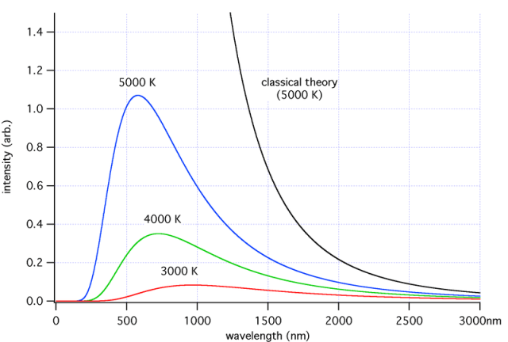
Blackbody radiation
Wien, 1896
Rayleigh (1900)
Max Planck (1900)

Slide 48
Kuhn: Scientific Revolution, cont.
Revolutions have a “non-accumulative” nature
  We gain as well as lose something
  Questions that the old paradigm answered now become puzzling again, or they cease to be questions
  (My view) during and after a revolution, people critically review our knowledge and start a filtering process to our knowledge by remove out-of-date knowledge
Has a revolution to be chaotic?
  Breakdown of communication
  Different standards of evidence and arguments
  Incommensurability: relativism vs real increased problem-solving power, are we closer to a perfect single paradigm? Is there such one? If no, it is “relativism”
  (my opinion) A new paradigm may develop an overarching theme to cover a discipline: gene, Darwinian
  but may just form a new subdiscipline and the old paradigm remains in the conventional domain, relativity, atomic physics, Euclidean geometry/non Euclidean
  In a single subject, say physics, it is possible to have multiple paradigms each covers a discipline, relativity, quantum, elementary particle (not firmly developed yet?), astrophysics (jointing multiple paradigms?)

Slide 49
Comments by the Author of Textbook on Kuhn’s Theory
Importance of formation of a new paradigm,
  Artificial Life, premature commercialization
  Looking outside the paradigm too often to application and external reward is not good for normal science
“The X-rated Chapter X is the worse material in Kuhn’s great book. It would have been better if he had left this chapter in a taxi…”
  Kuhn: after a revolution, “scientists work in a different world”,
  Is reality paradigm dependent? If the change is metaphysical: basic view of the reality and our relationship to it?
  The X-rated “Chapter X”: “Revolutions as Changes of World View” -- not the world itself
Kuhn: we can accumulate knowledge about “structure of the world” not about how the world really works, because of the “fall” of Newtonian description
  (my view) the Newtonian tent just covers a smaller area, but the tent itself is basically intact.
  Relativity provides a large tent to cover the Newtonian tent
Success and power of science is due to delicate balance between the ordered cooperation and single-mindedness of normal science, together with ability of these ordered behavioral patterns of breakdown and reconstitute themselves in revolutions
Invisible hand: the source of science drive is largely from individual scientists’ curiosity: individual selfishness
Darwinian mutation and natural selection: decided by individual and community of scientists
Some, i.e. Carnap and Quine, want a paradigm less rigid, or call it a framework (Carnap) or two-layered view (Quine), to allow tinkering

Slide 50
Thomas Kuhn: Scientific Paradigm
Reality of science: The Structure of Scientific Revolution (1962)
  Scientific behavior has little to do with traditional philosophical theories of rationality and knowledge, hypothetico-deduction, falsification, etc.
  Paradigm: (Kuhn used the term for 21 different senses)
    An illustrative example of something on which other cases can be modeled
    Broad sense: a package of claims about the world, methods for gathering and analyzing data, and habits of scientific thought and action.
    Narrow sense: a specific achievement or an exemplar: Mendel’s experiments with peas, Newton’s law of motion, Maxwell’s equations of electromagnetism, Euclidean geometry
  A paradigm is relatively stable for a period of time, Euclidean >2300 years
  Most of time, science is done in a paradigm: normal science– with common agreed concepts/assumptions
  Paradigm shift: scientific revolution during which there is no commonly agreed concepts/assumptions
Popper:
  Science is permanently open to criticisms, including its fundamental ideas
  Science is a single process: conjecture and refutation (is a social activity)
  Based on reason and evidence (Wrong reasons or flawed interpretation)
Kuhn:
  Science is not always open to criticisms of its fundamental ideas, or chaotic environment is created
  Two forms of science: normal science and revolutionary science, bridged by crisis science
  Based on history

Slide 51
Lakatos: Research Programs
Similar to Kuhn’s paradigm, but several programs exist in a field and they compete
A program contains (1) a hard core, and (2) protective belt
Change cannot be made to the hard core; protective belt can change progressively
Large scale science progress/changes result from competition between programs
Some programs progress rapidly, others slowly, and others degenerate at a given time.
It is acceptable to protect a research program for a while during a degenerating period. It may recover, but did not specify how long, which is considered a fatal flaw
He saw Kuhn’s theory destructive of reason and ultimately dangerous to society
He call Kuhn’s theory on scientific changes as a fundamentally irrational process: mob psychology, a process where the loudest, most energetic, and most numerous voices would prevail regardless of reasons
He was to rescue the rationality of science from the damage Kuhn had done
He thought we should write “rational reconstruction of the historical episodes in which scientists’ decisions are made to look as rational as possible, “deliberately misrepresent” the history, with the facts in footnotes.
(My) Comments:
  Can a field have a few sets of solid “paradigms”?
  Or are they different disciplines of the same subject?
  Or are they different sects under the same paradigm?
  How can people referee/review papers across programs and not rejecting them?
  If each follows its own set of concepts/rules, are they still in the pre-paradigm state?

Slide 52
Laudan: Research Traditions
Kuhn’s science is irrational
  Science decision is ”basically a political and propagandistic affair”, inaccurate reading of Kuhn
Large-scale units of science work are called “research traditions”
  Between traditions, the links in theories are weak
  There can be movement of ideas in and out of the hard core
  There is nothing bad about later theory covering less territory than previous one (agree)
  (Me) These are more like something either pre-paradigm or sects under the same paradigm
Acceptance vs pursuit of theories
  Degree of belief, attitudes to theories => Acceptance ~ belief
  Accepting the ideas in mainstream research tradition but pursuing an unaccepted idea with large potential is rational
  Acceptability of a theory is measured by its overall level of problem-solving power (note not rationality)
Criticisms to Laudan’s theory (more descriptive and less normative)
  No aim of philosophy of science
  No principle for philosophy of science
  No procedure for a scientist to follow when making decision (bad comment)
  How do people know which tradition has more future potential? (or PoS should not be one)
  Without well defined rules scientists may be lost or make mistakes (or should not be one)
All criticism are not valid depending on what you want (my view)
  Science is a risky business
  Scientists need to have scientific judgments (this is what they learn and their ability)
  If one makes a wrong judgment, takes its consequences
  It does not need philosophers to tell them what to do!
  Philosophers care too much about “what is right” and not about “how to get it right”

Slide 53
Feyerabend: Epistemological Anarchy
Against method: everything goes!
  Oppose to all systems of rules and constraints in science
  Science is an aspect of human creativity
  Great scientists are opportunistic and creative
  Strongly against Kuhn’s promotion of normal science and thought that the concept of paradigm never succeed in control science.
An argument from history that haunts philosophers of science
  Is the earth moving? the central issue in debate against Copernicus
  According to Copernicus, earth is moving (at about 30 km/s~67,000 mph)
  But we have no experience of this motion
  Based on “empiricism”: the earth is at rest and not moving
  Galileo’s experiment show no evidence for such motion
  Didn’t Galileo’s experiment falsify the Copernicus’ theory? (or Popper’s theory wrong?)
  Galileo explained in terms of relative motion/absolute motion
  Experience can be interpreted wrongly
  If we had followed a rule, we would have considered Copernicus wrong
  Theories of philosophy of science is sometimes irrelevant to science
  Laudan’s theory of “pursuing”: an unaccepted idea but with large potential to work
(This has argued about the wrong thing: sun rise/set is due to spin of earth)
Does science needs to be rational? Feyerabend’s principles
  Principle of tenacity: do not give up too easily
  Principle of proliferation: marketplace of new ideas, privately or publically?
    there is a credibility issue for a scientist.
    how to eliminate and reject ideas? (a junkyard?)

Slide 54
Success of Philosophy of Science
Some pieces of the PoS ideas/thinking are very insightful and useful:
  Importance of observation (empiricism)
  Reasoning: Descartes (1596-1650) (rationalism)
    Never accept anything as true unless you “recognize it to be evidently such”, unless it represented itself “so clearly and distinctly to the mind that it could not be doubted”, such as things “self evident” (We hold these truths to be self-evident)– sometimes math alone is not enough
    Divide each of the difficulties into as many parts as possible, “divided and conquer”, (derivatives)
    Always think in an orderly fashion, beginning with the things that are simplest and easiest to understand
    Make enumerations so complete, and review so general, that we can be certain nothing is omitted
  Problems with inductive inference, explanation (problem with positivism)
  Falsification vs confirmation (Popper, problem with “scientific methods”)
  Risk taking (Popper)
  Paradigm: those who are not actually scientists would not be able to appreciate. (Kuhn)
  Normal science, e.g. Euclidean geometry (Kuhn)
  Revolution of science (Kuhn)

Slide 55
Failures of Basic Ideas of Philosophy of Science
Failure to provide strong “prescriptive moral” for emerging sciences
Failure to produce a universal scientific method
Failure to produce a universal logic for induction of confirmation
Failure to find a universal paradigm/scheme/framework
Difficulties the Popper’s universal statement (“meaningful statement”: if…then…) encountered
  if a single example can be used to falsify a generic (universal) theory: Popper’s theory should have been falsified by e.g. Copernicus theory by Galileo’s free-fall experiment
History of science has shown (descriptive, “be”)
  Different processes/paths through which better understanding has been developed,
  at the same time, flawed ideas have been filtered out.
  However, some flawed ideas may still exist in our knowledge system,
  either we do not realize them or we have no better alternatives.
Science itself seems to be able to defy all theories of PoS because
  New technologies and methods have been developed successfully based on progress in our knowledge-understanding, computers, cell phones, better bridges
  Some of our knowledge-understanding is definitely correct (or true), not as Popper assumed, airplanes– heavy objects flying in thin air, human landing on moon
  Falsification may often affect only the conditions or applicability, atomic nucleus formed by multiple positive charges do not falsify Coulomb's law
Philosophy of science has put too much emphasis on normative: “should be”
  “what is right” or “who is right” and not about “how to get it right” or “how do I know I am not wrong”
  Plato vs. Euclid: philosophy (how to get right) vs. geometry (what is right)
  Young scientists worry more about to get work published in the best journal, not the rules

Slide 56
Searching for Theories of Science
An example of the process a scientist experiences
  Often a scientist is driven by Curiosity based on or related (maybe indirect) to some (natural and/or intellectual) observations: no existing satisfactory explanation, no belief to justify yet (falling apple, or application of ones’ knowledge)
  Some of the curiosities grow to become Belief, and then the scientist wants to test or Justify (or prove, in a scientific term) that the belief is True.
  The scientist tests or justifies a belief with evidence/reasoning/math
  Other scientists may have different ideas/beliefs and they will falsify your new idea/belief with their counter evidence and reasoning
  A theory is successful if it withstands the falsification tests
  It takes a much longer time for a successful theory to eventually become knowledge of a community
  Often a piece of knowledge is formed with a collection of successfully justified true beliefs/theories through abstraction/condensation/reduction
What is the key issue to a theory of science?
    Scientific thinking? Scientific method? Scientific logic? Scientific reasoning?
Sources of knowledge:
  Experience
  Conceptualization, mathematics and (existing) science/knowledge

Slide 57
Searching for Theories of Science
An example of the process a scientist experiences
  Often a scientist is driven by Curiosity based on or related (maybe indirect) to some (natural and/or intellectual) observations: no existing satisfactory explanation, no belief to justify yet (falling apple, or application of ones’ knowledge)
  Some of the curiosities grow to become Belief, and then the scientist wants to test or Justify (or prove, in a scientific term) that the belief is True.
  The scientist tests or justifies a belief with evidence/reasoning/math
  Other scientists may have different ideas/beliefs and they will falsify your new idea/belief with their counter evidence and reasoning
  A theory is successful if it withstands the falsification tests
  It takes a much longer time for a successful theory to eventually become knowledge of a community
  Often a piece of knowledge is formed with a collection of successfully justified true beliefs/theories through abstraction/condensation/reduction
What is the key issue to a theory of science?
    Scientific thinking? Scientific method? Scientific logic? Scientific reasoning?
Sources of knowledge:
  Experience
  Conceptualization, mathematics and (existing) science/knowledge
Private domain
Public domain

Slide 58
Knowledge Defined
Knowledge: collection of justified true beliefs that withstand falsification tests and are held by a large fraction of the community
  Knowledge has social attribute: shared and commonly accepted and passed on to next generations – individual’s idea/opinion is not knowledge until accepted by others
  Knowledge is based on and/or describes truth but may or may not be the truth itself
  Knowledge is subjective, its current objective form is authentic books (old sayings)
  Unfalsifiable: testable and able to withstand the falsification tests
  Knowledge is beliefs held by a large portion of a community and not only by a few experts (i.e. it is tested by these people to be true), the one held by few experts may be knowledge in science stage which can be modified substantially when becoming real knowledge
  Knowledge best reflects truth at a time (this is what humans can be closest to truth)
  Knowledge can later be falsified
  New knowledge can be added continuously through history
  Knowledge is accumulative: when new knowledge is in conflict with existing knowledge, the new knowledge has to be backward compatible and/or the existing knowledge has to be falsified.
  Such defined knowledge has a time delay from the justification process
  Scientific news is in general not knowledge-understanding

Slide 59
Science Defined
Science: a collective activity/process on the whole society level to systematically build, organize, and validate true beliefs based on experience, knowledge, and reasoning in a form of testable explanations and predictions and filters out those that are falsified based on observations
  Searching for truth to connect experience with reasoning based on, but with possibility of challenging, knowledge-understanding (e.g. laws)
  An essential function of science is to filter out failed ideas
  Testability is in contrast to being done by a ghost, but not Popper’s demarcation (too strong)
  The ultimate judge of science is observation/experience (which may depend on interpretations)
  Science has human factors in it
    Strong drive from individual/small group’s curiosity and beliefs
    Organized social activity: individual curiosity in isolation does not account as science until it is open to public and in a falsification process by the science community. (after the result developed in isolation is open, even from a coffin, it takes time to falsify or accept it, a process which is part of science).
  Many disciplines of Natural Science, Social Science, and Formal science, which, such as math, follow strict formal logical reasoning, are all qualified as science (not Popper’s demarcation)
  However, natural science and social science may use different standards to evaluate at a time
  Such defined science (testable but may be falsifiable) overlaps and is different from “knowledge-understanding” which withstands exhausted falsification tests
Notes:
There is an issue whether social science and psychology are science.
I personally do not think much of social science and significant part of the behavioral science (except some branches) as science.
But if I have to define science as “testable explanations” they are qualified.
Formal science: I do not think math is independent of empirical observations, because they can be falsified if it is inconsistent with observations.

Slide 60
Deductive Forms and Fallacies
Law of Syllogism
  Major premise + minor premise =>conclusion
  Promises can be partially positive/negative
  There are 256 distinct logical types, 24 types are true– too many for being general knowledge
An example (most often used one)
  Involving 2 subjects and 3 concepts
  All A is B and all B is C, therefore A is C.
  A is major term (predicate of conclusion)
  C is minor term (subject of conclusion)
  B is called “middle term” and has to be in the middle
    A=>B, B=>C, therefore A=>C
    All men are mortal, Socrates is a man, …
  All A is B and all C is B, therefore C is A.
    Moon is a sphere, earth is a sphere
    Invalid, “no, that does not follow”
  In general, the form of all A being B and all B being C may not be satisfied and may be partially true: conclusion needs be carefully drawn
__ and/or __ form
A
B
C
B
A
C
A
B
C
A
B
Notes:
UML is in Lowell, Lowell is in Mass, UML is in Mass
Lowell is in Mass, Boston is in Mass, Lowell is in Boston
It rained last night, the ground s wet

Slide 61
Deductive Forms and Fallacies, cont.
If__ and then __ form
If P (premise) is true, then Q (consequence) is true
Both P and Q can be true or not true (2x2=4 possibilities)
For deductive: P is more general than Q
  P is true, Q is true (valid)
  Q is truth, P is true (invalid)
  Q is not truth, P is not true (valid)
  P is not true, Q is not true (invalid)
Soundness: Premises can be false:
  All men can see 3 miles far; a car is 3 miles away; everyone can see it. (valid but not sound)
  Some people can see 3 mile far; a car is 3 miles away; some people are able to see it (under certain circumstances). (valid and sound)
P
Q
P
Q
P
P
Q
Q
Notes:
UML is in Lowell, Lowell is in Mass, UML is in Mass
Lowell is in Mass, Boston is in Mass, Lowell is in Boston
It rained last night, the ground s wet

Slide 62
Reasoning
  Deductive reasoning: linear reasoning from A=>B=>C …, formal logic, i.e. math, Euclidean, P and then Q form
  Abductive reasoning: C (result) is known to be true. Assuming if A (cause) is true, following the deductive/inductive reasoning, C is positively inferred, conclusion: A causing C is proved to be true. Q then P form. Widely used in science, but it is not scientific reasoning because other possibilities can derive the same result. example: simulation without independent tests of the code itself, polygraphic tests
  Dialectical reasoning: C is known. Assuming “if” A is right and following deductive and inductive reasoning, C is negatively inferred, so A is false– falsification; not Q then not P form, a method of elimination by trial and error from all possible assumptions
  Analogy: from A to C, to prove A’ to C’. useful to describe a truth, but often not prove a truth because A and A’ may not be comparable. It is common to hear that because all ravens are black, “similarly”, all swans are white.
  Inductive reasoning: generalization of limited observations (not based on logic but observations)
  Citations: a way to present evidence and simplify the presentation of reasoning
  Exhaustive search/brute force method: a problem solving method, not a reasoning, applicable only to discrete problems, especially in computer sciences, dialectical
  Pragmatic argument: looking for economy not necessarily truth-- not scientific
  Occam’s razor or argument of Simplicity: when two or more equivalent conclusions are derived, the simplest one and/or the one with fewest assumptions is chosen as “correct” for the time being. (geocentric vs heliocentric)
Notes:
(law of parsimony in philosophy)
For scientific research we are often only able to prove “most” real, not knowledge yet, but close. Knowledge eventually be a collection of many such proofs.
A scientist should equally emphasize both observation and conceptualization. Physics is based on observations/experiments.
If theory is inconsistent with observations, the observation has an upper hand. All physicists should be absolutely firm on this.
Conceptualization is the one that lead to understanding and can guide new observational tests, e.g. without conceptualization, there is no understanding.
Reasoning concerns how we derive our knowledge, i.e. our methods of scientific justification.
Parsimony: spareness. Razor: to shave away unnecessary assumptions or cutting apart two similar conclusions.
One way to argue for the rule is the probability. Each assumption has a probability to be true and the total probability is multiplication of these probabilities.
The simplicity is an “argument” to me, sometimes referred to as a “rule”, not a law in scientific research, because a counter argument could be a single assumption of existence of a god that can explain everything.
An example, When studying the motion of planets, one can base on the universal law of gravitation to write the momentum equation for each planet.
The law and the momentum equations are independent of frame of reference, and can be in either a frame rest with sun or earth.
Therefore, it is possible to study the motion of the planets in a geocentric or heliocentric description.
We like heliocentric description better (note this is a “choice”) because it is simpler (although the number of assumptions are the same), but this choice does not say earth centric is wrong as it also describes the motion correctly. Of course, historically, Copernicus heliocentric theory was not justified based on the Occam’s razor.
Another example is the BV and EJ paradigms in M-I coupling. In theory EJ and BV are two equivalent descriptions of MHD systems. But Parker has shown that the EJ paradigm is not mathematically trackable while BV is.

Slide 63
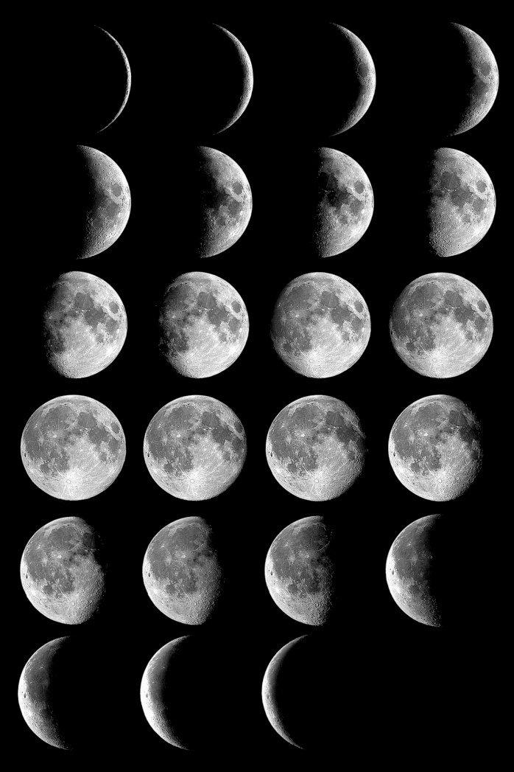
Moon Phases
Moon is spherical, not a disk
Moon is not a source of light
Moon reflects light from a single source
Earth is also spherical based on (full and partial) lunar eclipses
What reasoning has this conclusion been based on?
http://aa.usno.navy.mil
Notes:
Empiricism vs rationalism
Moon has phases, phases can be produced by a sphere with a light source from varying direction

Slide 64
Happy World Philosophy Day!
Philosophy is the study of the nature of reality and existence, of what is possible to know, and of right and wrong behavior. It comes from the Greek word phílosophía, meaning 'the love of wisdom.' It is one of the most important fields of human thought as it aspires to get at the very meaning of life.
World Philosophy Day was introduced in 2002 by UNESCO (the UN Educational, Scientific and Cultural Organization) with the following objectives:
to renew the national, subregional, regional and international commitment to philosophy;
to foster philosophical analysis, research and studies on major contemporary issues, so as to respond more effectively to the challenges that are confronting humanity today;
to raise public awareness of the importance of philosophy and its critical use in the choices arising for many societies from the effects of globalization or entry into modernity;
to appraise the state of philosophy teaching throughout the world, with special emphasis on unequal access;
to underline the importance of the universalization of philosophy teaching for future generations

Slide 65
A Theory of Science
  No specific method governing scientific research because of diversity of approaches
  Because of the social attribute, scientific results are proved/disproved based on scientific reasoning – a common language used by scientists to communicate
  The objective for science and scientific research is to
    Connect knowledge-that to become knowledge-understanding
    Reduce “belief” components in knowledge and replace them with inductive and deductive reasoning
    Reduce the inductive components and replace them with fewer inductive elements and/or more deductive reasoning – to become more deterministic
    Present more and more laws mathematically– to become more quantitative
    Reduce/loosen requirements/conditions– to use more general (universal) laws
  Scientific Reasoning: deductive, inductive, dialectical, and Occam’s razor
  Commonly used scientific approaches: (using these methods does not guarantee being correct)
    Systematic experiments
    Isolation of variables
    Order analysis (ranking and prioritizing)
    Correlation
    Alternatives
  A scientist needs to learn the language of reasoning and use it consciously
Notes:
(law of parsimony in philosophy)
For scientific research we are often only able to prove “most” real, not knowledge yet, but close. Knowledge eventually be a collection of many such proofs.
A scientist should equally emphasize both observation and conceptualization. Physics is based on observations/experiments.
If theory is inconsistent with observations, the observation has an upper hand. All physicists should be absolutely firm on this.
Conceptualization is the one that lead to understanding and can guide new observational tests, e.g. without conceptualization, there is no understanding.
Reasoning concerns how we derive our knowledge, i.e. our methods of scientific justification.
Parsimony: spareness. Razor: to shave away unnecessary assumptions or cutting apart two similar conclusions.
One way to argue for the rule is the probability. Each assumption has a probability to be true and the total probability is multiplication of these probabilities.
The simplicity is an “argument” to me, sometimes referred to as a “rule”, not a law in scientific research, because a counter argument could be a single assumption of existence of a god that can explain everything.
An example, When studying the motion of planets, one can base on the universal law of gravitation to write the momentum equation for each planet.
The law and the momentum equations are independent of frame of reference, and can be in either a frame rest with sun or earth.
Therefore, it is possible to study the motion of the planets in a geocentric or heliocentric description.
We like heliocentric description better (note this is a “choice”) because it is simpler (although the number of assumptions are the same), but this choice does not say earth centric is wrong as it also describes the motion correctly. Of course, historically, Copernicus heliocentric theory was not justified based on the Occam’s razor.
Another example is the BV and EJ paradigms in M-I coupling. In theory EJ and BV are two equivalent descriptions of MHD systems. But Parker has shown that the EJ paradigm is not mathematically trackable while BV is.

Slide 66
Deductive Reasoning
To derive understanding of a specific problem based on general knowledge.
It is forwardly deterministic and truth preserving, like a pipe: if the thing put-in is right, the outcome is right!
A=>B=>…=>Z, in mathematics, A=>Z can be a very long derivation
Issues of concerns:
  If the deduction is not pure math, the system may be permeable -- there are possible fallacies (invalid reasoning)
  If additional approximations are made at some steps: pipe has connections!
  Reasonable possibilities can get lost in the steps – Leakage at connection?
  False possibilities can be introduced in the steps -- contaminations?
  Can the reasoning eventually reach the start point -- circular and flawed?
Causality:
  If time is in a law, the law carries/describes causal relation
  If time is not in a law (quasi-steady state), causal relation is provided externally by one of the variables
Notes:
Deductive reasoning is like a pipe. You put something into the input end, the output end is right. if the output is not right, you put in wrong things.
If the reasoning starts with “if A…” it is already a dialectical, not a deductive.
The problem in science is that there are many connections in this pipe.
Often, approximations are made during the mathematical derivation. Different approximations lead to different results.

Slide 67
Deductive Reasoning, cont. I
Problems with Deductive reasoning:
  Deductive reasoning itself cannot provide a starting point. The reasoning cannot go backward. (solution is known but guessing the equation=>abductive)
  Without a justified start point, the reasoning is “infinitely regressive”. People can question the start point. (Socrates is a man=>all man is mortal=>>Socrates is mortal)
  If the steps are not mathematical, every step has to be checked carefully
  If deductive reasoning is carried out by numerical simulations, some leakage or contamination may occur. A question is whether they will be large enough to affect the conclusions
  If result is known but try to derive the cause, the reasoning has to start at the beginning and eliminate all other possibilities along the way— dialectical and not abductive (Alvarez hypothesis: extinction of dinosaurs, took 30 years to be accepted, Darwinian still has work to do on social aspects although most scientists accepted it)
A starting point may be assumed by
  a “self-evident” assumption, (less often in science because these have been called laws)
  physical laws with thorough examination of relevance and applicability
  observational evidence, which often involves or is based on inductive reasoning
  If the assumption is wrong, everything is questionable (putting garbage in a pipe)
Notes:
Example of not backward, you can forward solve an equation and find a solution, but with that solution alone, you cannot determine what equation has been used. There are a lot of equations that can have the same solution.
Example of regressive: Socrates is mortal: start point is: Socrates is a man. All men are mortal, therefore Socrates is mortal. But how to know Socrates is a man? Born by human, but how to know human gives birth to a man?.... Infinitely regressive.
Example: MHD theory based on Newton’s laws and Maxwell’s equations.

Slide 68
Deductive Reasoning, cont.II
Applied sciences:
  many science laws are written in forms of mathematical equations, i.e.
  many engineering problems can become solving these equations numerically with different terms under different initial and boundary conditions
A fundamental assumption in science:
  If the deductive reasoning is based on mathematics, there is no leakage and contamination:
  This assumption so far works “amazingly” perfectly.
Relationship between science (other than math) and mathematics
  Since mathematics was developed independent of the science laws and their mathematical forms, why should the solutions based on the mathematical procedures be related to the problem we are studying?
  Can mathematic procedures introduce leakage or contamination in the process? Why not—the most puzzling question to me concerning philosophy of science?
  In our scientific research, if the solutions are inconsistent with the observation/expectations, we question the equations used, approximations made, the terms included, boundary conditions, and initial conditions, but not the mathematical procedures!
  Some steps in a research may not be purely mathematical, but are based on assumptions. These assumptions are often subjects of careful scrutiny.
Notes:
Example: MHD theory based on Newton’s laws and Maxwell’s equations.
Why should the correct solutions of these coupled equations be relevant to the phenomenon I am studying?

Slide 69
Inductive Reasoning
(not the induction method in mathematics, which is deductive)
Inductive reasoning is empirical: to build our knowledge based on generalization of limited observations, not based on logic, i.e. observation based laws.
It can go across the lines of deductive reasoning
In science, observational correlation between two (or more) phenomena is a most commonly used method. (Chinese medicine)
To generalize an observation is based on inductive reasoning. (observation itself is not reasoning)
There are two general possible situations:
  The correlation may be traced to some reasonable expectations (parallel to deductive reasoning )
  It is not understandable: may lead to discovery of new knowledge (perpendicular to deductive reasoning)
Parallel situation: usually used as justification and explanation for deductive results
Perpendicular situation: often used as start point for deductive reasoning and/or to simplify the mathematics.

Slide 70
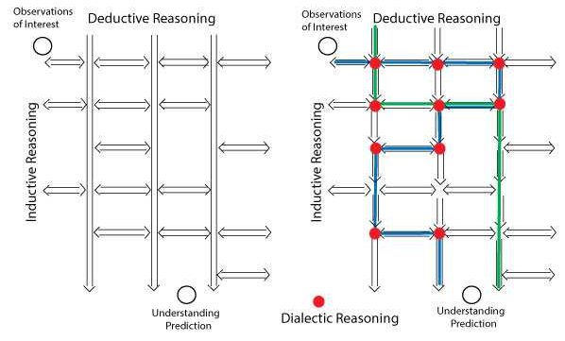
演绎推理
观测
归纳推理
辩证推理
理解

Slide 71
Problems with Inductive Reasoning
  There are often or always exceptions (black swans/non black ravens)
    Falsifiable by a singe case according to Popper: a flawed and failed theory of PoS
  Two related observations may be unrelated (accidental)
  Correlation study, in general, cannot determine the causal relation between two correlated quantities
    in science, often assuming either as the cause of the other is valid
    In some experiments, time history is included which can be used to established the causal relation
  Interpretation inherently uncertain:
    A single correlation can draw many different interpretations/conclusions,
    Some of them can be inconclusive or totally wrong (tattoo vs GI driving accident: preference for bodily risk)
    Smoking and cancer: why not every smoker gets but non-smoker can also get
Notes:
Inductive reasoning is known to be flawed, depending on how and what conclusion to draw from.
An example: correlation between the number of tattoos on a GI and driving accident rate during WWII. Because it is clear that tattoos cannot cause accidents and vice versa, behavioral scientists found an explanation: preference for bodily risk. Based on an argument that the GIs who takes bodily risk of tattooing process (at that time tattooing was very painful), he/she is more likely to risk his/her body for an accident which can also be very painful, a flawed conclusion. Although the two share the same effect, bodily pain, one is planned (which can be considered preference) and the other is not. In fact the driver often assumes he/she could make it and not get an accident. Few people would prefer an accident because he/she can take pain of the accident, or to calculate whether the pain is within the range of his/her bodily toleration when running into it. It is more likely an tendency of showing off and hungering for attention.
In social science, confounding variable analyses are wide spread. For example, using race as an independent variable to analyze many different phenomena for which Income, education, religion, cultural background should have been used.
In contrast, race is not allowed in most double-blind tests in medicine development because of racial discrimination: politics interferes science if medical science is a science.
Medical science is another example: just look at the periodical contradicting recommendations for vitamins.
Henry and Barn facades: henry driving through a district filled with barns. He checked one of them and drew a conclusion: these are all barns, but actually the rest are pictures of barns.

Slide 72
Inductive Reasoning: Statistical Analyses
  Correlative analysis: measurement Y is correlated with factor X
    X has to be the dominant factor governing the phenomenon Y
    All other factors have to be random (not correlated to X) so that they cancel each other when the sample size is large enough
    If scattering is larger than the trend (cc. <0.5), the result is uncertain, need to reconsider the variable or subgroup of the database
    Multi-variance correlation analyses: the variables have to be independent, i.e. orthogonal. If not independent, it is the duty of a scientist to find a right set.
    Secondary factors can be studied by subtracting the dominant factors
    Confounding variables are a major problem in statistical studies. (race)
    Using confounding variables in studies has been, debatably, abused in some sub-branches of social, medical and behavioral sciences. (double blind test, vitamin recommendations)
    Reliabilism. Henry and the Barn façades. In science, research often starts with a case study and is followed by a statistical study. This method is falsifiable according to reliabilism. (common law system)
  Polling:
    Fundamental assumption: people telling the truth/true opinion
    When a large fraction of polling samples do not tell their true opinion for the same reason, the fluctuations are not random and cannot cancel each other– invalid poll
Notes:
Inductive reasoning is known to be flawed, depending on how and what conclusion to draw from.
An example: correlation between the number of tattoos on a GI and driving accident rate during WWII. Because it is clear that tattoos cannot cause accidents and vice versa, behavioral scientists found an explanation: preference for bodily risk. Based on an argument that the GIs who takes bodily risk of tattooing process (at that time tattooing was very painful), he/she is more likely to risk his/her body for an accident which can also be very painful, a flawed conclusion. Although the two share the same effect, bodily pain, one is planned (which can be considered preference) and the other is not. In fact the driver often assumes he/she could make it and not get an accident. Few people would prefer an accident because he/she can take pain of the accident, or to calculate whether the pain is within the range of his/her bodily toleration when running into it. It is more likely an tendency of showing off and hungering for attention.
In social science, confounding variable analyses are wide spread. For example, using race as an independent variable to analyze many different phenomena for which Income, education, religion, cultural background should have been used.
In contrast, race is not allowed in most double-blind tests in medicine development because of racial discrimination: politics interferes science if medical science is a science.
Medical science is another example: just look at the periodical contradicting recommendations for vitamins.
Henry and Barn facades: henry driving through a district filled with barns. He checked one of them and drew a conclusion: these are all barns, but actually the rest are pictures of barns.

Slide 73
Dialectical Reasoning
Examine a problem from multiple view points/directions, based on the method of elimination by falsification.
One makes a/any reasonable and relevant assumption to start the reasoning: if ….
He/she then follows standard deductive and inductive reasoning until negative results are derived with respect to the problem; then the initial assumption is falsified
The logic form is not Q => not P, a valid form for If P then Q
The Socratic dialogues are a particular form of dialectic (refutation, scrutiny) with questions
  to clarify a more precise statement of a vague belief,
  To explore the logical consequences of that statement
  contradiction is discovered.
  The method is largely destructive. The detection of error does not amount to a proof of the antithesis
The method can be used at any critical connecting points in inductive or deductive reasoning
In dialectical reasoning, a positive result does not account as a justification (abductive reasoning), because the assumption may not be relevant or intrinsically circular, or supporting evidence being an exception. Other assumptions will have to be tested.
Hagel: Dialectical triad: thesis, antithesis, and synthesis, which can continue at higher levels (wave-particle duality), but is generally dismissed by American philosophers.
Dialectical reasoning is investigative, not argumentative, i.e. Gedanken experiment.

Slide 74
Problems with Dialectical Reasoning
  It is not conclusive: if done correctly, one can (a kind of) know for sure what does not work but not sure what works.
  There are infinite number of possibilities: possibilities of falsification cannot be tested completely, i.e. we cannot come up with an ultimate proof of our idea.
    Many possibilities cannot be tested directly because of available means.
  The problems associated with each of the deductive and inductive reasoning steps, e.g. questionable assumptions, irrelevance, accidental, exception, permeability, leakage, and contamination, may also lead to false falsification.
    Sometimes correct or partially correct answers may be eliminated for wrong reasons because of limited knowledge or mistakes in the process.
    In polling, assumptions could be wrong, or questions may lead to biased responses
    Sometimes, wrong conclusions can be drawn if a small number of or incompetent people are involved.
  Sometimes, debates are futile and do not provide useful conclusion.
  Sometimes, synthesis cannot be reached or is not accepted by everyone involved.
  Some people, according to dialectical logic, would accept both thesis and antithesis, for “why not?”-- The law of the exclusion of contradictions would be broken.
Notes:
Items starting with “times” refer specific situations and not the situations in general.
The last point refers to the situation when people think both sides of the arguments reasonable and are ready to accept two opposite arguments. In this case dialectical reasoning becomes a sort of game. These are not serious scientists.

Slide 75
Scientific Reasoning Process
归纳推理
辩证推理
理解

Slide 76
Dialectical Reasoning: Falsification
“Unfalsifiable” is the most difficult aspect in science research
First, the relevance between the justification and the underlying truth can be falsified. Simple correlations in observations can be accidental.
Evidence (note, this is not the observation itself, but interpretation) can be flawed
The quality of the data may not be able to support the level a conclusion demands
Reasoning can be flawed, especially at each critical connecting point
The method/precision/condition/probability of justification plays the key role in proving any new knowledge
Falsification tests often limit the range and conditions or improve the soundness of a belief if the belief originally bears truth.
To figure out the limits is often the most important aspect of a scientific research.

Slide 77
Summary
It is clear that no single reasoning method of the three alone is able to produce a sound scientific result.
For scientific research, all 3 ways of reasoning are necessary: e.g.
  Empirical observations, based on inductive reasoning and maybe combined with deductive reasoning, are often the start point, the key is how to interpret
  Deductive reasoning is essential for any theoretical research or interpretation/understanding of an observation
  Dialectical reasoning combined with deductive reasoning is used to examine each critical point and the outcomes. (referee/reply process)
  The Occam’s razor, or argument of Simplicity, is used to break a tie. (higher probability)
  If these three ways of reasoning are conducted in whole society level by most intelligent people in the society (when they are not under political pressure), we may have the best chance to derive results that are close to the truth
  This is what safe-guard science enterprise, not a scientific method.
The scientific refereeing process is mostly a dialectical reasoning process
  To reduce the difficulty in the referee process, a scientist needs to learn how to question your own ideas.
  Learn to think from philosophical level
  Questioning yourself is an important part of education (most important for PhD
  Your advisers and fellow scientists are the best sources for the improvement and criticisms
Students should be able to teach their professors with their new findings!

Slide 78
Scientific Reasoning Process
归纳推理
辩证推理
理解

Slide 79
Schedule
April 16, Sociology of Science
April 18, Naturalism
April 23, Scientific realism
April 25, Causal relation and explanation, Bayesianism
April 30, Discussion
May 2, Challenging existing scientific knowledge

Slide 80
Sociology of Science
Because science is a social enterprise =>
Sociology: general study of human social structures (not logic based)
  Believing gender, money, prestige, politics, and intelligence should not be a factor in science
  Science may benefit a certain group of people so that they support it (how to define “benefit”, doesn’t science benefit everyone?)
  PoS is misguided, asking big (wrong) questions they cannot answer, SoS is to replace PoS
  Old Sociology of Science: structure of science and its history development
    Norms of science, basic values that govern scientific community
    Universalism: personal attribute/social background irrelevant to scientific value of a person’s idea
    Communism: common ownership of scientific ideas and results
    Disinterestedness: scientists are not for personal gain
    Organized skepticism: community-wide pattern of challenging and testing, not simply trusting, ideas
  Reward system (against disinterestedness?)
    Recognition/first: publications/patents/national committees/reviewers
    Punishments: fraud, plagiarism, libel, slander
    Publish or perish (sometimes produce junks)
New: use sociological methods to explain
  why scientists believe what they do, why they behave as they do, how scientific thinking and practice change over time
  Symmetry principle: same toward beliefs you think true or false in history and social roles
    Scientists are not a special breed of pure, disinterested thinkers
    Like tribes, each science community has local norms to regulate beliefs/disagreements.
    Scientific ideas reflect the interests of a social/political group and benefit the group
    Scientists know only local norms, not outside norms, but local norms can be justified only from outside and non-scientific norms

Slide 81
Examples of New Sociology of Science
Problem of vacuum
  Air is everywhere– vacuum, nothing in it, is impossible
  Definition of vacuum is a language game (is vacuum natural or manmade?)
  Facts (i.e. vacuum) are made rather than found (by scientists) although making facts (deception) is not something bad
  Science is not only to describe and understand but also manufacture facts! Very bad label!
  It is ourselves and not reality that is responsible for what we know
  Human knowledge is part of reality (nature vs. fact vs. reality)
Laboratory Life: based on visits to a molecular biology lab, work from which resulted in a Nobel Prize
  Lab is a kind of machine with inputs and an output, in a process aimed at
  Taking scientific claims
  Building structures of support around them
  So they would eventually be taken as facts
  A key step in this process is hiding the human work involved in turning something into a fact
  To turn something into a fact is to make it look like it is not a human product but is given directly by nature (error: making ideas are different from making reality)
Experiments are expensive “PR” exercises
When one explains why one side (of a scientific controversy) succeeded and another side failed, he/she should never give the explanation in terms of nature
One side win because the facts become immune to challenge, or better “PR”
Science is controlled entirely by human collective choices and social interests
What makes science run is negotiation, conflict resolution, hierarchies, power inequality

Slide 82
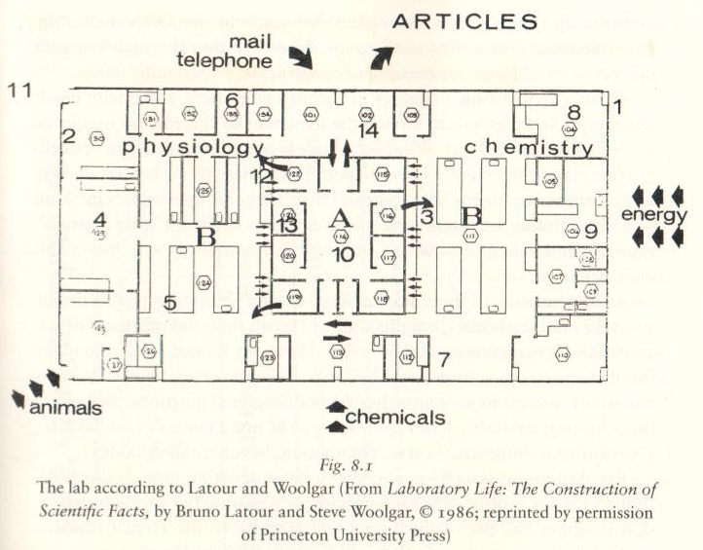
Laboratory Life
Inputs:
Animals,
chemicals,
energy,
Mails, telephones
Reams of blank papers
Output:
Small printed pieces of papers: journal articles and technical reports

Slide 83
Naturalism, PoS
Foundationalism: PoS should be done from an external and more secure standpoint
  The description of knowledge and science cannot be more accurate than scientific theory itself
Naturalism: PoS can use results from science, not only logic in PoS, to help answer philosophical questions and even in philosophy of science itself
    Criticisms: circular?
Epistemology Naturalized (Quine, 1969): Psychology will eventually give a purely scientific description of how beliefs are formed and how they change, i.e. epistemology
  Epistemology is not judged by truth but psychology!
  Against psychology=>biology=>chemistry=>physics
  Project of trying to give general philosophical foundations for science is always doomed to fail
  Philosophical foundation is not needed for science in any case
Normative naturalism: PoS involves a value judgment, “is” vs “should be”
Instrumentally rational: PoS is only about how to achieve a goal but not what that goal is or whether the goal is good, goal oriented
They question: Can observation be trusted (against empiricism)?
  When science becomes complicated, many scientific understandings are not intuitive, and
  Observations often are not direct, but based on some theories (theory-ladenness)
  An observational result can be interpreted differently (hundred explanations)
  Observations are often “guided” by theories (what and where to look)
  Observers can be biased because of previous experience (reviewer will remove most of it)
  Illusions (low-level sets of assumptions about e.g. 2-D projection of 3-D nature of space, not high-level scientific theories
They conclude: traditional empiricist views of roles of observation in science are flawed
Simple falsificationism does not work in science judgments

Slide 84
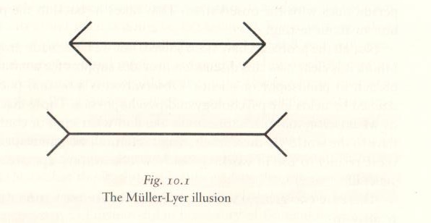

Slide 85
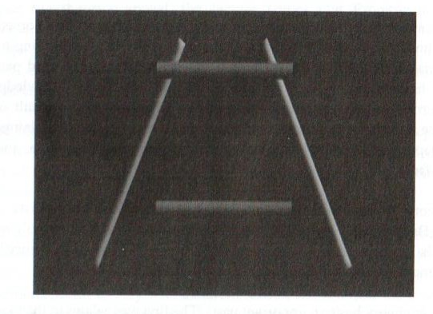

Slide 86
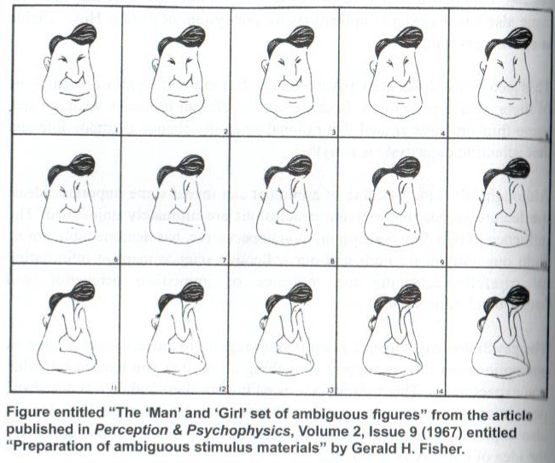

Slide 87
Naturalism, cont. 1
(My comments) Most problems above against empiricism can be resolved among scientists in review processes
  “Armchair speculations” by outsiders who do not understand how science is regulated
  New successful scientific theories, new technologies, new inventions prove the system works
  Underestimate the urge and courage scientists search for truth, (short-time irregularities: nutrition guideline)
  PoS should not have focused too much on the “linguistic” level,
    a fact or a correlation does not depend on how you call it.
    if a theory depends critically on choice of word, the scientist is considered deceitful
To answer the epistemology question: what is the relationship between the common-sense knowledge and scientific description of our real contact with the world
  “Philosopher patrols relationship between adjacent sciences and occasionally climbing into a helicopter to get a synoptic view of how pieces fit together”
  (me) This used to be true, but based on the work described in the book, they have done a poor job (Copernicus, Newton
  Sciences have become too complicated and intertwined for philosophers to understand
  It is done now by scientific leaders (any philosopher in national science council/board?)
Better questions to ask
  To what extent is observation a reliable way of forming true beliefs?
  when is observation using ordinary human senses reliable and when is not?
  Is observation neutral between competing theories of the kind we wish to test in science?
  Can people with very different theoretical commitments agree about what has been observed?

Slide 88
Naturalism, cont. 2
A theory proposed by a Naturalist of philosophy (the author of the book, a new empiricism)
  Begin based on current best scientific knowledge, do not try to justify outside of science,
  Ask traditional philosophical questions, e.g. nature of belief, justification, and knowledge
  Science is used as a source for settling philosophical questions, not as a replacement for philosophy
  Philosophy serves a useful role of an incubator for novel ideas, and benefits from the open-ended agenda
  Observation is a form of physical contact between our minds and the world
  Because we are limited by our ability to contact the world, without science, our observation can only cover a very small range
  Science is an attempt to exploit this limited contact between our mind and the world
The theory does not tell much other than a logical relationship between science, observation, and philosophy

Slide 89
Science as a Process
David Hull, Prof, Northwestern, author of (1988) Science as a Process
  Scientists are driven by two basic human motivations: curiosity and individual recognition (different level of importance, scientists are not rewarded well)
  Fundamental relationship among scientists are balanced between cooperation and competition (depending on the scope of the project, large one cannot be do by simple competition)
  Reward is recognition of “first” or “to use”, but latter more important
  Measure for “use”=> citations
    H-index
    PR,
    Citation is reciprocal=> tread favor, networking
  Review/referee:
    Assumption: no one has the time to do much of replication and checking! (wrong: more important are the ideas shown in the work)
    You either check whether your previous work can derive the same results so that you can ask the authors to cite your work, or
    You seriously examine the results if your results are discredited or made less important
  Fraud is more serious than theft, as the latter hurts only one person (low cost?)
  No need for self-criticizing, referees will do for you (your reputation?)
  Science evolves in a similar manner to an evolutionary biology process
    Darwinian variation and selection (when I used Darwinian: no single scientist can decide a theory is right or wrong)
    Science ideas are replicated similar to genes
    The truth is determined by the fastest replicating ideas/publications (mosquitos are a better fit than human according to this logic)
Can we trust the results from science process? (wrong starting point, deductive)

Slide 90
Scientific Realism
The concern is about the relationship between science and reality (not about truth)
Common-sense Realism: we all live in a common reality that is independent of how we think about it, as we may think about it differently
Scientific realism: the world as described by science is the real world=> no miracle
  because the success of scientific theories means they are related to truth/reality even if the current description is not accurate,
  But more unsuccessful theories, are they reality before being falsified?
  Some successful theories are wrong/not reality (Carnot, caloric theory
  What about speculative ideas? (is a black hole, or an electron, or a quark, a reality?
  we do not have sense or common-sense of each)
  Is a scientific realist a common-sense realist?
  Common-sense realism is often wrong: earth is flat, sun moves around the earth
Redefining common-sense realism (to naturalized one) or refine “reality” to include something that might later find false by science. (knowledge: collectively, presently
Current debates in scientific realism
  Optimistic scientific realism: thinks we can be confident that science is succeeding in uncovering the basic structure of the world and how it works
  Pessimistic: more cautious or slightly skeptical
  The confidence we have in basic physics is the assumption that low-level structural features of the world has been captured reliably by our models and equations (mostly deductive)
  But we have not found powerful mathematical formalisms in other fields, e.g. biology, psycho
  Because fundamental ideas have changed so often in science—especially in physics– we should expect our current view to be wrong!, pessimistic
  The issue is about the right level of optimism in well-established theories.
Only Popper and many naturalists in favor of realism, but Kuhn, sociologists not

Slide 91
Challenges to Scientific Realism
From Traditional empiricism
  Limited sensory evidence is not good enough for us to have access to real world, reality of external world is a meaningless concept
  Relation between science and reality is a meaningless discussion
  Under-determination of theory by evidence: there is a range of alternative theories compatible with all our possible evidence.
  Truth cannot be determined by observational data, because scientists can make data more like theory
From Metaphysical constructivism: world is created or constructed by scientific theorizing (Laboratory life, grue)
  The phenomenal world is knowable, but it is partly our creation. It does not exist independently of the structure of our minds
  People have different minds so that there is no common-sense reality
From Instrumentalism: (antirealism)
  scientific theories are devices for helping us deal with experience (observable parts of the world), do not need to worry about whether they truly describe reality
  All we need for an acceptable theory are: (there is no reality among them!)
    The theory is empirically adequate, explain all phenomena within domain, both observable and unobservable.
    Use of the concepts/pictures provided by the theory can go beyond the domain when trying to extend and refine the theory
    detectable vs. observable, unobservable/undetectable vs. unobserved/undetected

Slide 92
Explanation
Explanation, proof (confirmation), prediction, forecast
  Proof: is often when believing a scientific theory being true but in the process of proving
  Explanation: we have to assume we have chosen the theory at least for now,
  Sometimes the two may affect each other
  Explanation vs prediction, happened vs not happened yet
  We have known the problem associated with “explanatory inference” (a hundred of explanations, symptom vs. illness).
  We have to narrow the number of candidates
  Types of explanations: particular event vs general phenomena/pattern/regularities
  Covering Law Theory of Explanation: to explain using logical arguments with a law
  “Why X? because Y”. (X: explanandum, Y: explanans)
    Y must be independently verifiable and is used as premise, X is conclusion
    A good explanation requires: (a) a good logical argument, (b) at least one statement of law of nature, (c) the law has to contribute to the argument
    Covering law theory allows non-deductive arguments, but what qualifies as a law?
  Comparing with “if P, then Q”, Y=>P, X=>Q, and recall,
    P is true=>Q is true, valid, deductive;
    Q is true =>P is true, not valid, abductive
  Covering law theory is fundamentally flawed: uniqueness! (why headache, because drunk)
  More difficulties with explaining patterns than with explaining a particular event
  In covering law theory, explanation equals prediction
Asymmetry problem, flagpole and the shadow
  when sun direction is known, one is able to derive either flagpole height or shadow length from the other
  Which “causes” which? We know the pole causes shadow not vice versa.
  Covering law theory fails as it uses the word “because”.

Slide 93
Alternatives to Covering Law Theory
Causation theory: explanation is about how it is caused, (causation is a not a law)
  Causation is suspicious to empiricists, e.g Hume, dog and bell, birth control pill, drawn, Carnot- caloric theory
  what is causation? Is it some sort hidden connection between things?
  Causation is a suspicious metaphysical concept which cannot be used in PoS although it can be used in philosophy: caused by God? But what causes God?
Unification theory: explanation in science is to connect a diverse set of facts under a set of basic patterns and principles: use familiar to explain unfamiliar (Newton’s law explains planetary motions, free-fall, then other things
Pluralism: it is a mistake to think a single type of relation can explain everything
My theory:
  Results base on deductive reasoning have causal relation (Newton’s law, light wave)
  Results based on inductive reasoning, if timing information is not included in the study, either can be the cause of the other, even with time information, it can be false, (dog and bell)
  Causal relation has to be connected not circularly in time, e.g. the time delay determined by propagation speed, e.g. speed of light for shadow, acceleration time, e.g., applying a force on a body, its position changes=> force cause motion, rumor
  When observations are not connected as time consequence, e.g. statistics, their causal relations cannot be determined and should not be assumed known
  In the flagpole problem, there are two variables, pole height and sun direction angle.
    When pole height is fixed, shadow length is a function of sun angle only.
    When the angle is given, the two quantities are connected by sun angle, no causal
  If pole height does not change, (it could: a fan of piles), the shadow length is determined by sunlight angle alone. (This is how the causal relation can be tested.)

Slide 94
Problems with Inductive Reasoning
  There are often or always exceptions (black swans/non black ravens)
  Two related observations may be unrelated (accidental)
  Correlation study, if time information is not included, cannot determine the causal relation between two correlated quantities (in science, assuming either as the cause of the other is valid)
  Interpretation inherently uncertain: a single correlation can draw many different interpretations/conclusions, some of them can be inconclusive or totally wrong (tattoo vs GI driving accident: preference for bodily risk)
  Multi-variance correlation analyses: the variables have to be independent, i.e. orthogonal. Confounding variables are a major problem in statistical studies. (race)
  Using confounding variables in studies has been, debatably, abused in some sub-branches of social, medical and behavioral sciences. (double blind test, vitamin recommendations)
  Reliabilism. Henry and the Barn façades. In science, research often starts with a case study and is followed by a statistical study. This method is falsifiable according to reliabilism.
Notes:
Inductive reasoning is known to be flawed, depending on how and what conclusion to draw from.
An example: correlation between the number of tattoos on a GI and driving accident rate during WWII. Because it is clear that tattoos cannot cause accidents and vice versa, behavioral scientists found an explanation: preference for bodily risk. Based on an argument that the GIs who takes bodily risk of tattooing process (at that time tattooing was very painful), he/she is more likely to risk his/her body for an accident which can also be very painful, a flawed conclusion. Although the two share the same effect, bodily pain, one is planned (which can be considered preference) and the other is not. In fact the driver often assumes he/she could make it and not get an accident. Few people would prefer an accident because he/she can take pain of the accident, or to calculate whether the pain is within the range of his/her bodily toleration when running into it. It is more likely an tendency of showing off and hungering for attention.
In social science, confounding variable analyses are wide spread. For example, using race as an independent variable to analyze many different phenomena for which Income, education, religion, cultural background should have been used.
In contrast, race is not allowed in most double-blind tests in medicine development because of racial discrimination: politics interferes science if medical science is a science.
Medical science is another example: just look at the periodical contradicting recommendations for vitamins.
Henry and Barn facades: henry driving through a district filled with barns. He checked one of them and drew a conclusion: these are all barns, but actually the rest are pictures of barns.

Slide 95
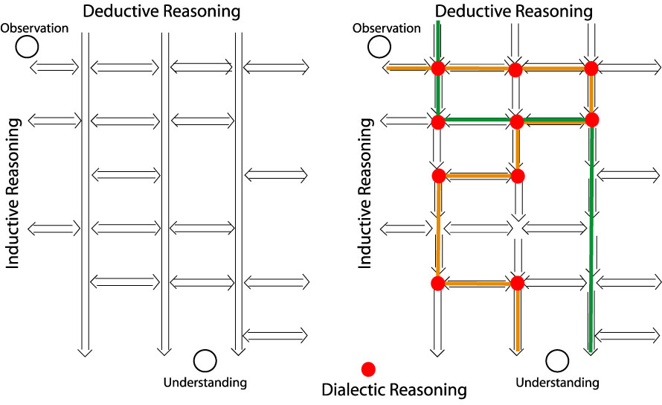
Scientific Reasoning Process

Slide 96
When You Are Challenging Authority/Convention
Do not assume you are smarter and more creative than them
After you finish your proof, jump out from the details to examine your work from the philosophical level
Sanity check: after deriving an exciting result,
  Why have people not found it? Why not?
  Can it be used in elsewhere? If yes, why have those fields not invented it?
Use a single sentence to explain why other people did not think this way but you did:
  New knowledge (often from other fields)
  New observations (could be for other phenomena, but you made connection --blind persons feel an elephant
  If the reason is other than the two: be extremely careful!
Answer three questions:
  What is new? (in less than three sentences)
  So what?
  Who care?
Total number of pieces of information >= total number of answers (cannot explain more
  If no new information is introduced, no new unknown can be derived
  If a new unknown is derived, an additional measurement/assumption must have been made.
  The condition and validity of the new assumption have to be examined.
Follow rigorous science reasoning among the three ways, being able to identify which way
Carefully examine every critical point to see other possibilities: most important

Slide 97
When You Are Challenging Authority, cont.
Types of acceptable proof (depending on convention of a field)
  Mathematics (with evidence for all assumptions/approximations)
  Observations (evidence from a figure has to be obvious to most untrained eyes)
  Citations: citations alone are difficult to prove a new idea/understanding
Possible proof: simulations
  Remember that simulation may bring in leakage and contamination
  Numerical code and models have to be validated independently with observational verifications under similar conditions.
  Often used to reduce the uncertainty/ambiguity and constrain the interpretations but not direct proof
Unacceptable proof:
  a large number of hand-waving physical arguments/assumptions (conjectures) without substantiation from the above 3 acceptable types. (Hand-waving arguments are useful after showing proof but are not usually considered as a proof.
  standing-alone neural network/artificial intelligent simulations as they usually do not provide understanding of the problem although they may make good predictions. (better for engineering and not for science)

Slide 98
Summary
We started with two main questions
  How to get it right?
  How to know I am not wrong?
As a scientist, you have to
  be able to question the existing ideas/theories => be critical to/falsify others’ ideas
  look for new possible answers to the problem => your new ideas/creativity (no formula for this)
  question yourself: falsify yourself => this is much harder
  There is no formula or template in this process (no scientific methods but to learn the communication method => reasoning)
In the process, your Belief can undergo constant changes or refinement.
Sometimes, the final belief can be just opposite to the original belief.
More experience can be gained in the process by deep thinking/asking deeper/simpler questions (these are philosophical questions, not technical ones)
Want to be a good scientist?--Personality effects:
  Deep vs superficial
  Stubborn vs flexible
  Broad and systematic vs penetrating
  Open and Resourceful vs closed
Popper once said: good or great scientists are
  able to come up with imaginative, creative, and risky ideas, and
  with hard-headed willingness to subject these imaginative ideas to rigorous critical testing
Notes:
No formula because, as to be discussed later, there is no single method that gives you an unfalsifiable justification on everything.
The personality effects are based on my observations
Scientists want to be deep and not superficial.
A scientist does not want to be extremely stubborn or flexible.
However there is a correlation between being flexible and being superficial based on my observations
Science is a very serious enterprise because it is built upon hard work by hundred generations of extremely intelligent people. Being too flexible often leads to superficial works.
I often refer “broad and systematic” intelligent people who are less capable of penetrating deep to as scholars. Those with penetration capability are scientists. We want to be strong in both instead of in the middle.
Open and resourceful is extremely important in scientific research. For example, using a simple computer program can take a lot of time, but there are a lot colleagues around you know how to use it.

Slide 99
Feminism Epistemology
Bacon: knowledge is power => knowledge controls nature.
Bacon’s model of knowledge: the relation between mind and nature is the model of marriage, a marriage between the knowledge (man) and nature (women).
Evolutionary biological?
Cultural? this has been interpreted as a reason why fewer scientists are female. Clearly this is not universal: USSR after WWII
And/or historical? General education for women started not long ago
Feminism epistemology
  Spontaneous feminist empiricism: using a feminist point of view to criticize biases in scientific works, but not challenging the traditional ideals
  Philosophical feminist empiricism: revise and improve traditional ideas about science and knowledge
  Standpoint epistemology: the “situatedness” of an investigator (physical nature, location, status in the world) affects the facts being seen
  Question: “is it really true that men and women in modern western societies have different perspectives of a kind that the is relevant to science?”
  “whether the experience and viewpoint of women is systematically different from that of men in a way that is likely to matter to science disputes?”
Some suggest that women, on the whole, more prefer cooperation to competition => a better manager of science

Slide 100
Philosophy of Science
Philosophy of science: investigation of philosophical questions that arise from reflecting on science
  Questions cannot be specific to a subfield of science
  Answers cannot be only specifically for only a subfield
  A new subfield of philosophy started by positivism (1920-60) that separates science from metaphysics
  Not to provide prescription for conducting science
The central questions concern how to gain knowledge, while not be fooled (by others as well as by ourselves)?
  concerned with the foundations, methods, and implications of science.
  what qualifies as science, the reliability of scientific theories, relationship between science and truth, and the ultimate purpose of science.
Two systematic ways to gain knowledge
  Observations (including experiments: planned and controlled)
  Conceptualization
Reasoning is needed to link the two and within each
Notes:
For scientific research we are often only able to prove “most” real, not knowledge yet, but close. Knowledge eventually be a collection of many such proofs.
A scientist should equally emphasize both observation and conceptualization. Physics is based on observations/experiments.
If theory is inconsistent with observations, the observation has an upper hand. All physicists should be absolutely firm on this.
Conceptualization is the one that lead to understanding and can guide new observational tests, e.g. without conceptualization, there is no understanding.
Reasoning concerns how we derive our knowledge, i.e. our methods of scientific justification.
Parsimony: spareness. Razor: to shave away unnecessary assumptions or cutting apart two similar conclusions.
One way to argue for the rule is the probability. Each assumption has a probability to be true and the total probability is multiplication of these probabilities.
The simplicity is an “argument” to me, sometimes referred to as a “rule”, not a law in scientific research, because a counter argument could be a single assumption of existence of a god that can explain everything.
An example, When studying the motion of planets, one can base on the universal law of gravitation to write the momentum equation for each planet.
The law and the momentum equations are independent of frame of reference, and can be in either a frame rest with sun or earth.
Therefore, it is possible to study the motion of the planets in a geocentric or heliocentric description.
We like heliocentric description better (note this is a “choice”) because it is simpler (although the number of assumptions are the same), but this choice does not say earth centric is wrong as it also describes the motion correctly. Of course, historically, Copernicus heliocentric theory was not justified based on the Occam’s razor.
Another example is the BV and EJ paradigms in M-I coupling. In theory EJ and BV are two equivalent descriptions of MHD systems. But Parker has shown that the EJ paradigm is not mathematically trackable while BV is.

Slide 101
Types of Scientific Research
Several observations but no scientific paradigm to connect and explain them, propose new laws: free-fall, Kepler, Newton
Several observations contradict the existing paradigm, special relativity
There is a known scientific paradigm, but to explain some regularly observed properties or abnormal observations, discovery of the Neptune from Uranus orbital deviation
An observation or several observations that may or may not be related: there may or may not be laws to govern them but definitely not in straightforward ways-- do not know how to understand or interpret (not to challenge the existing laws, paradigm)
To develop an explanation for an observation or several observations based on some known laws to govern them in straight ways-- (not to challenge the existing laws, paradigm)
There exist several piecemeal theories, but want a unifying theory
Based on existing theories to develop new techniques/instruments
Derived a new idea, but want to use it in other settings or problems
Conducting systematic experiments to understand a phenomenon under some vague guidance of ideas
Collecting information about a phenomenon with some vague controlling factors.
A theory has to be able to handle all possible activities above. Conclusions:
  A universal method does not work
  Science is in public domain– communication—how scientists communicate?
  Scientists communicate according to reasoning!

Slide 102
Stephen Hawking
A theory exists only in our mind and does not have any other reality requirements.
A theory is good if
  It must accurately describe a large class of observations on the basis of a model that contains only a few arbitrary elements
  It must make definite predictions about the results of future observations.
  Any physical theory is provisional, a hypothesis. You can never prove it, you can show observations agree with it. But you can disprove it with a single observation

Slide 103
Laplace’s dream of a theory of science
Deterministic: “there is a set of scientific laws that allow us to predict everything that would happen in the universe if only we know the complete state of the universe at one time” (Hawking)
But time-space uncertainty principle makes it impossible
Observations cannot disturb the system.
Hawking call Occam’s razor “principle of economy”.
To determine everything at one time is too expensive and impossible even without the limit of uncertainty principle.
Einstein: “God does not play dice”

Slide 104
What Do We Learn in This Course
Philosophy of science: investigation of philosophical questions that arise from reflecting on science
  Cannot be questions specific to a subfield of science
  Answers cannot be only specifically for only a subfield
What is science?
What is knowledge?
How to gain knowledge, while not be fooled (by others as well as by ourselves)?
What is scientific research?
Can we generalize a single observation to a lot of things?
Can we generalize things we can observe to somethings that we cannot observed?
Who is a scientist? Can I be one?
When I am making a new scientific discovery, how do I know I am not wrong?

