Slide 1
科学家谈科学哲学
宋普
空间科学实验室和物理系
麻省大学洛厄尔分校
致谢: Vytenis Vasyliunas
哲学、知识、真理、信念、验证
科学哲学、科学研究、证伪
科学推理：演绎、归纳、辩证、奥卡姆的剃刀
向权威挑战！
Notes:
This may be to first talk of this nature, by a space scientist, definitely in UML and possibly in all space science community.
philosophy has been my love since my teenage.
Scientists usually do not think philosophy is related to their research
However when you are challenging an existing theories and understanding, I hope you have to constantly examine and reexamine whether you are doing right.
Often during these self-examinations, you can neglect the details as to why you are right and why the existing understanding is flawed.
Eventually these self-examinations often lead to questions of philosophy of science: why are you doing this? what is your evidence, what is your conclusion, and how do you test it? What are the alternatives?
When working with Vasyliunas, some of these questions become more pronounced. We spent much time to discuss philosophy: can we prove our ideas in simple terms?
Some of the terms used may mean different things to different people with different background and orientation. But in my talk they do not mean anything related to religions. And some terms in philosophy are different from those in everyday life.
This may not applicable to less rigorous fields

Slide 2
哲学（Philosophy）
(美国互联网)哲学: 热爱智慧的。研究关于存在、知识、价值、理性、思想、语言等一般问题和根本问题
(百度) 是世界观和方法论的统一
希腊语: Sophia: 智慧 （wisdom)，Sophist: 智者 （欠债不还）
(我所学和理解）哲学（Philosophy):热爱智慧的(love of wisdom)
  我不是智者，我只是喜欢智慧
  不打算回答具体实际问题
  只寻找 ”如何做才能对" 的可能性和方法
  什么是“对”并不重要, 虽然 ”对" 有时可能意味着对自己不利
第一个哲学家: 泰雷兹 (Thales, 624-546 公元前) 和毕达哥拉斯 (570-495 公元前)
最有影响的哲学家: 苏格拉底、柏拉图、亚里士多德
“The unexamined life is not worth living”
在其他文明, 如印度和中国, 哲学也在相近的时间开始发展
我讨论的哲学仅限于西方哲学, 因为它比较有系统地表述我们当今通用的逻辑思维体系
Notes:
释迦牟尼（梵語：शाक्यमुनि，Śākyamuni，意為「釋迦族之聖者」），姓喬達摩，名悉達多（約公元前566年-公元前486年，巴利語：Siddhāttha Gotama；梵語：सिद्धार्थ गौतम, Siddhārtha Gautama），古印度著名思想家，佛教創始人，尊稱释迦牟尼佛，出生於今尼泊爾南部。
Socrates 470-399BC, Confucius 557-479BC
Before philosophy was developed, there was Sophia: wisdom. Sophist: wise man.
Iran and Egypt, although older civilizations, did not seem to have major philosophers before they obtained Greek philosophy
The unexamined life is not worth living
They were today’s teachers: why they had to self-claim to be wise man: to get students who pay tuitions.
Philosophy was a different “practice”. They did not claim to be wise, but pursuing wisdom.
If you look at what philosophy has been often arguing about, too much is about “I am right or I am a wise man’, other than how to get it right.
Thales is the one everyone attribute to as the first philosopher and Pythagoras was the one who first claim to be a philosopher
Pythagoras who, 580-500BC, discovered the musical scale, musical harmonies, and Pythagorean theorem of right-angle triangle,
These people did not claim to be wise, but “love” to be wise. This is not about knowledge but about how to get knowledge.
Socrates was one of the most influential philosopher
Plato and Aristotle systemized and further developed the many key ideas of Socrates.
One can say these three men popularized concept of philosophy.

Slide 3
哲学 （继续）
哲学家(Philosopher)与智者 (Sophist) 的学说的中心差异是哲学方法: 称为苏格拉底式(Socratic), 或辩证 (dialectical) 的，探究方法 (学美德)。
  不是关于一个研究主题，而是如何看问题
  不是关于一个特定观点或谁是正确的
  是批判、自我批判
中国和印度发展的哲学也采用了同样的方法
哲学大约包含三大问题
  知识（knowledge）问题: 如何可以获得知识？
  行为（conduct）问题: 什么是正确/错误, 好/坏, 美丽/丑陋？
  治理（governance）问题: 政府的最佳形式是什么？
这三个问题的顺序与社会文明发展步伐相关
科学家主要关心讨论知识问题
Notes:
Socrates was the most influential person in developing the method of critical inquiry.
Some virtues cannot be teach in classroom such as 勇敢. 节制，慷慨，大气，高尚，有志向，礼，诚实，智，友爱，公正。 没有：容忍，热情，信仰，知耻
Meno became a traitor, be executed by Persia’s king.
He claimed that he was a gadfly, possessed no wisdom but to pursue it. he challenged effectively many sophists in his time.
Knowledge is deterministic, against it often leads to death.
Here we are interested in how to get it right but not specific on exactly what knowledge is about.
Conduct: when you have choices. Personal taste, judgement/bias can be involved, your action may affect others.
Governance becomes an issue when a lot of people living closely and sharing some resources

Slide 4
知识 （Knowledge）
三种知识的类型:
  知识--那 (knowledge—that): 事实 （历史，地理，，，）
  知识—怎样(knowledge—how): 技能 (包括算数技能）
  知识--理解 (knowledge—understanding): 例如：数学应用题，与科学有关
  一些知识可以容易地测试它的真伪性, 但有些不能，特别是“理解”
知识--理解 会错误吗？如何知道“理解”不是错的？
真理 (Truth，真，真实): 客观外在的、不能是虚假的(不用被检验）
信念 (Belief): 主观的，（需要被检验）
    信念可以改变, 对科学家来说很重要。
验证(Justification): 证明信念与真理相符的过程
  验证可能，也可能根本不，与待证的真理相关
  验证也取决于个人的经验、方法、环境条件
  验证可能包括缺陷, 或者可能被证伪
知识(knowledge): 经受长时间大范围验证为真实的信念的集合
Notes:
My classification of knowledge may be different from that of many philosophers, e.g. Some of them consider knowledge-how as knowledge-understanding and the third knowledge as knowledge of a person.
2nd point in Belief: here I am against a view popular in the US high school teaching that science starts with a hypothesis.
Very often you just curious about something and have no hypothesis.

Slide 5
科学哲学 （Philosophy of Science）
研究科学的基础、方法、含义本性、科学理论的结构、科学解释、科学检验、科学观察与理论的关系、科学理论的选择等
认识论 （Epistemology=theory of knowledge=知识哲学)
什么是最真实的？(知识是最真实信念的集合，最接近真理)
获取知识的两种系统方法
  观测 observations (包括实验: 有计划有控制的)
  概念化 conceptualization（理论）
  如果理论与观测不一致,观测本身是真实的 (truth)，对观测的解释可错
  证伪：是用反证据和推理来证明一个想法或信念是错的
知识: 经受了证伪 (falsification)过程后验证为真实的信念的集合
  证实通常比较容易, 例如一个想法可以用罕见的事例证实(弗洛伊德的精神分析理论)
  知识是主观的，是当前最能反映真理的信念, 不是真理本身, 真理是客观的
  知识是迄今能够经得起证伪过程的考验（Unfalsifiable）的信念
  知识今后可能被证伪，随着历史发展知识可以不断更新
  这种定义下的知识与验证过程可能会有一个时间延迟（这对科学家很重要）
Notes:
For scientific research we are often only able to prove “most” real, not knowledge yet, but close. Knowledge eventually be a collection of many such proofs.
A scientist should equally emphasize both observation and conceptualization. Physics is based on observations/experiments.
If theory is inconsistent with observations, the observation has an upper hand. All physicists should be absolutely firm on this.
Conceptualization is the one that lead to understanding and can guide new observational tests, e.g. without conceptualization, there is no understanding.
Reasoning concerns how we derive our knowledge, i.e. our methods of scientific justification.
Parsimony: spareness. Razor: to shave away unnecessary assumptions or cutting apart two similar conclusions.
One way to argue for the rule is the probability. Each assumption has a probability to be true and the total probability is multiplication of these probabilities.
The simplicity is an “argument” to me, sometimes referred to as a “rule”, not a law in scientific research, because a counter argument could be a single assumption of existence of a god that can explain everything.
An example, When studying the motion of planets, one can base on the universal law of gravitation to write the momentum equation for each planet.
The law and the momentum equations are independent of frame of reference, and can be in either a frame rest with sun or earth.
Therefore, it is possible to study the motion of the planets in a geocentric or heliocentric description.
We like heliocentric description better (note this is a “choice”) because it is simpler (although the number of assumptions are the same), but this choice does not say earth centric is wrong as it also describes the motion correctly. Of course, historically, Copernicus heliocentric theory was not justified based on the Occam’s razor.
Another example is the BV and EJ paradigms in M-I coupling. In theory EJ and BV are two equivalent descriptions of MHD systems. But Parker has shown that the EJ paradigm is not mathematically trackable while BV is.

Slide 6
科学研究 （Scientific Research）
  科学家通常是对一些相关性 (可能是间接的，可以是自然或智力的) 的观察产生好奇心 : 为什么会这样，而不是其他样？(下落的苹果)
  一些好奇心会成长为信念, 然后科学家想要验证 自己的信念是真实的
  科学家用证据和推理来测试或验证自己的信念， 其他科学家可能有不同的想法或信念, 他们会用反证据和推理想证伪新的想法或信念
  改进你的证明方法、精度和确定性，理解你的信念所适用的具体条件
  只有当一个验证能经住这些证伪的测试，它才是成功的（文章发表）
  成功的验证需要更长的时间才能最终成为社会的知识
  通常一个知识的形成需要一些成功的验证为真的信念 （单一成功的验证一般不会成为“知识”）
  科学研究: 是验证“个人信念”, 使之成为我们知识的一部分的过程
    在这个过程中, 信念可以经历不断的变化或细化，有时候, 最终的信念可能与最初的信念相反。
    任何新的想法都会受到严格的审查/证伪,你的理由要能说服审稿人或科学界，
    所以，你既要进行正面的证明，又要抵御来自他人的证伪
Notes:
For example, one notes that apples fall from the tree to the ground. Without curiosity, this is “knowledge-that”. Curiosity can drive the person to wonder whether other things fall as well. if the person stops here, his/her “knowledge-that” becomes broader when he/she notes other things also fall to the ground, but is still not “understanding”. Until this person develops a personal belief, for example, there is a “love” between objects and the ground and he/she wants to prove his/her belief. This is what we say he/she starts a scientific research, for example on what is the love, how strong is the love (one can catch the apple to prevent it from falling to the ground) and what determines the love. Newton gave a particular type of the love a new name: the gravity and justified it in a form of law of universal gravitation with planetary orbits as well as falling objects.

Slide 7
科学推理 (Scientific Reasoning)
科学推理提供观测与理解之间及每个内部的联系
  科学家的主要工作
科学推理: 三种方法 + 一把剃刀
  演绎推理: 线性推理从 A = >> B = >> C..., 形式逻辑, 例如数学
  归纳推理: 或称综合推理，由有限观测推广到无限
  辩证推理: 假设 A 是正确的, C 就是正确的。但如果 C 与已知的事实发生冲突, 所以A有误–被证伪; 从所有可能的观点/假设中尝试而发现错误的方法
  奥卡姆的剃刀 (Occam’s razor,哲学中的简约定律) : 当有两个或多个等价结论时, 最简单的一个或假设最少的一个被选择为 "正确"。 (地心 vs 日心说)
Notes:
For scientific research we are often only able to prove “most” real, not knowledge yet, but close. Knowledge eventually be a collection of many such proofs.
A scientist should equally emphasize both observation and conceptualization. Physics is based on observations/experiments.
If theory is inconsistent with observations, the observation has an upper hand. All physicists should be absolutely firm on this.
Conceptualization is the one that lead to understanding and can guide new observational tests, e.g. without conceptualization, there is no understanding.
Reasoning concerns how we derive our knowledge, i.e. our methods of scientific justification.
Parsimony: spareness. Razor: to shave away unnecessary assumptions or cutting apart two similar conclusions.
One way to argue for the rule is the probability. Each assumption has a probability to be true and the total probability is multiplication of these probabilities.
The simplicity is an “argument” to me, sometimes referred to as a “rule”, not a law in scientific research, because a counter argument could be a single assumption of existence of a god that can explain everything.
An example, When studying the motion of planets, one can base on the universal law of gravitation to write the momentum equation for each planet.
The law and the momentum equations are independent of frame of reference, and can be in either a frame rest with sun or earth.
Therefore, it is possible to study the motion of the planets in a geocentric or heliocentric description.
We like heliocentric description better (note this is a “choice”) because it is simpler (although the number of assumptions are the same), but this choice does not say earth centric is wrong as it also describes the motion correctly. Of course, historically, Copernicus heliocentric theory was not justified based on the Occam’s razor.
Another example is the BV and EJ paradigms in M-I coupling. In theory EJ and BV are two equivalent descriptions of MHD systems. But Parker has shown that the EJ paradigm is not mathematically trackable while BV is.

Slide 8
演绎推理 （Deductive Reasoning）
基于一般知识得出对特定问题的理解
它是具有“决定性”（deterministic）的正向（forward）推理, （像一个管子，进去的对，出来的就对）
在数学中, A = >> Z 可以是一个很长的推演， (100页)
科学应用中关注的问题:
  如果演绎推理过程不是严格的数学，管道的密封性可能值得怀疑
  在某些步骤中（管道接口）可能会有额外的近似
  合理的可能性：会不会在某步中漏掉--渗漏？
  错误的可能性：会不会在某步中被引入--污染？
  推理能否最终达到起点--自循环 （逻辑错误）？
Notes:
Deductive reasoning is like a pipe. You put something into the input end, the output end is right. if the output is not right, you put in wrong things.
If the reasoning starts with “if A…” it is already a dialectic, not a deductive.
The problem in science is that there are many connections in this pipe.
Often, approximations are made during the mathematical derivation. Different approximations lead to different results.

Slide 9
演绎推理 （Deductive Reasoning）继续,
演绎推理存在的问题:
  演绎推理本身不能提供一个出发点。 推理不能倒推。(等式的解答)
  没有一个合理的起点, 演绎推理是 “无限退行的”，人们可以质疑起点：(苏格拉底是个凡人 =>>凡人必死=>>苏格拉底必死)
  如果演绎步骤不仅仅是数学, 每个步骤都必须仔细检查
  如果通过数值模拟进行演绎推理,数值模拟方法可能会发生泄漏或污染。问题是, 它们是否会大到足以影响到结论 （取决于什么样的结论）
出发点可以由
  一个 “不言而喻的” 假设
  观测证据, 通常涉及或基于归纳推理
  科学定律：其相关性和适用性必须彻底审查
Notes:
庄子曰：“儵（tiáo）鱼出游从容，是鱼之乐也。”
惠子曰：“子非鱼，安知鱼之乐？”
庄子曰：“子非我，安知我不知鱼之乐？”
惠子曰：“我非子，固不知之矣；子固非鱼也，子之不知鱼之乐，全矣。” Example of not backward, you can forward solve an equation and find a solution, but with that solution alone, you cannot determine what equation has been used. There are a lot of equations that can have the same solution.
Example of regressive: Socrates is mortal: start point is: Socrates is a man. All men are mortal, therefore Socrates is mortal. But how to know Socrates is a man? Born by human, but how to know human gives birth to a man?.... Infinitely regressive.
Example: MHD theory based on Newton’s laws and Maxwell’s equations.

Slide 10
演绎推理 （Deductive Reasoning）继续
物理与数学的关系
  由于数学是独立于物理定律及其数学形式发展起来的, 为什么基于数学演绎得到的解与我们正在研究的问题有关？
  数学演绎过程是否会引入渗漏或污染吗？
  为什么不会？？这是最令我费解的科学哲学问题？
在科学研究中, 如果数学理论解与观测/期望不一致, 我们会质疑所使用的方程式、近似条件、边界条件、初始条件, 而不怀疑数学演绎本身!
有些步骤可能不是纯粹的数学, 而是基于假设，这些假设往往是被仔细审查的对象。
Notes:
Example: MHD theory based on Newton’s laws and Maxwell’s equations.
Why should the correct solutions of these coupled equations be relevant to the phenomenon I am studying?

Slide 11
归纳推理 （Inductive Reasoning ）
(不是关于数学归纳法)
是经验性的: 基于有限的观测, 用以建立我们的知识
可以跨越演绎推理的线索
在科学中, 两种 (或更多) 现象的观测相关性是最常用的方法（中医）
推广这些相关性是基于归纳推理，通常会有两种情况：
  相关性可以理解：追溯到一些合理的期望 (与演绎平行／等效)
  相关性不可理解：这可能导致新知识的发现 （与演绎正交）
用归纳推理得到的与演绎平行／等效的知识通常用于验证和解释演绎推理的结论， 提供相关参数数值
与演绎正交的归纳推理得到的知识通常用于演绎推理中所需假设，和/或简化数学。这种归纳推理在科学研究中更重要

Slide 12
归纳推理 （Inductive Reasoning ）继续
归纳推理存在的问题:
  经常或总有例外 (黑天鹅)
  两个相关的观测可以毫无关系
  相关性研究不能确定两个相关量之间的因果关系 （鸡生蛋）
  内在的不确定: 一个单一的相关性可以得出许多不同的解释/结论, 其中一些可能是没有定论或完全错误的 (纹身 vs GI 驾驶事故: 对身体风险的偏好)
  多变量相关分析: 变量必须是独立的, 即正交的。非独立混杂变量是统计研究中的一个主要问题。（种族)
  在医学、社会和行为 "科学" 的一些分支中, 使用混杂变量 debatably 被滥用。(双盲试验, 维生素推荐)
  可靠性主义（Reliabilism）：亨利和农舍。在某些科学中, 研究常常以案例研究开始, 随后进行统计研究。该方法根据 reliabilism可被证伪
Notes:
Inductive reasoning is known to be flawed, depending on how and what conclusion to draw from.
An example: correlation between the number of tattoos on a GI and driving accident rate during WWII(?). Because it is clear that tattoos cannot cause accidents and vice versa, behavioral scientists found an explanation: preference for bodily risk! Based on an argument that the GIs who takes bodily risk of tattooing process (at that time tattooing was very painful), he/she is more likely to risk his/her body for an accident which can also be very painful, a flawed conclusion. Although the two share the same effect, pain, one is planned (which can be considered preference) and the other is not. In fact the driver often assumes he/she could make it and not get an accident. Few people would prefer an accident because he/she can take pain of the accident, or to calculate whether the pain is within the range of his/her bodily toleration when running into it. It is more likely an tendency of showing off and hungering for attention.
In social science, confounding variable analyses are wide spread. For example, using race as an independent variable to analyze many different phenomena for which Income, education, religion, cultural background should have been used.
In contrast, race is not allowed in most double-blind tests in medicine development because of racial discrimination: politics interferes science if medical science is a science.
Medical science is another example: just look at the periodical contradicting recommendations for vitamins.
Henry and Barn facades: henry driving through a district filled with barns. He checked one of them and drew a conclusion: these are all barns, but actually the rest are pictures of barns.

Slide 13
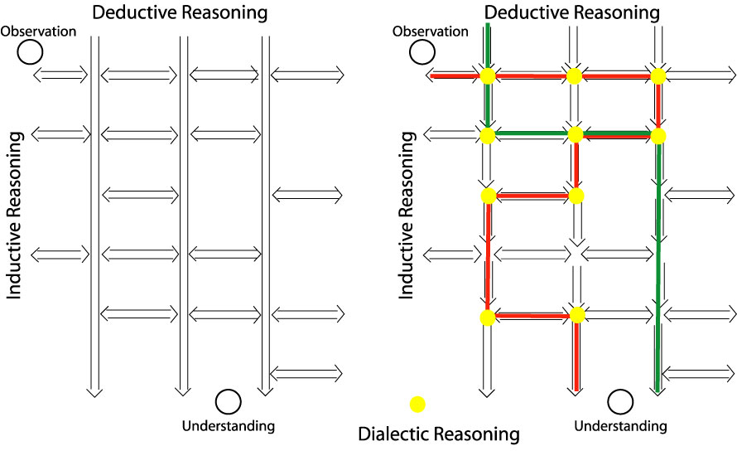
演绎推理
演绎推理
观测
观测
归纳推理
归纳推理
理解
辩证推理
理解

Slide 14
辨证推理 （Dialectical Reasoning ）
它是从多个视角/方向, 基于证伪去除法来检查问题
  从一个或任何合理的但相关的假设来开始推理: 如果...
  然后, 遵循标准的演绎和归纳推理, 直到发现关于这个问题的负结果, 即最初的假设被证伪
  该方法可用于归纳推理或演绎推论中的任何关键连接点
  在辩证推理中, 一个证实的结果并不能解释为一个理由, 因为假设可能不是相关的或有内在的循环, 或者支持证据是一个例外。
  不得不对其他可能的假设可能进行测试
辩证推理是思辨, 而不是吵架

Slide 15
辨证推理 （Dialectical Reasoning, cont.）
辩证推理存在的问题:
  有无数的可能性: 不可被证伪性 （unfalsifiability） 无法被完全测试
  不是“决定性”的（deterministic）。如果做得正确,它可以 确定 什么不可行, 但不确定什么是有效的
  辨证推理不能给一个想法最终的证明，仅能用于证伪
  由于可利用的手段的限制，许多可能性不可能直接地被测试
  演绎和归纳推理过程中的缺陷，可能导致错误的结论
  因为知识是有限的或由于推理过程中错误，有时正确或部分正确的答案可能由于错误的原因而被排除
  如果辩论参与人数较少, 有时会得出错误的结论
  有时, 辩论是徒劳的, 没有提供有用的结论，仅是吵架
  有时, 合成结果并不是每个参与的人都接受
  根据辩证逻辑, 有些人会同时接受正论和对立, 因为 “为什么不呢？”，排除矛盾的法则将会被打破
Notes:
Items starting with “times” refer specific situations and not the situations in general.
The last point refers to the situation when people think both sides of the arguments reasonable and are ready to accept two opposite arguments. In this case dialectic reasoning becomes a sort of game. These are not serious scientists.

Slide 16
科学推理过程：结论
显然, 在三种推理方法中没有一种方法可以保证得到良好的科学结果
对于科学研究, 所有三种推理方法都是必要的: 例如,
  经验观测, 基于归纳推理, 也许要结合演绎推理，才能达到出发点
  演绎推理是必要的，尤其对于理论研究或观测解释/理解
  辩证推理结合演绎和归纳推理, 用于检验结果。
  奥卡姆的剃刀或简约定律可用来裁断优劣
科学结果的审阅过程主要是辩证推理过程。
  为了减少审阅过程中的困难, 科学家需要学会如何质疑自己的想法
  要学会跳过细节从哲学层面整理自己的思路
  学会质疑自己是研究生教育的重要组成部分
  导师，同学和其他科学家是改善和批评意见的最佳来源

Slide 17
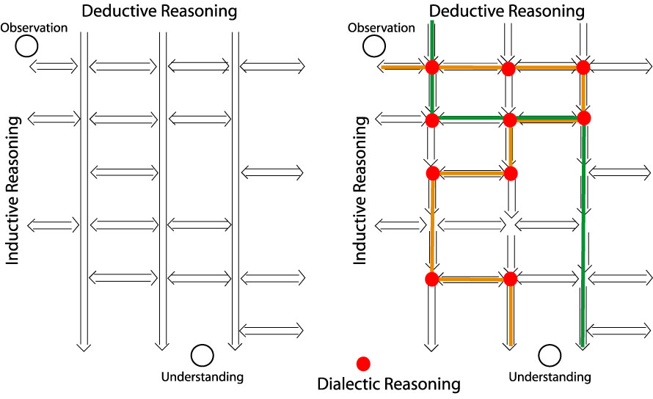
科学推理方法过程
演绎推理
演绎推理
观测
观测
归纳推理
归纳推理
选择结果
理解
辩证推理
理解

Slide 18
当你挑战权威的结果时
不要假设自己比前人都聪明、更有创造力
当完成了新的证明，要跳出证明的细节，从哲学层面审视自己的工作,
回答三个问题：
  什么是新的 (what’s new)？（用少于三句说明）
  那又怎样 (so what)？
  谁会在意呢 (who care)？
一定要能用“一句”简单的话说明为什么别人没想到而自己想到：
  新知识（往往是从其他领域），
  新观测结果 （有可能是对其它的现象：将不同测量结果联系起来，避免盲人摸象）
  如果理由不能用上述二者之一概括，要加倍小心
严格遵守科学推理进行论证 （不要存侥幸心理）
在每个推理关键转折点是否有其他可能性：最重要
Notes:
形而上者谓之道，形而下者谓之器
metaphysics： 超物理科学--形而上学）

Slide 19
科学推理方法过程
演绎推理
演绎推理
观测
观测
归纳推理
归纳推理
选择结果
理解
辩证推理
理解

Slide 20
当你挑战权威的结果时 （继续）
通常可接受的证明类型（与领域通行惯例有关）
  数学 (math)：所有假设、近似都要有明确说明并有证据支持
  观测数据 (observation/data)：相关的证据必须任何人一眼就能看出
  援引 （citations)：仅靠援引很难证明新的想法/理解
可能被接受的证据：计算机模拟 (numerical simulation)，
  记住计算机模拟会有“渗漏”(leakage)“污染”(contamination)
  数值方法和模型必须通过独立观测验证
  多用于减少不确定性/模糊性，限制解释
不可接受的证据：
  大量似是而非的猜测/假设：如果…就怎样…的方法通常仅适用于证伪而不是证实
  独立的神经网络 (neutral network)/人工智能 (artificial intelligence)模拟 ，因为它们通常不能提供对问题的理解(understanding)，尽管他们可能做出很好的预测 (prediction)（多用于工程，而不是科学）

Slide 21
好科学家--人格效应
  深刻 vs 肤浅
  固执 vs 灵活
  知识广博 vs 科研突破能力
  开放和足智多谋 vs 封闭
不要想走捷径，捷径是在回来的路上找到的：当你从哲学层面审视时发现的
Notes:
No formula because, as to be discussed later, there is no single method that gives you an unfalsifiable justification on everything.
The personality effects are based on my observations
Scientists want to be deep and not superficial.
A scientist does not want to be extremely stubborn or flexible.
However there is a correlation between being flexible and being superficial based on my observations
Science is a very serious enterprise because it is built upon hard work by hundred generations of extremely intelligent people. Being too flexible often leads to superficial works.
I often refer “broad and systematic” intelligent people who are less capable of penetrating deep to as scholars. Those with penetration capability are scientists. We want to be strong in both instead of in the middle.
Open and resourceful is extremely important in scientific research. For example, using a simple computer program can take a lot of time, but there are a lot colleagues around you know how to use it.

Slide 22
辨证推理：证伪（Falsification）
结果不能被证伪"Unfalsifiable" 是科学研究中最难的方面
  正当理由和基本真理之间的相关可能被证伪：观测中的简单相关可能是偶然的。
  证据(注意，不是观测本身，而是对观测的解释）可能有缺陷或是间接的
  数据的质量可能不足以支持一个结论要求的水平
  推理可能有缺陷, 特别是在每个关键的连接点上
  方法/精度/条件/概率往往在新知识证明时起决定性作用
  如果最初的信念是真实的，证伪测试往往仅限制了信念的适用范围和条件：科学家不会轻易的放弃自己的信念—固执的重要性
想找出信念适用极限, 往往是科学研究的最重要的问题

