Slide 1
Principles of Global Modeling
Paul Song
Department of Physics, and
Center for Atmospheric Research,
University of Massachusetts Lowell
Introduction
Principles
Example: Northward IMF
Conclusions

Slide 2
Why is Modeling Needed in Space Physics?
“Modeling” is a method to link key physical processes in distant regions according to physical laws: observations and predictions.
Its objective is to provide qualitative physical understanding.
It is in the form of cartoon-type sketches
Computer simulations: field line tracing, streamline tracing, more quantitative.
Simulation is a useful tool for modeling
Can “modeling” be replaced by computer simulations?
Computer simulations: sensitive to boundary conditions and initial conditions, as well as numerical methods about which simulationalists care most.
Field line tracing near reconnection sites: large uncertainty.
Stream line tracing: large uncertainty in regions of large velocity shears.
Can simulation results and their interpretations be trusted unconditionally?

Slide 3
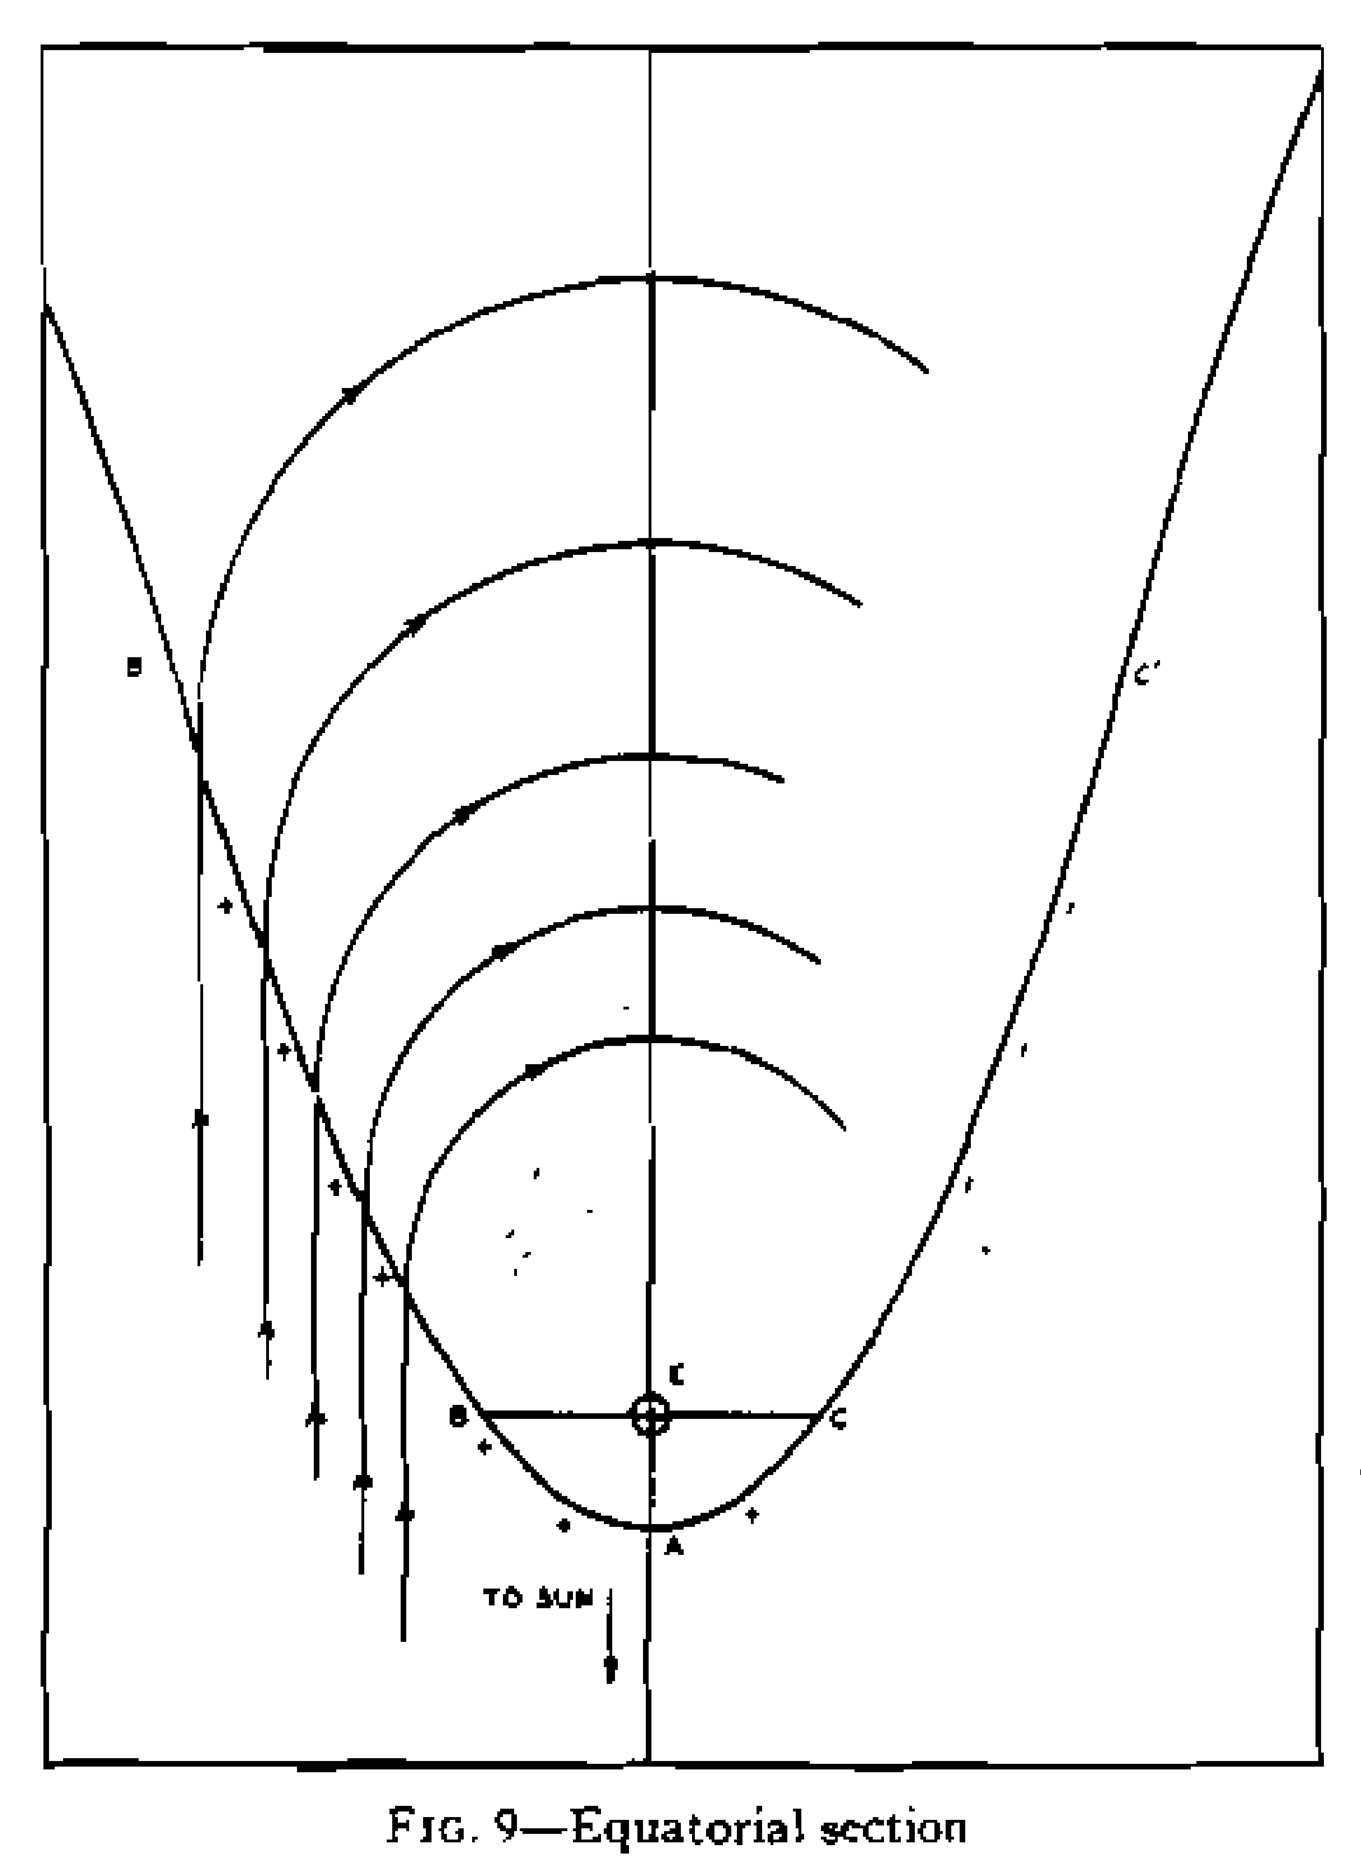
Chapman & Ferraro [1931]
A new theory to explain magnetic storm
Solar agent moves under the influence of the earth’s magnetic field
Current associated with ion gyromotion reduces the field on the ground

Slide 4
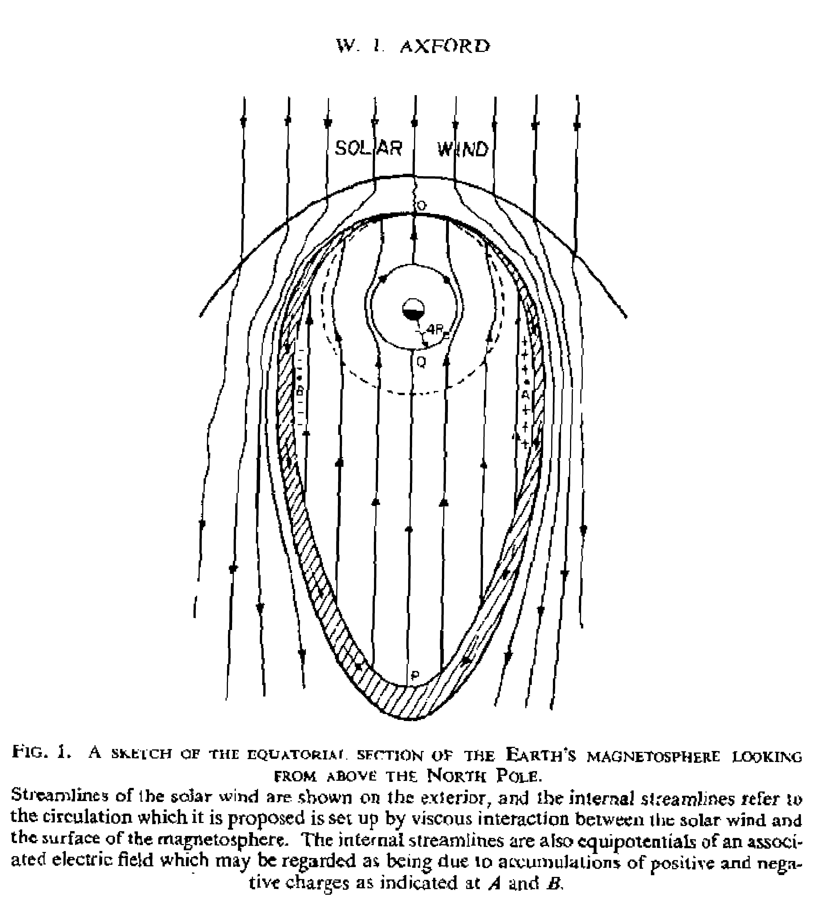
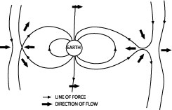
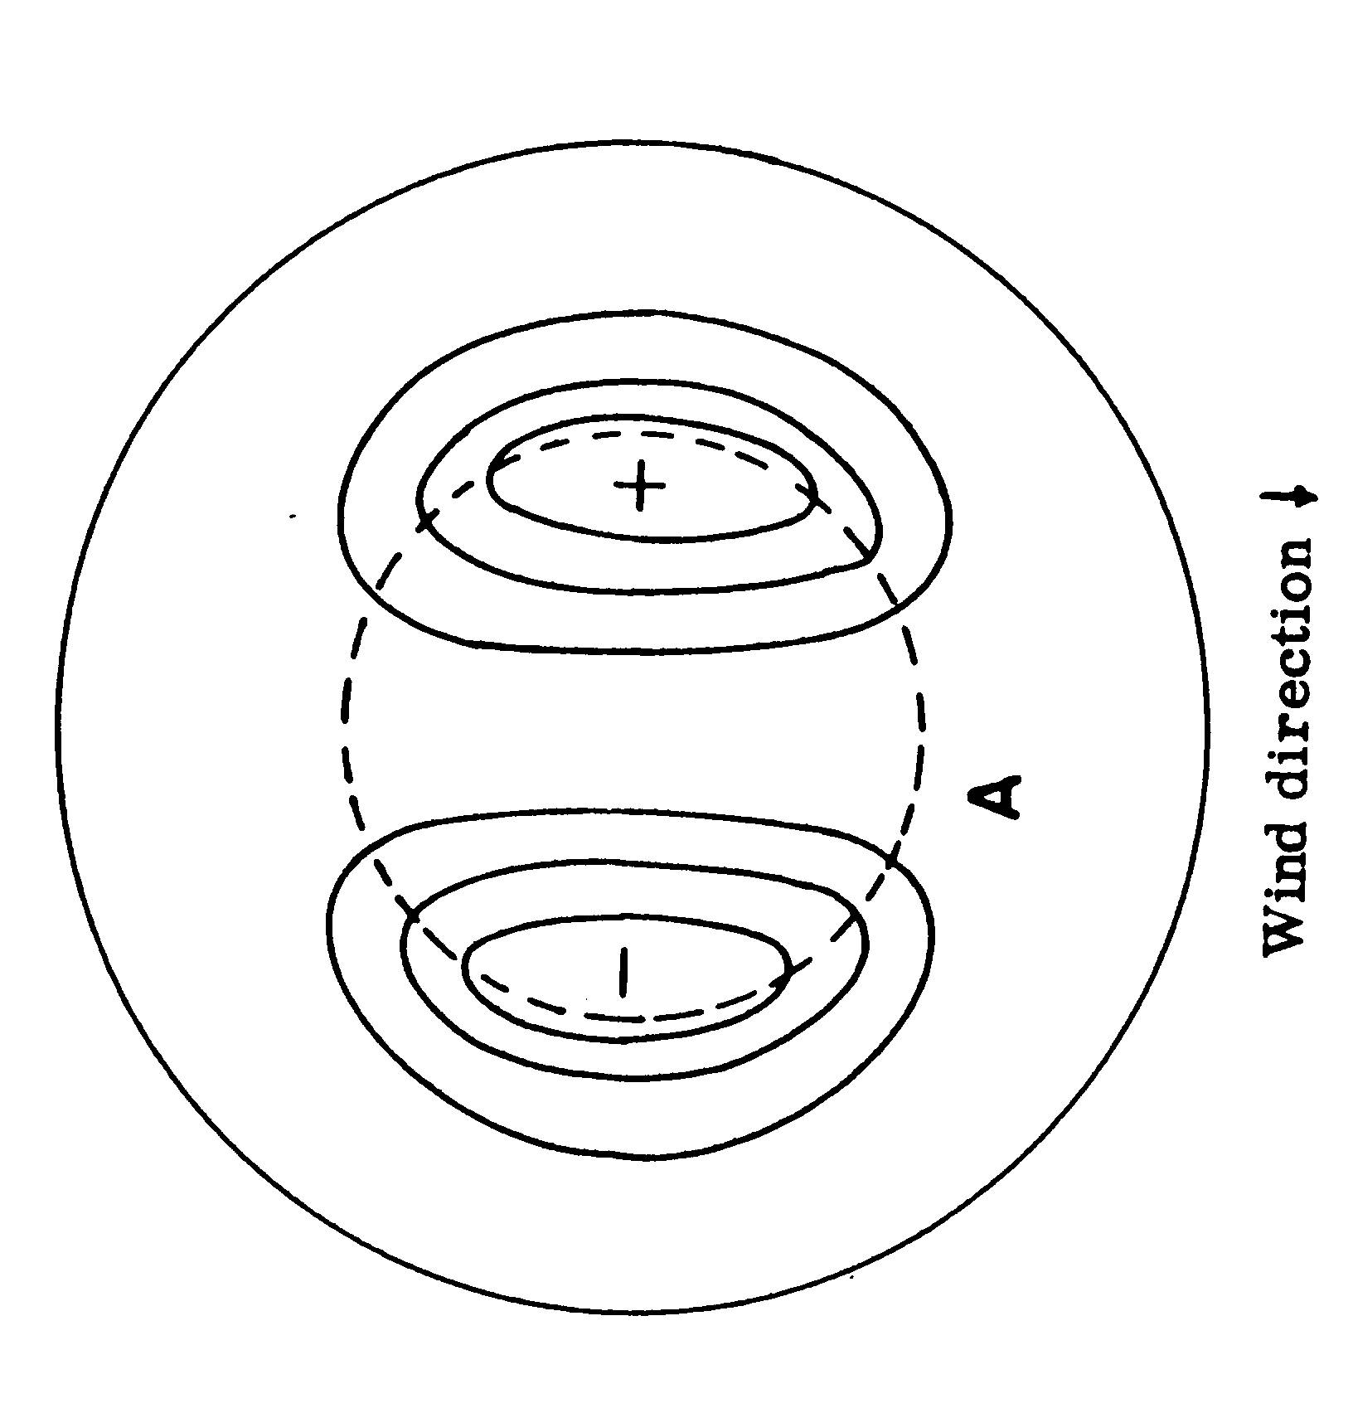
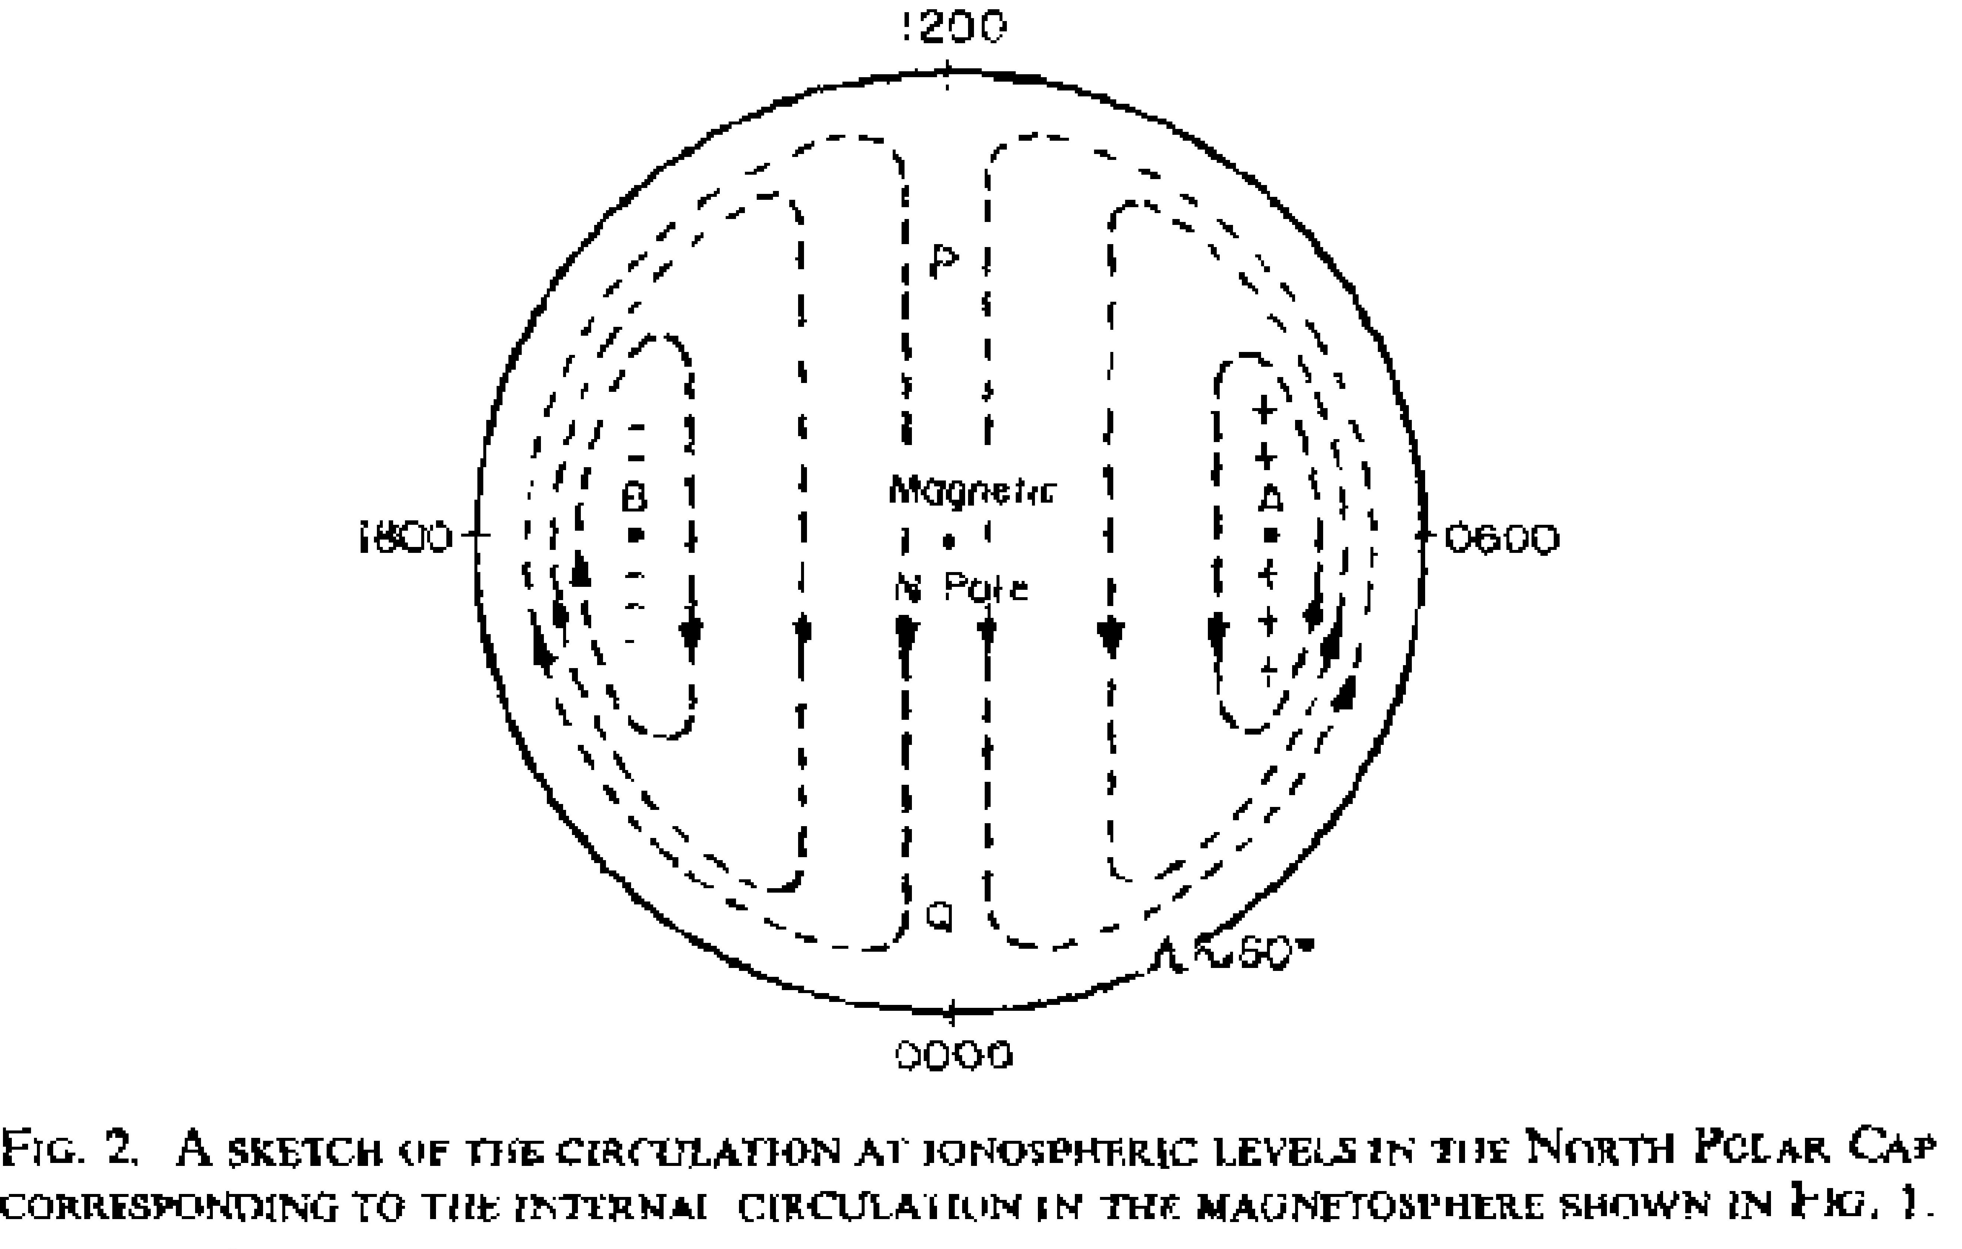
Dungey [1961] Axford [1963]

Slide 5
Principles of MHD Modeling
Perpendicular velocity: Frozen-condition is applicable everywhere except in reconnection regions and ionospheres
In regions of ideal MHD: (steady state, E =- V x B)
  E parallel to B is 0=> Field line is equipotential => different field lines have different potentials
  Potential mapping: (VxB)L = constant
  Field lines cannot intersect (or infinite E field). At reconnection site B=0
  E parallel to V is 0 => Streamline is equipotential => different streamlines have different potentials
  Streamlines cannot intersect (or infinite E field). At reconnection site V=0
  Points on a field line move at their flow speeds to form the next field line. Must follow a given field line through a cycle
  For the whole system, magnetic in-flux = magnetic out-flux

Slide 6
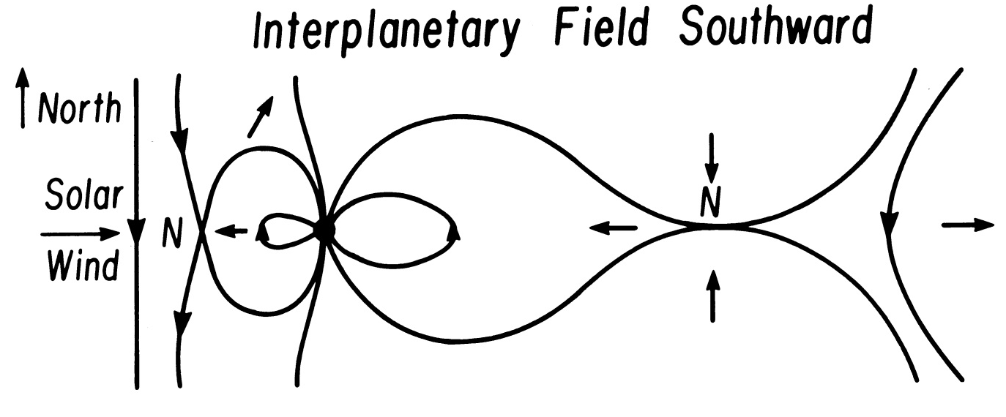
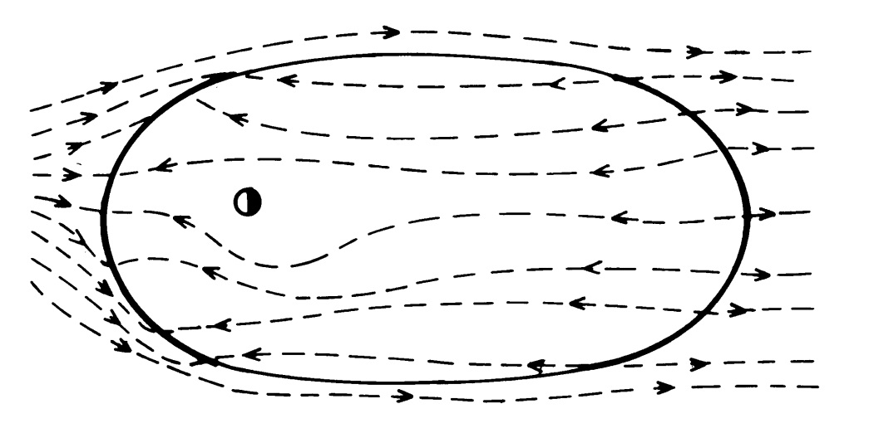
Southward IMF
Vasyliunas [1981]
http://sci.esa.int/science-e/www/object/index.cfm?fobjectid=36448

Slide 7
The Magnetosphere
Magnetopause Reconnection
Direct evidence of quasi-steady reconnection at the magnetopause.
  ISEE 2 spacecraft was moving from the magnetosphere to the magnetosheath.
  The magnetic field in magnetosheath had B_{Z}<0 and B_{y}>0
  As the spacecraft passed through the LLBL and the boundary there were large dawnward flows and antisunward flows
  The spacecraft made several incursions into the LLBL which gradually increased in length.

Slide 8
The Magnetotail
Magnetopause Reconnection
Field lines at the magnetopause for B_{z}<0 and B_{y}>0 (top).
  Magnetic tension will move the plasma along the direction given by the heavy arrows.
  ISEE 2 was post noon so in the LLBL and magnetosheath the flow should be northward, dawnward and antisunward as observed.
Reconnection at the magnetopause can also be “patchy” and localized in space. The left figure shows a localized reconnection event called a flux transfer event on the magnetopause.

Slide 9
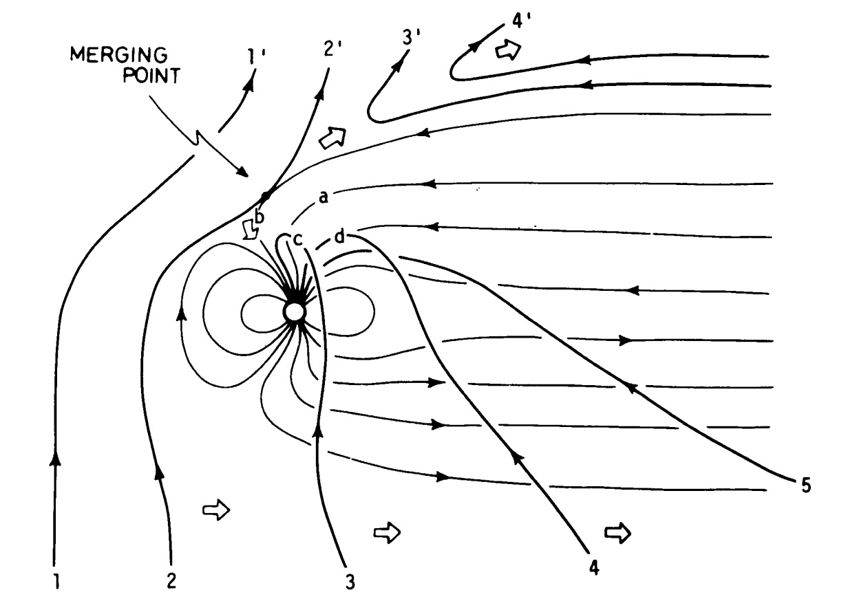
Connection Takes Place not on Stagnation Field Line
Russell, 1971

Slide 10
Principles of MHD Modeling, cont.
Magnetospheric driving force
  Field line motion: pressure gradients, curvature force, and ionospheric coupling; no ExB drift!!!
  Flow along the field: pressure gradient
Field line stretching/shortening: (caused by velocity shear)
  Field line length is proportional to B/ρ
  Slow mode: most efficient (convert pressure from parallel to B to perpendicular to B)
Acceleration/deceleration: (perpendicular to B)
  Fast mode: most efficient for high β plasma
  Alfvén mode: most efficient for low β plasma or highly distorted field lines
Field line bending: Alfvén mode: most efficient (no stretching/shortening needed)

Slide 11
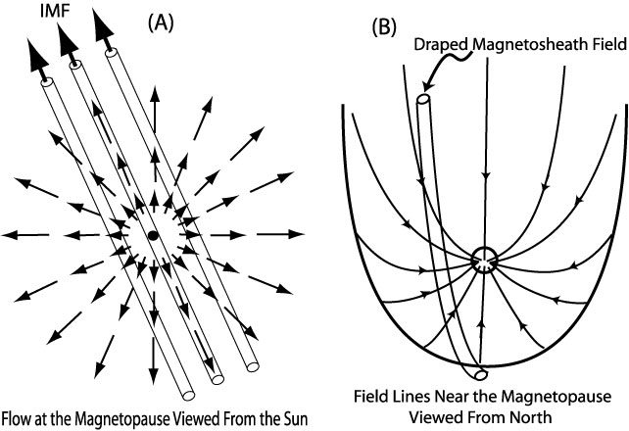
Field Bending and Draping/stretching

Slide 12
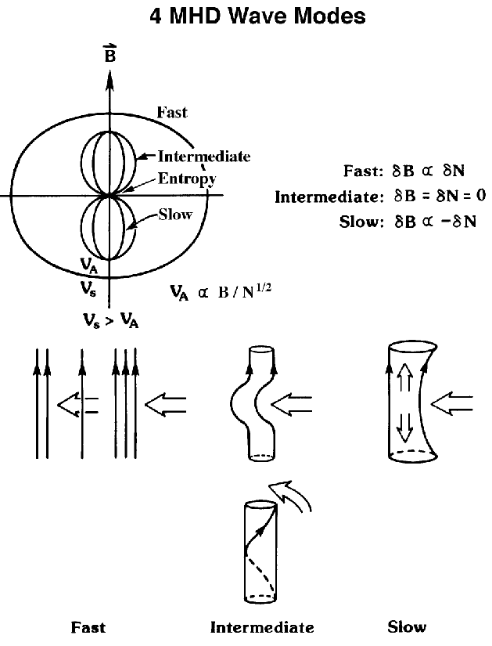

Slide 13
Principles of MHD Modeling: Special cases
Reconnection region
Bending of dipole field: dipole field is curved but curl-free
Field line pulling out of the ionosphere
Steady state Magnetosphere-ionosphere coupling

Slide 14
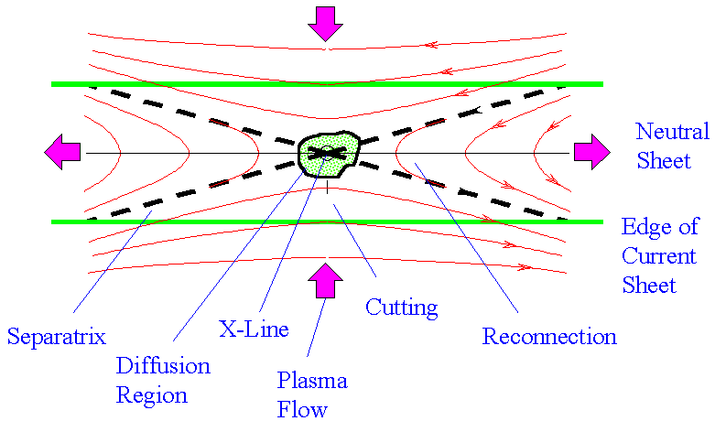
Magnetic Reconnection
Separatrix is not a slow shock
The outflow region can be described by ideal MHD.
Field-aligned potential drop is negligibly small.
In steady state, E field in -Y-direction are same in all regions
The outflow speed is Alfven speed
Z
X

Slide 15
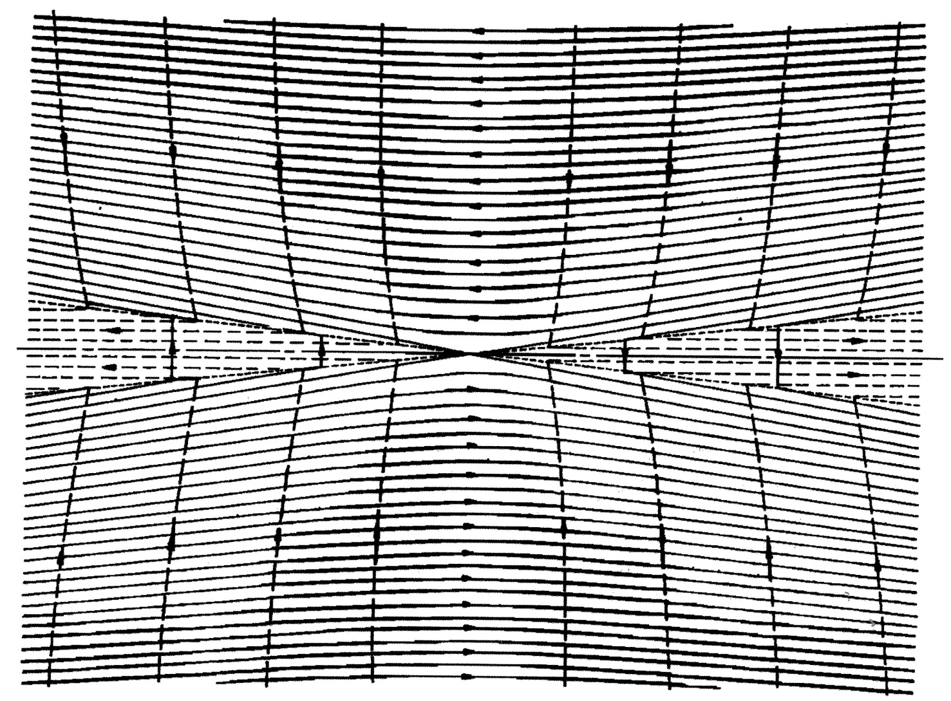
Reconnection: Separatrices and slow shocks
Separatrix
Slow shock

Slide 16
Principles of MHD Modeling: Special case, cont.
Reconnection region
Bending of dipole field: dipole field is curved but curl-free
Field line pulling out of the ionosphere
Steady state Magnetosphere-ionosphere coupling

Slide 17
Bending A Dipole Field and Pulling It up
Dipole field is current-free
Motion at the foot of B field line produces a kink in the field line with a pair of currents
The JxB force reacts to the initial foot motion (the motion needs to be sustained)
If the foot motion is sustained, the JxB force makes the kink propagates upward
The whole field is settled in a new L-value (current free again)
The field line becomes longer: pulled out from the ionosphere (with high density plasma)
The ionosphere rises (not due to ExB drift)
Bending the field from the magnetosphere is a reverse process

Slide 18
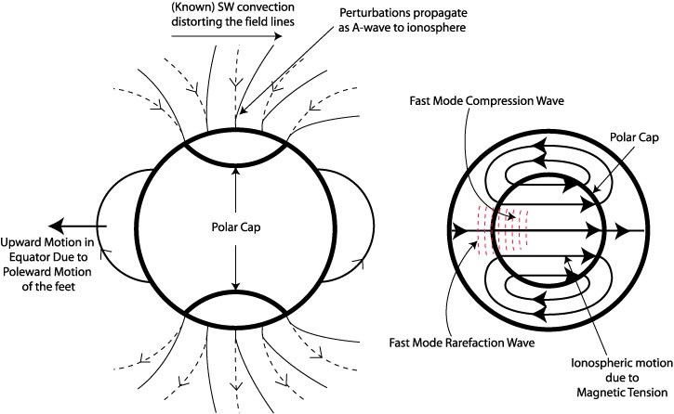
Global Consequence of A Poleward Motion
Antisunward motion of open field line in the open-closed boundary creates
  a high pressure region in the open field region (compressional wave), and
  a low pressure region in the closed field region (rarefaction wave)
Continuity requirement produces convection cells through fast mode waves in the ionosphere and motion in closed field regions.
Poleward motion of the feet of the flux tube propagates to equator and produces upward motion in the equator.
No mapping E-field and no penetration E-field

Slide 19
Principles of MHD Modeling: Special cases, cont.
Reconnection region
Bending of dipole field: dipole field is curved but curl-free
Field line pulling out of the ionosphere
Steady State Magnetosphere-Ionosphere coupling

Slide 20
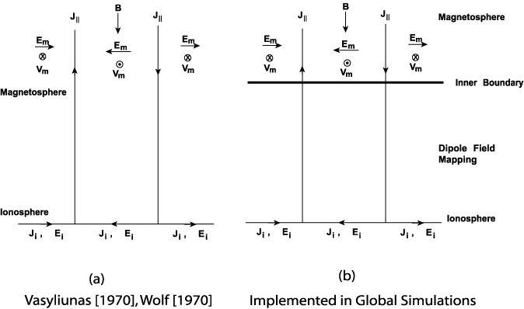
Steady State M-I Coupling
coupled via field-aligned current, closed with Pedersen current
Ohm’s law gives the electric field and Hall current
electric drift gives the ion motion
ionospheric JxB force is consistent with the ionosphere convection direction

Slide 21

Northward
IMF
[Dungey, 1964]

Slide 22
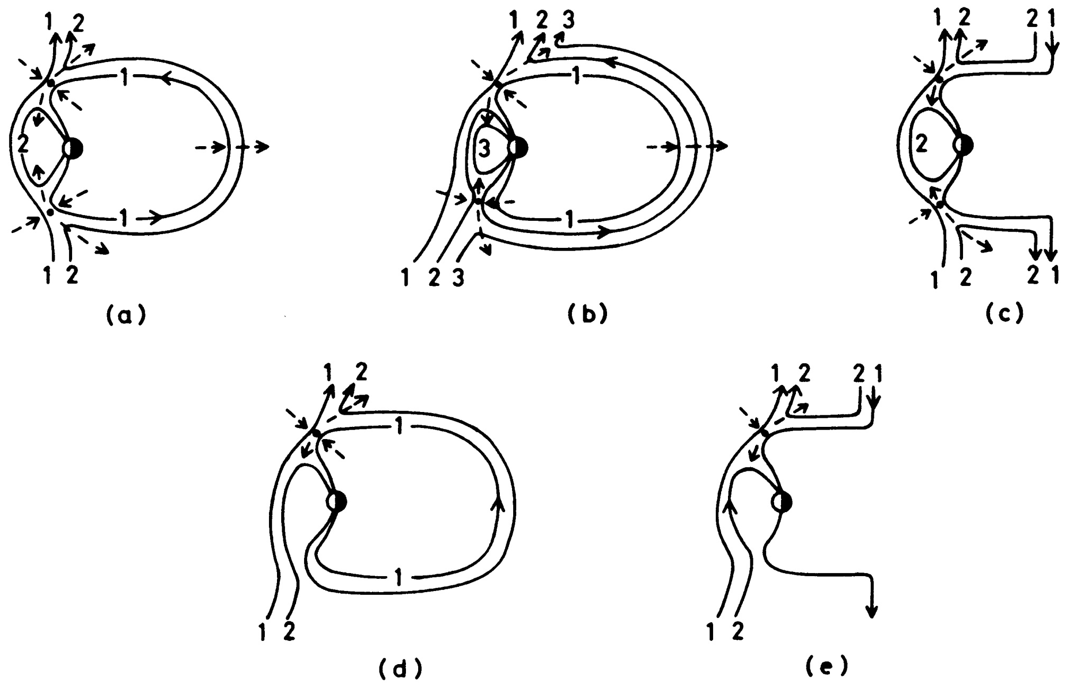
Topology for NBZ (Cowley, 1981)

Slide 23
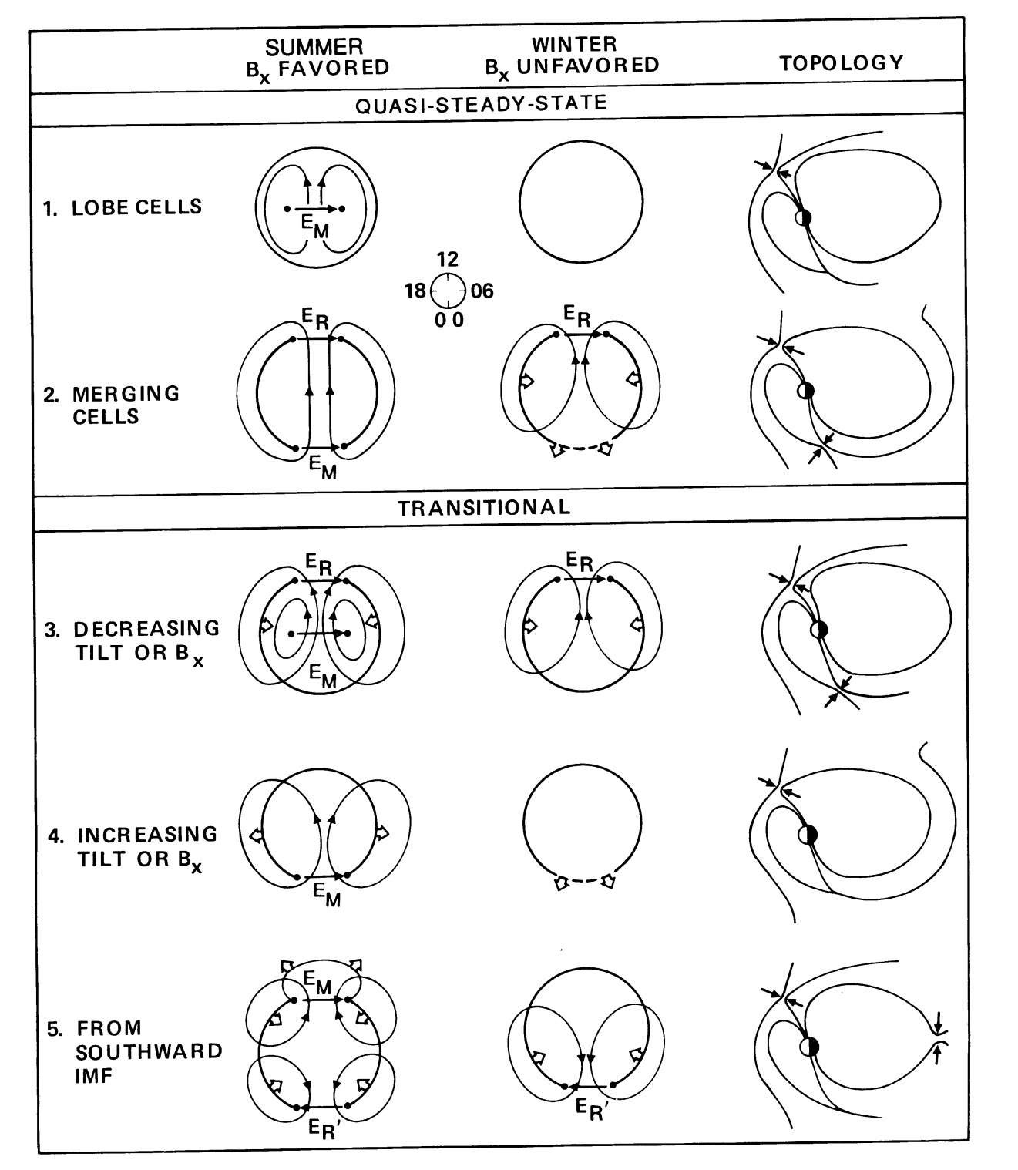
Topology and Ionospheric Convection for NBZ with Dipole Tilt; [Crooker, 1992]

Slide 24
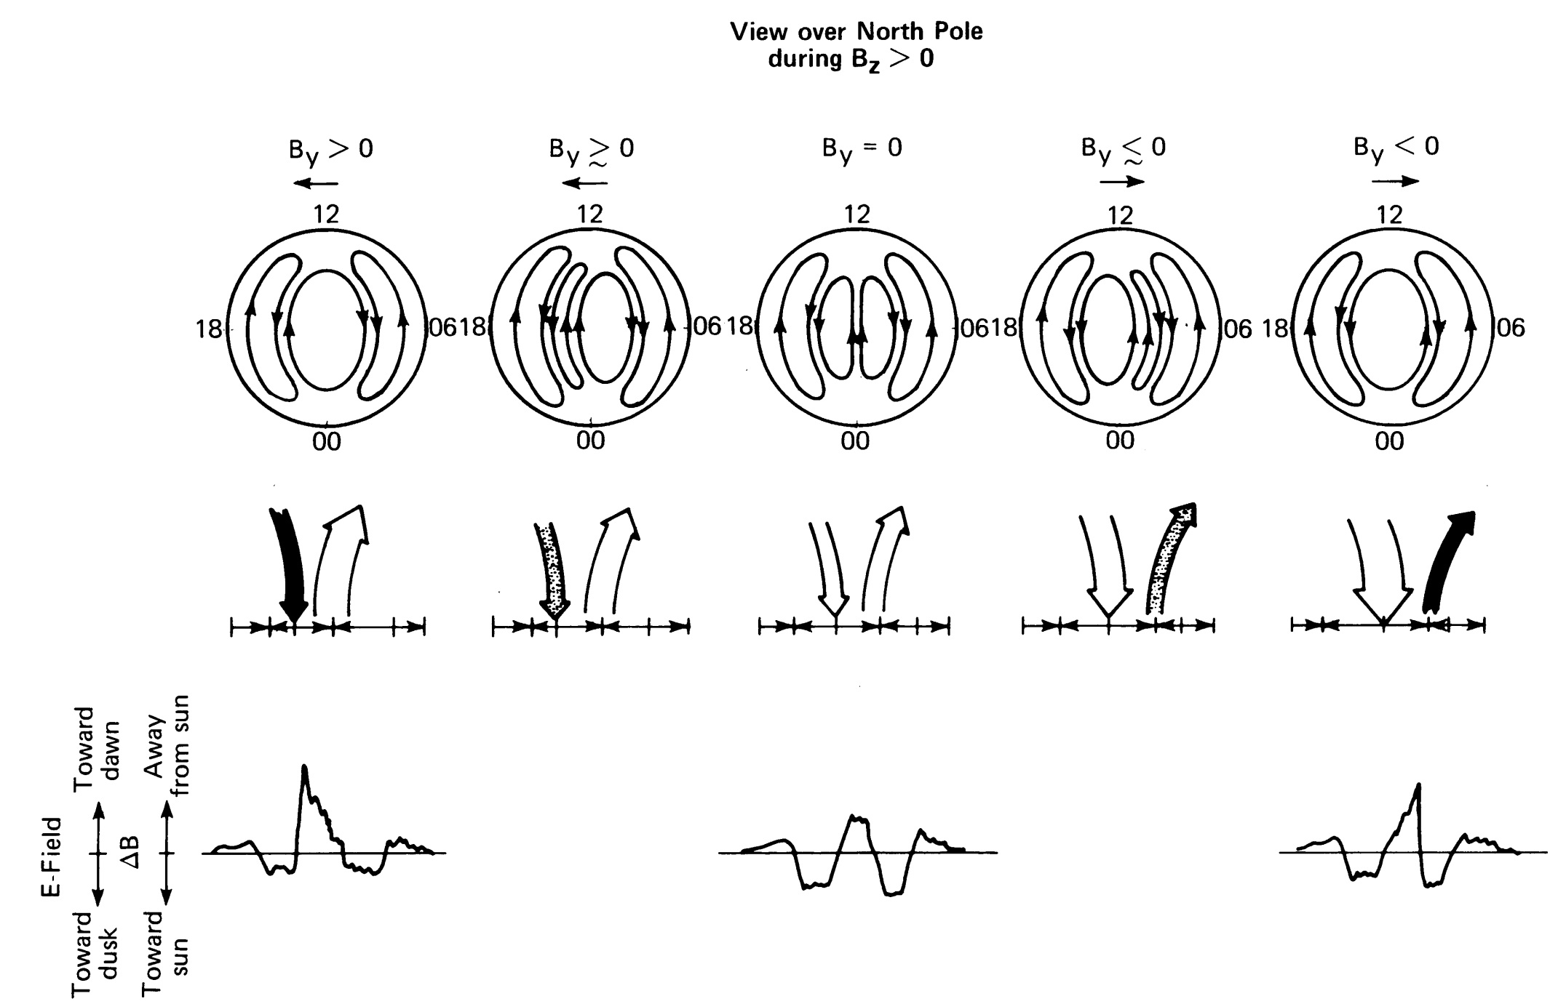
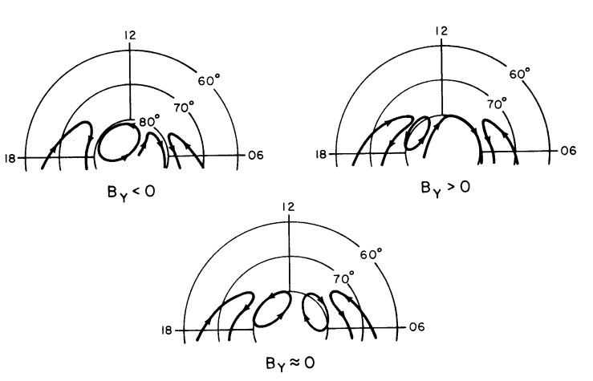
Ionospheric Convection and Field Perturbations for NBZ [Potemra et al., 1984]

Slide 25
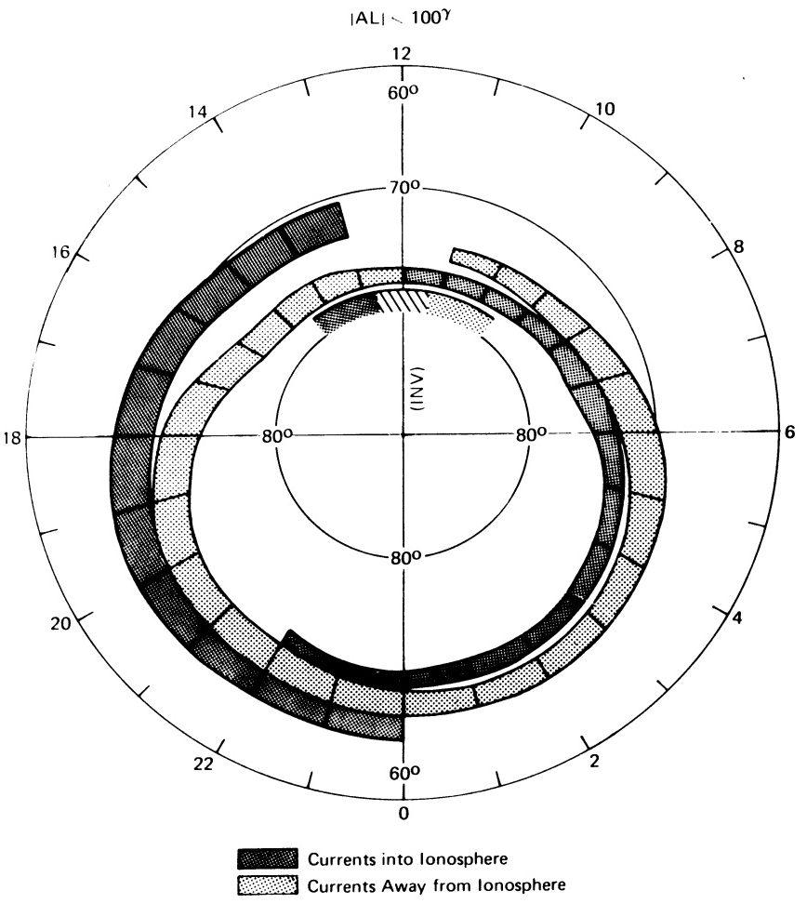
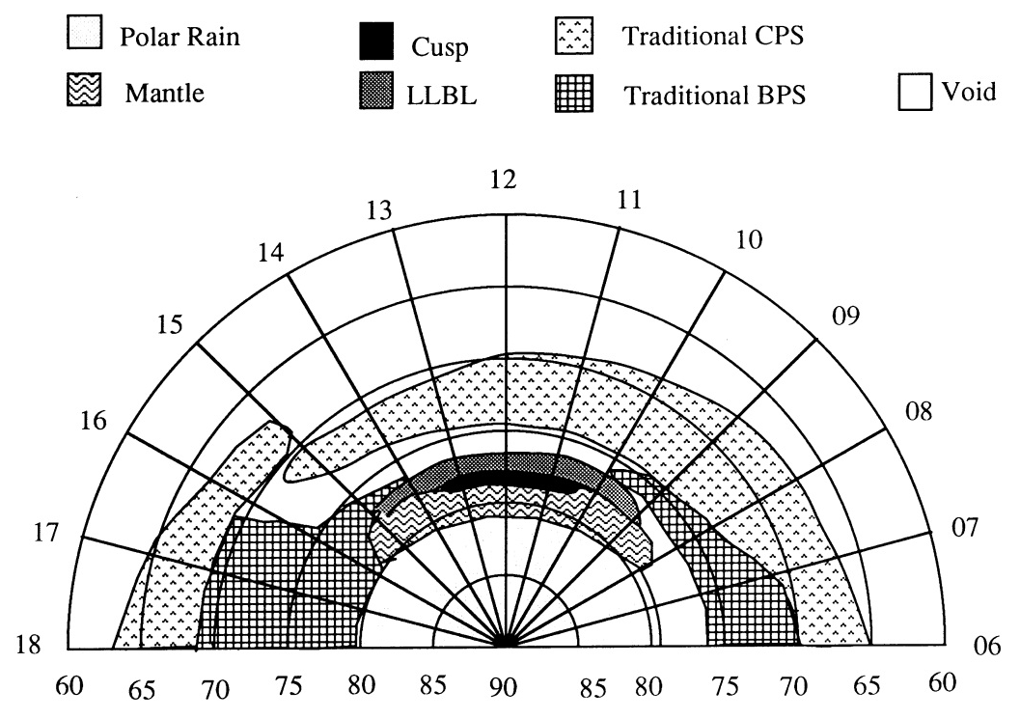
Ionospheric Observations for NBZ
Field-aligned current Precipitation particles
[Ijima and Potemra, 1978] [Newell and Meng, 1994]

