Slide 1
Wave-Particle Interaction
Waves:
Importance of waves
MHD waves,
Plasma waves
Wave-particle interaction:
resonance condition
pitch-angle diffusion
Radiation belt remediation

Slide 2
Waves in Space
MHD waves:
  frequencies much below ion gyrofrequency
  MHD modes: Alfven mode, slow and fast modes, entropy mode
  PC waves: (ULF waves)
    PC 1 (0.2-5 sec): ~ 1sec, ion cyclotron waves near the subsolar magnetopause
    PC 3 (10-45sec)-4 (45-150 sec): ~ 1 min, waves generated in the magnetosheath and field resonance along the field in the inner magnetosphere or radial to the field
    PC 4-5 (150-600 sec): ~3-20 min, outer magnetospheric field-aligned resonance
  Pi waves:
    Pi 1 (1-40 sec)
    Pi2 (40-150 sec): irregular, associated with substorms
  Measured with magnetometers/electric probes in time series, the Fourier analysis
  Mode identifiers: Compressional vs. transverse

Slide 3
Waves in Space, cont.
Plasma waves: (VLF and ELF waves)
  Frequencies above the ion cyclotron frequency
  Measured by radio receivers with antennas (electric dipole for E-field, search coil for B-field)
  Mode identifier: electrostatic vs. electromagnetic
    Electrostatic: dB=0, dE along k or k =0
    EM modes: dE/dB ~ V_{phase}
  Modes:
    Ion cyclotron
    Whistlers (hiss, chorus, loin roar)
    Electron cyclotron, and harmonics
    Plasma frequency
    Above plasma frequency
    Odd-half electron gyro harmonics

Slide 4
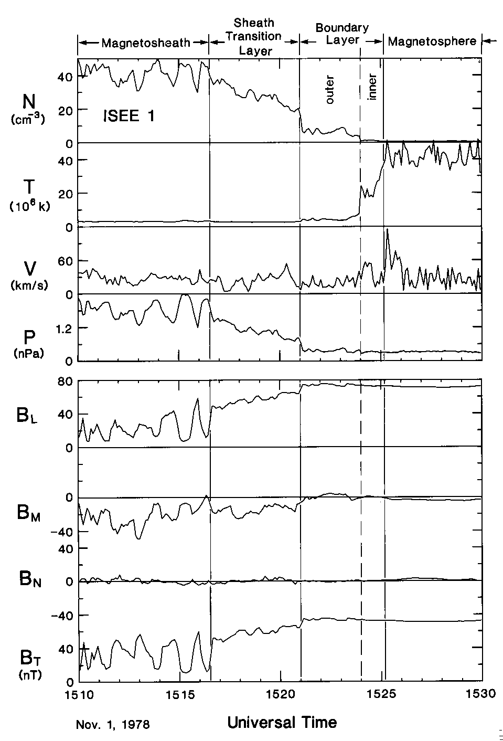
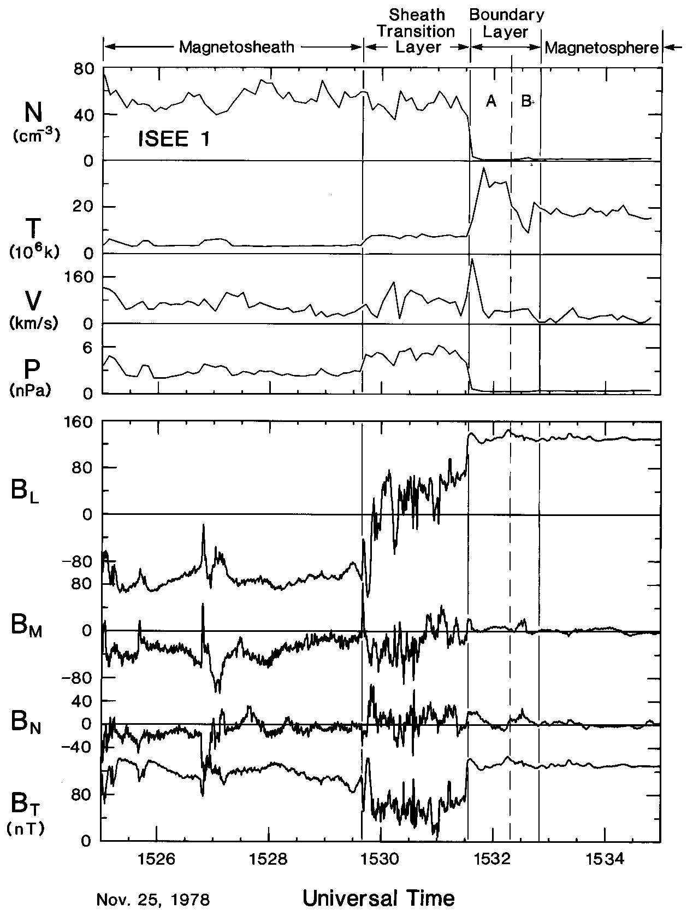
Structure of the Magnetopause
Northward IMF
Southward IMF

Slide 5
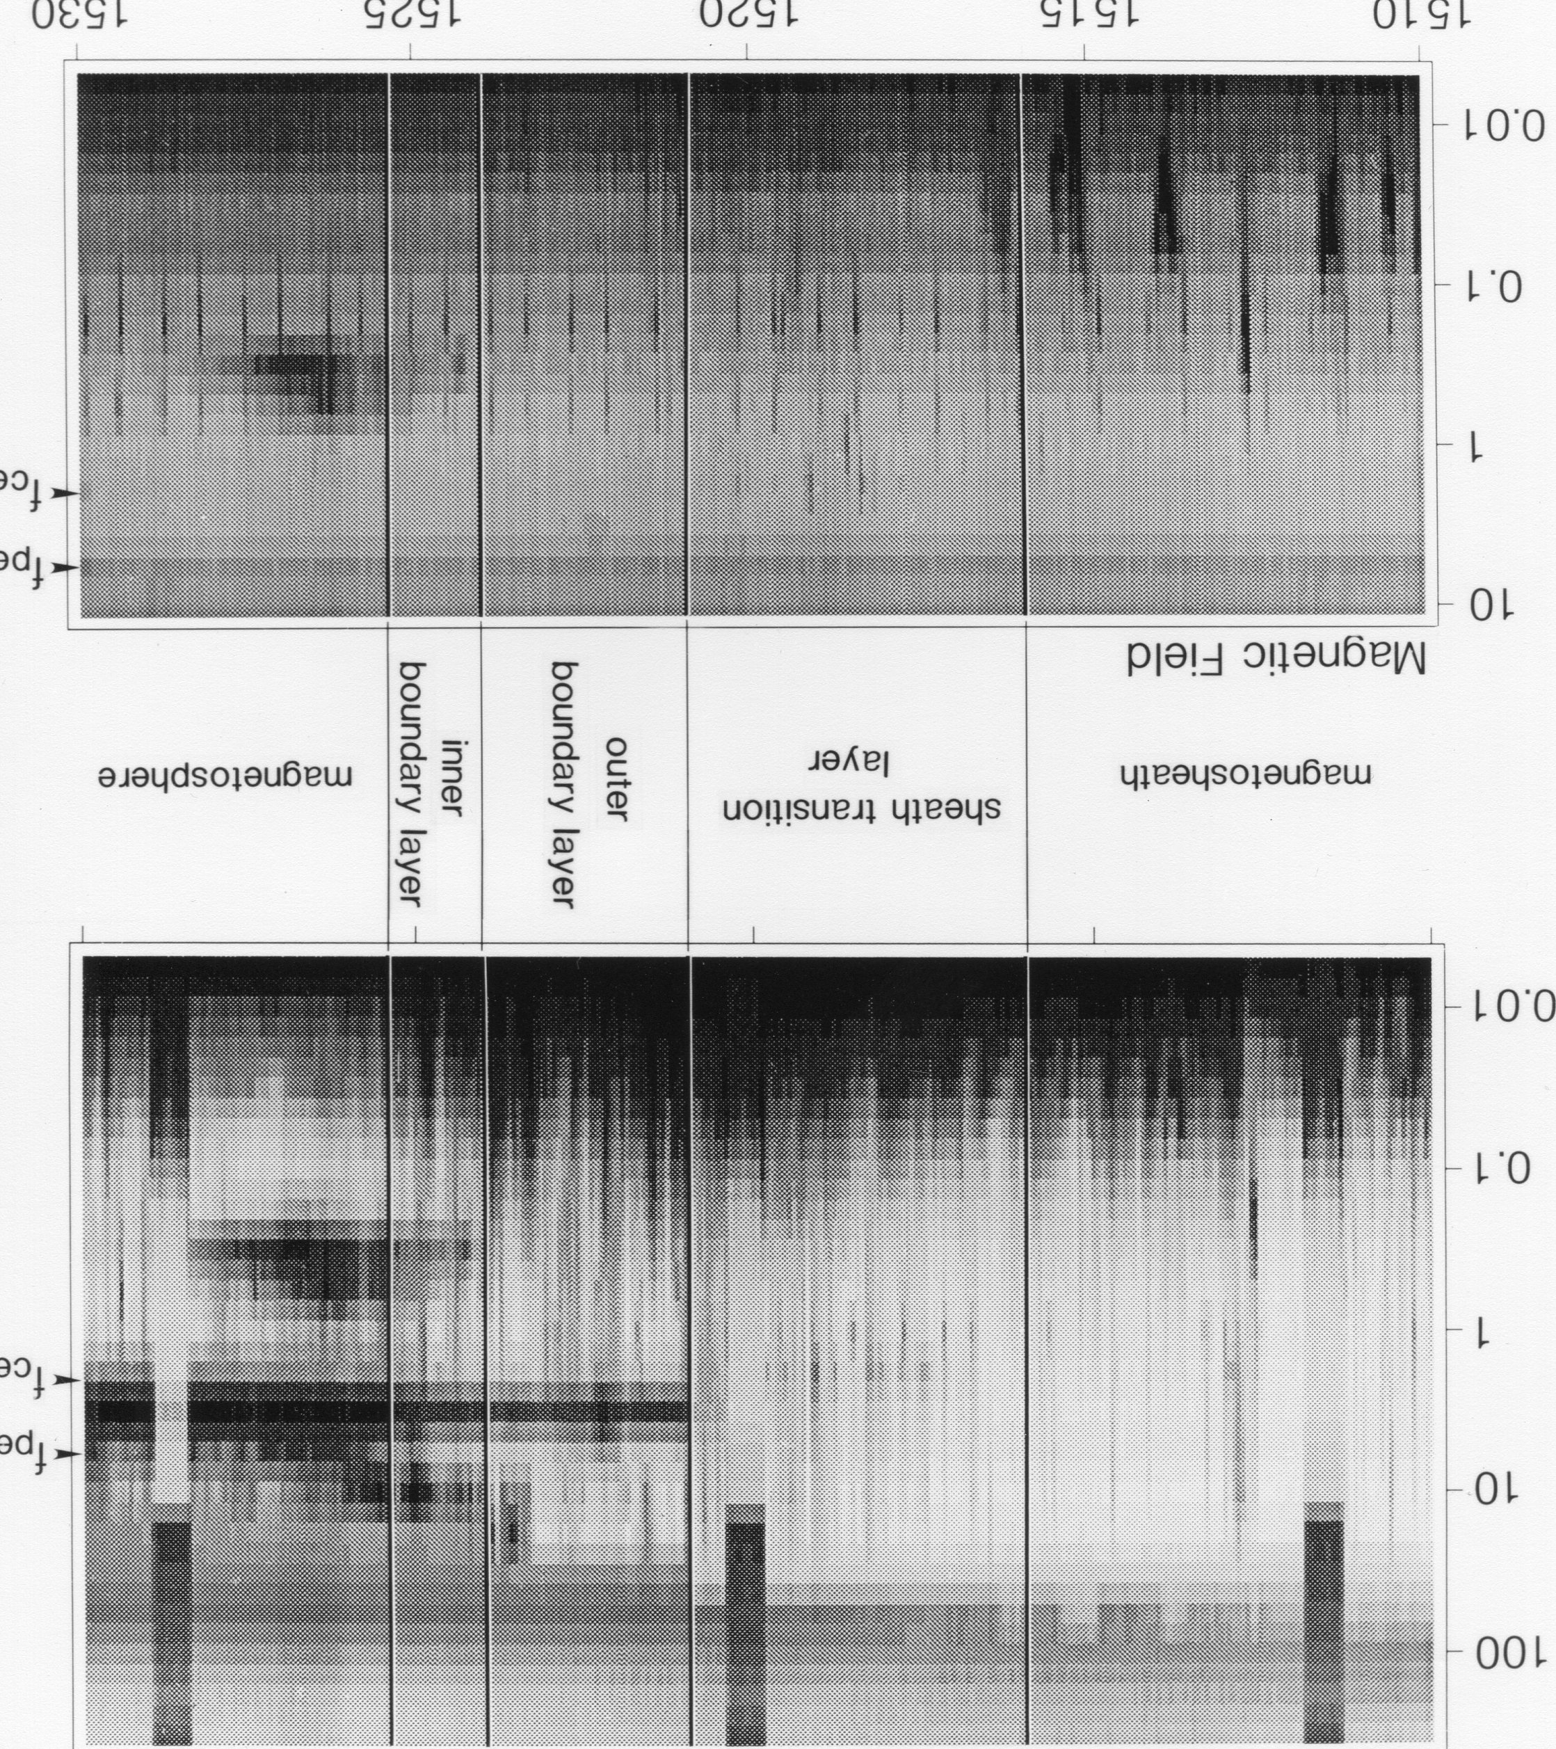
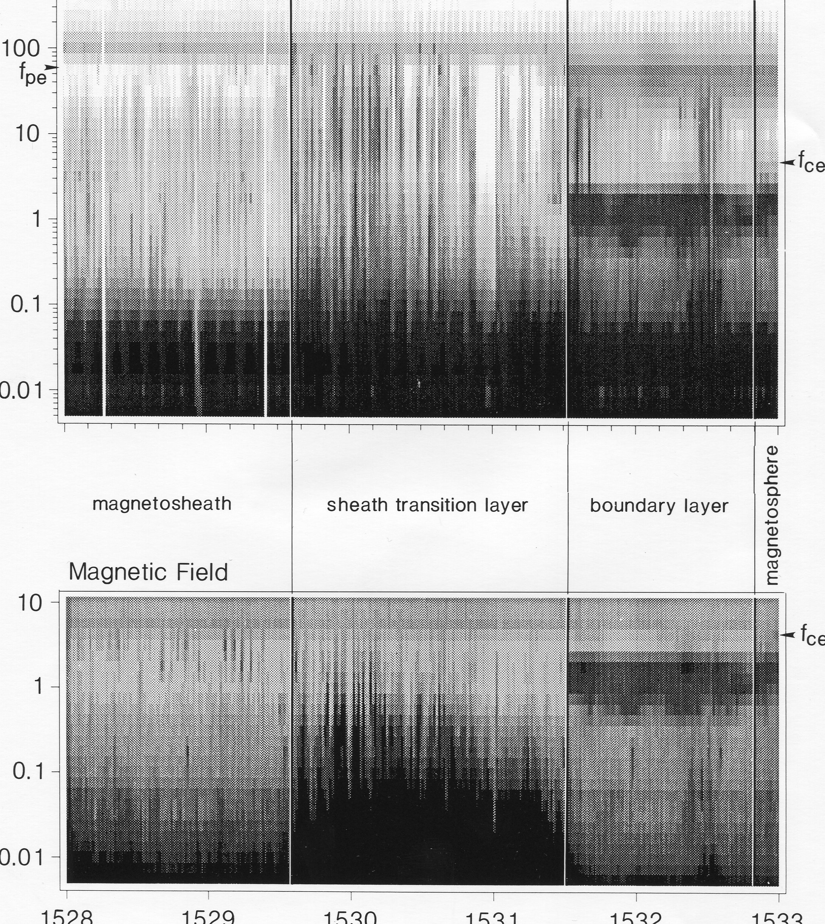
Plasma Waves at the Magnetopause
Northward IMF Southward IMF

Slide 6
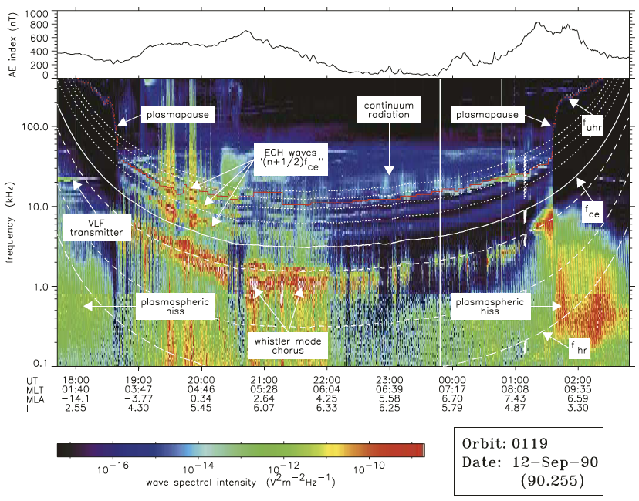
The wave environment in space
Meredith et al [2004]
Notes:
Explain scales, f, t

Slide 7
Equatorial distribution of waves
plasmaspheric
hiss
Sun
Wave power distribution:
W(L, MLT, lat, f, ψ, φ, M, D, t)
  L: L-shell
  MLT: Magnetic Local Time
  Lat: geomagnetic latitude
  f: wave frequency
  ψ: wave normal angle, zenith
  φ: wave normal angle, azimuth
  M: ULF, EMIC, magnetosonic, hiss, chorus, whistlers, ECH, … )
  D: Duty cycle, i.e., % of actual occurrence
  t: Storm/substorm phase?
LANL wave database (Reiner Friedel)
NASA VWO (Shing Fung); Also ViRBO for particle data
ULF
EMIC
waves
Chorus
magnetosonic
waves
Meredith et al. 2008 GEM tutorial

Slide 8
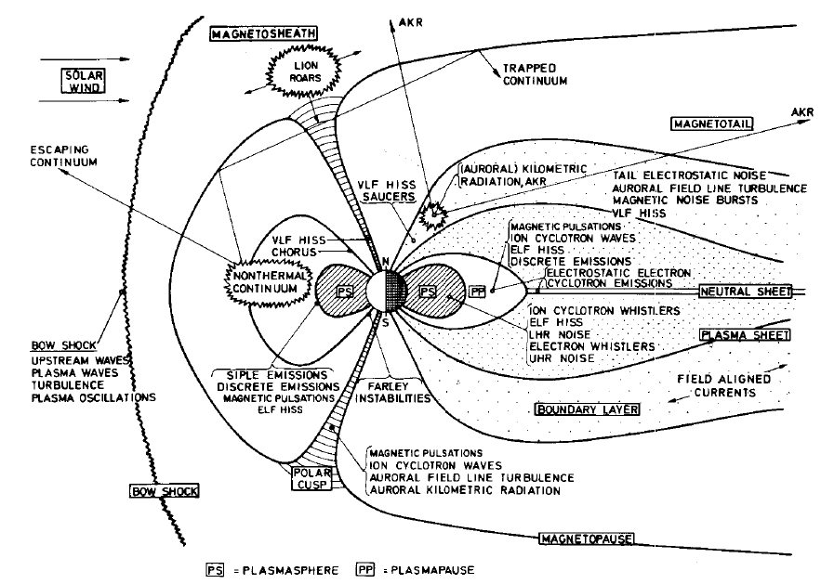
Plasma Waves and Their Possible Sources
ULF waves
Shawhan [1985]
Notes:
Note: some inconsistencies in wave nomenclature: e.g., wave named after freq ranges (ELF, VLF), or wavelengths (Kilometric, myriamteric), or sound (whistler, chorus hiss, lion roars), or plasma physics (ion cyclotron, LHR UHR), discoveres (Farley instability), or plasma mode (electrostatic, electromagnetic).

Slide 9
Wave Properties
Frequency: ω=2π/f
Wavevector: k
Dispersion relation: ω=Φ(k)
  CMA diagram: (in radio science: no ion effects)
  ω ~ k diagrams
Phase velocity: information propagation speed
(Note the difference in the definitions of “information” between physics and engineering)
V_{phase} = ω/k
Group velocity: energy propagation speed
  Wave packet: dω/dk
  Single wave (dω =0!): dω/dk≠0

Slide 10
CMA Diagram

Slide 11
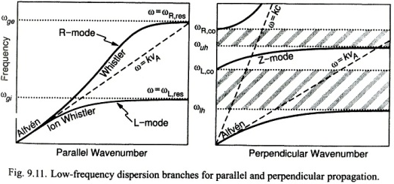
Dispersion Relations
Co=Cutoff: n=c/V_{phase}=k=0

Slide 12
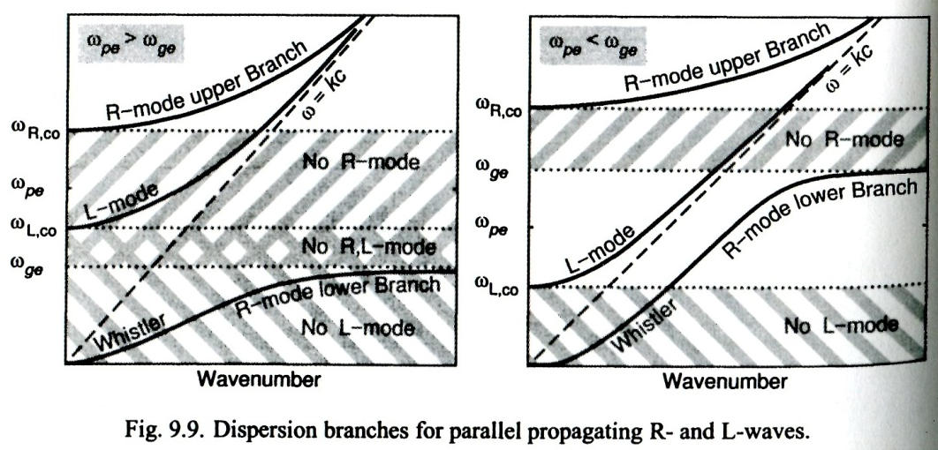
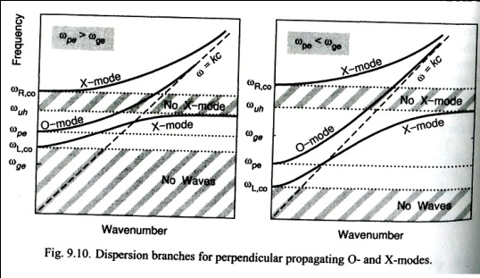

Slide 13
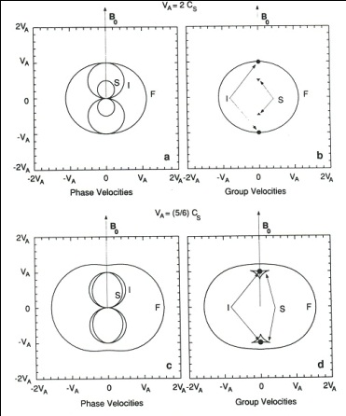
MHD Dispersion Relations and Group Velocities (Friedrichs diagram)
For Alfven mode:
Note that in this expression k_{x} and k_{y} do not need to be 0 but they do not contribute to Vg (but may reduce it).
The following physical process explains that the energy propagates along B at a speed of V_{A} , as shown in the figure, and k_{x} and k_{y} both contribute to the energy flux.

Slide 14
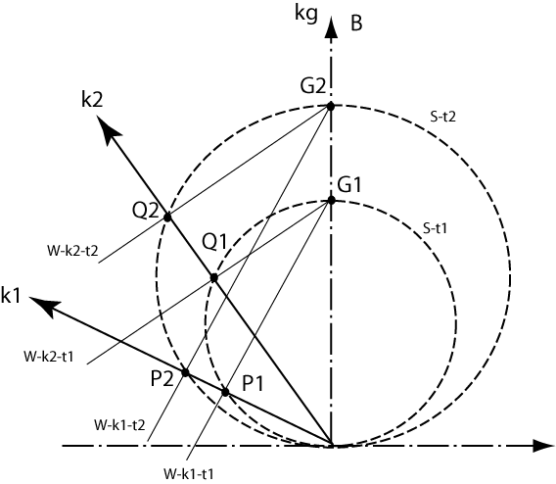
Physical picture of signal of point source propagating in anisotropic medium
Signal front S-t1=>S-t2
Phase front W: k1-t1=>k1-t2; k2-t1=>k2-t2
Group front (most energy) G1=>G2
Signals in k1 and k2 are in phase only along k_{g}
Signals in other regions cancel
Phase along k_{g}:
where v_{g} = Δr/Δt: ray velocity
Waves propagate in all
directions (not a beam)
Net amplitude is seeing only
within a narrow angle
This is when allowing waves to
propagate in all directions
If the wave is allowed to
propagate only in one direction,
the phase and group velocities are
equal for a single frequency wave

Slide 15
Wave Analyses
Amplitude (power): as function of time or location (plasma conditions)
Propagation direction: k: minimum variance dB perpendicular to k
Polarization: linear, circular
Source region?
  local plasma conditions unstable to instabilities at the observed frequency range,
  particle energy becomes wave energy
  Free energy that generates a wave comes from non-Maxwellian part of the distribution (hot population, beams, anisotropy)
  Note the ambiguity of greater T⊥ that may be the source of instabilities or a result from wave heating
  Dispersion relation may provide secondary information
Propagation region?
  instability conditions not relevant, unless the mode is strongly damped
  Dispersion relation is satisfied
  Dispersion relation is (often) determined by the bulk (cold) population
Absorption frequency:
  particles gain energy from waves through resonance
Manmade source: active transmission
  Above the ionosphere: GPS, communication s/c, TV s/c, f >f_{pe}: refraction.
  Above the ionosphere: RPI, ISIS, f~f_{pe}: refraction, reflection
  Above the ionosphere: DSX, whistler: field-aligned propagation
  Below the ionosphere: VLF radars, beacons, f<f_{pe}: waveguide propagation
  Below the ionosphere: digisondes, f~f_{pe}: refraction, reflection

Slide 16
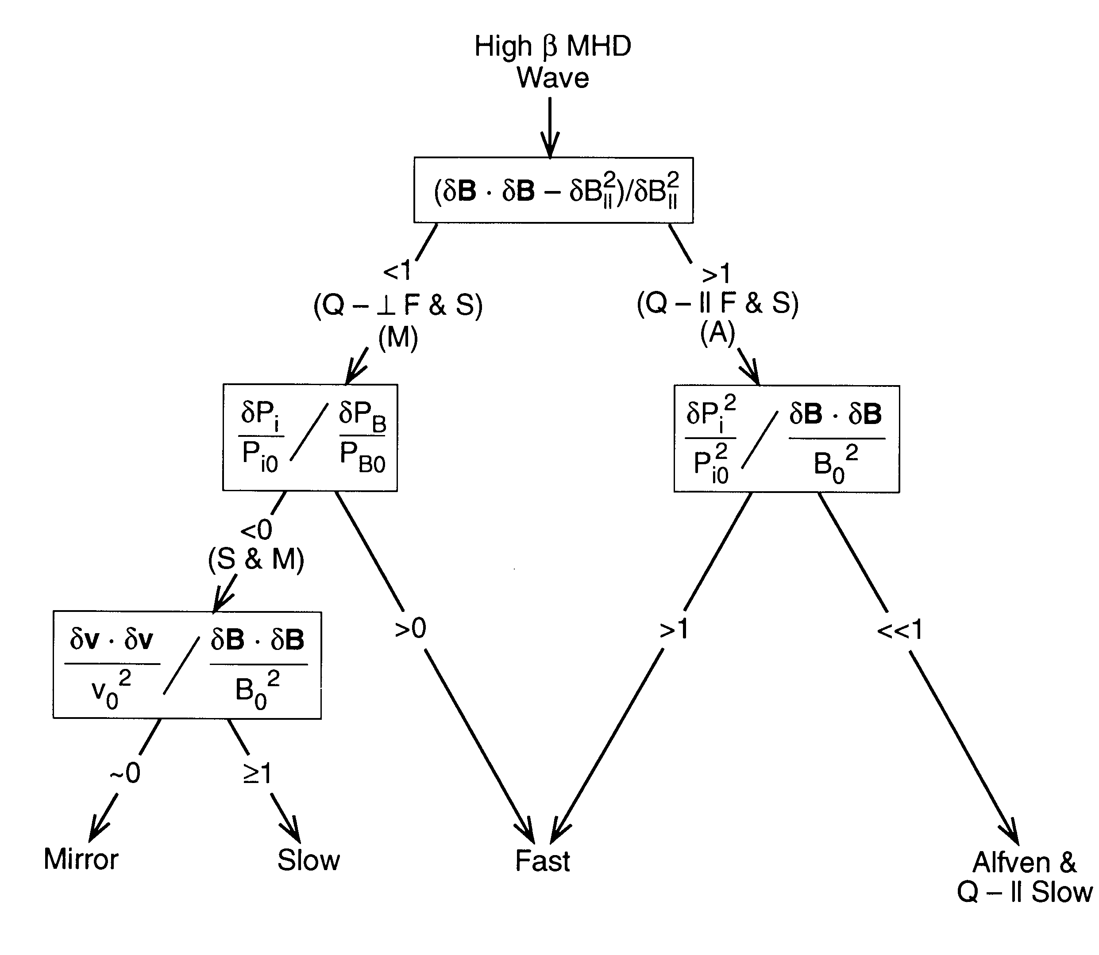

Slide 17
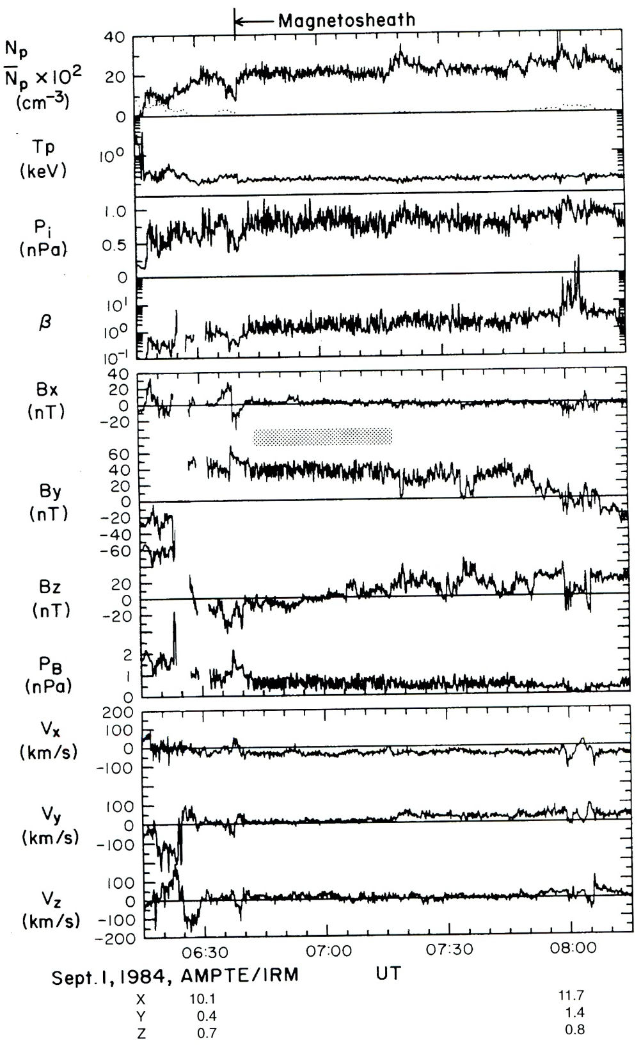
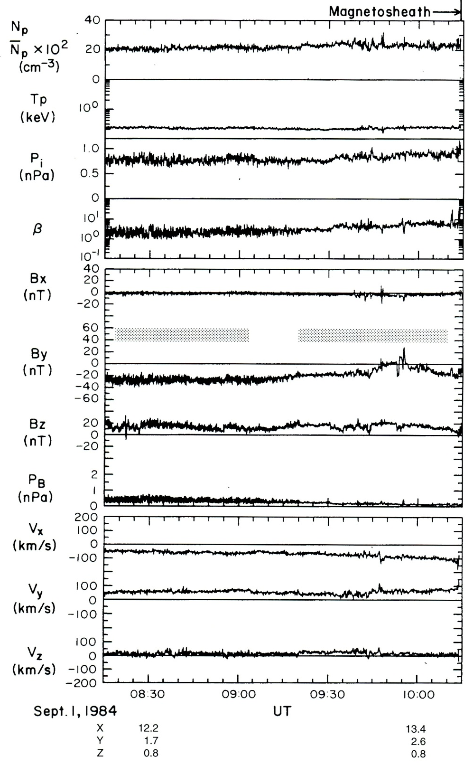

Slide 18
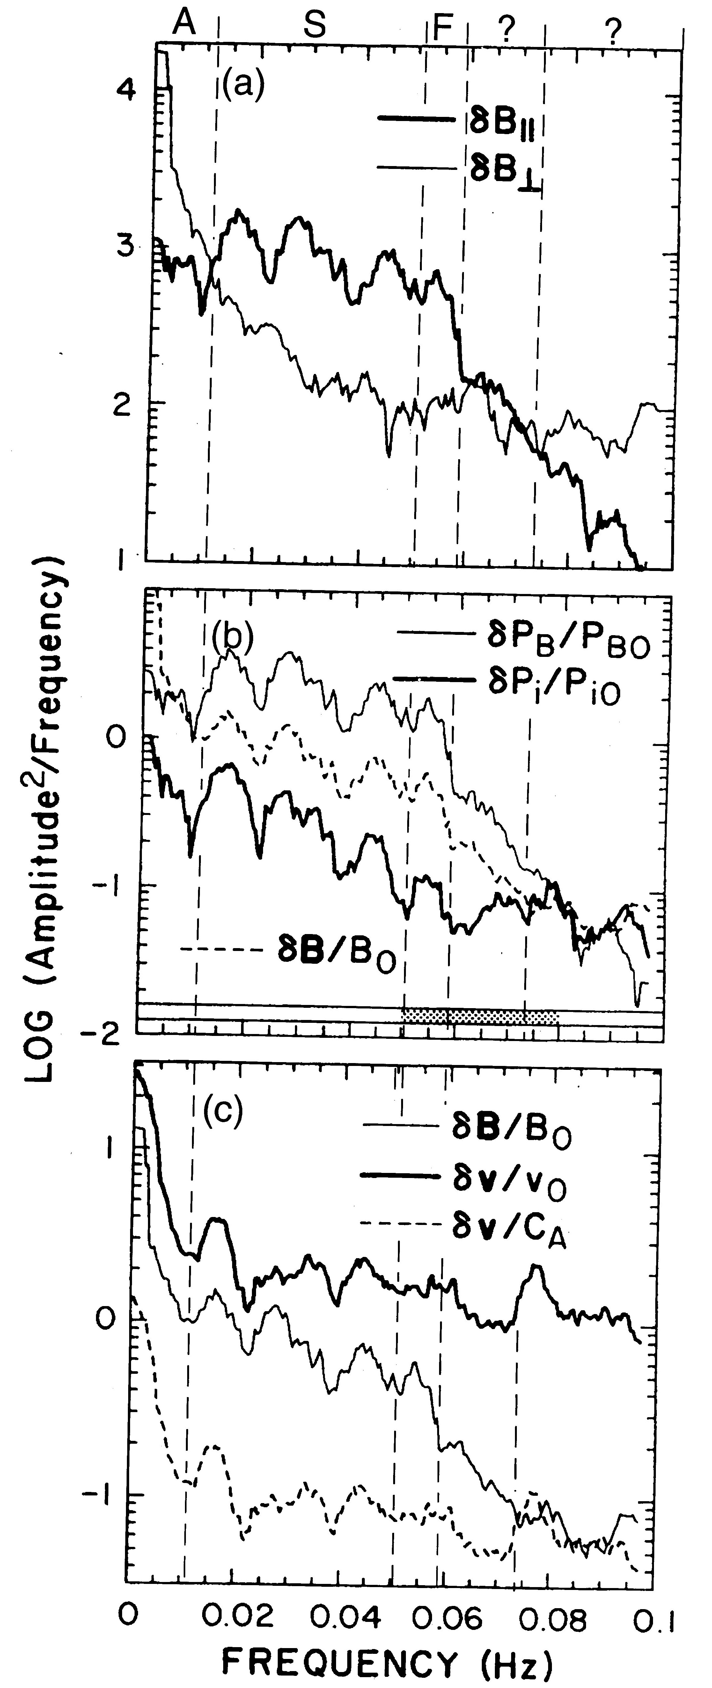
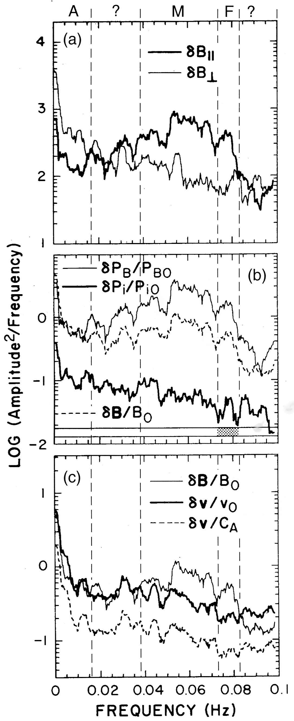
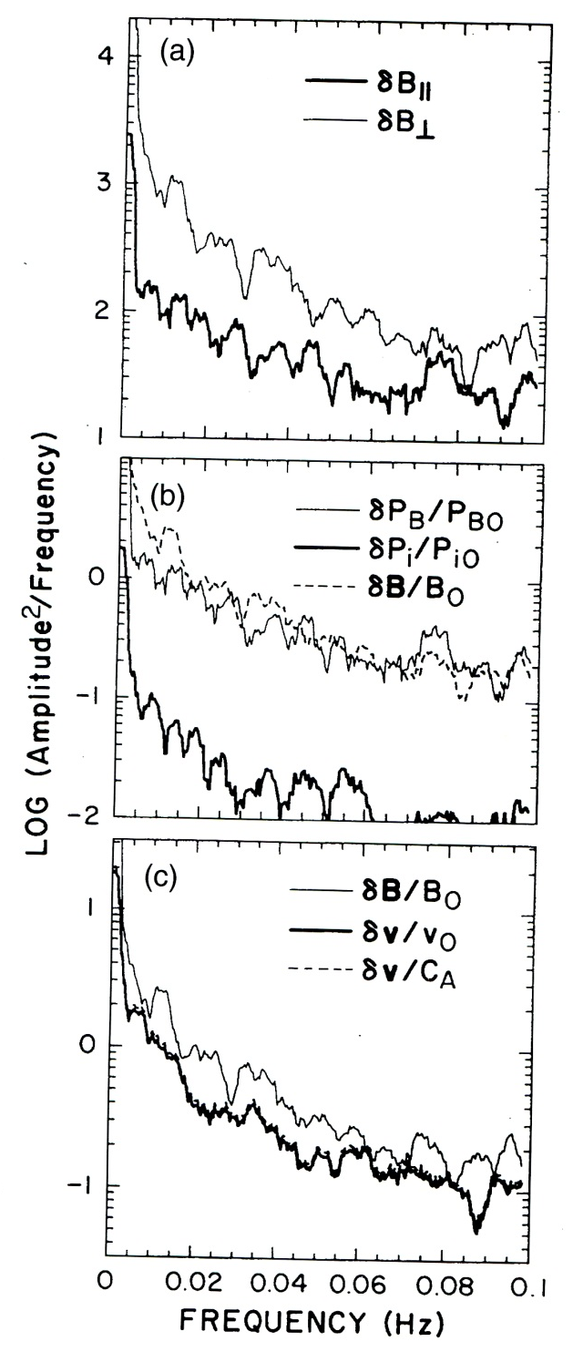
Inner Sheath Middle Sheath Outer Sheath

Slide 19
Resonance Condition
Particle motion: Particle motion can be decomposed to
  Plasma oscillation: ω_{pe}, ω_{pi}
  Gyro motion: ω_{ce}, ω_{ci}
  Field-aligned motion: V||
  Guiding center drift motion (perpendicular to B): V_{D}
Doppler shift ω = ω₀+k•V
  The frequency a particle seen a wave frequency ω₀ in its own frame of reference is Doppler shifted frequency, ω
  “a particle” usually refers to a particle this is different from the bulk population. For the bulk population, the Doppler shift is 0
  In general, when not in resonance, wave field randomly accelerates and decelerates the particle
  When bulk population is resonating with a wave, the damping is extremely strong
Resonance condition
  ω = nω_{ce}, nω_{ci}, nω_{pe}, nω_{pi}; n = 0, ±1, ±2, …
  Landau damping: n =0
  Dominant modes: n = ±1

Slide 20
Wave-particle Resonance Interaction
  In resonance, the wave field is in phase with the particle motion and will either periodically (or constantly) accelerate or decelerate the particle
  When wave field accelerates (decelerates) the particle, the particle gains (loses) energy and the wave is damped (grows)
  Pitch angle diffusion: whistler mode resonates with V||
  Drift mode resonance: MHD mode resonates with V_{D}
  Out of tune: when a resonating particle travel along a field, (B changes) the Doppler-shifted frequency may become out of tune from the resonance condition

Slide 21
Pitch-Angle Diffusion
Pitch angle: tan α=V⊥/V||
Pitch angle change by a wave
  Electrostatic wave (k||dE, or k=0: not propagating)
    dE along B
    dE perpendicular to B
  EM wave (k⊥dB)
    Linear dB
    Circular dB
    Magnetic field cannot do work (in the particle frame of reference where resonance occurs)
    For a resonance particle, it loses or gains energy in the plasma frame
    Pitch angle change: dα∝|V⊥xdB|
Pitch angle diffusion:
  Particles may have equal chances to gain or lose energy as the phases of gyration and the wave are random
  Pitch angle Diffusion: if there is a loss-cone in the distribution function and the particles that are scattered into the loss-cone will be lost to the atmosphere.

Slide 22
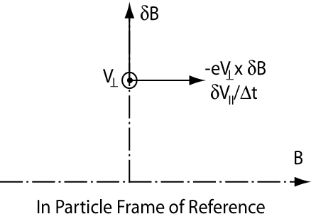
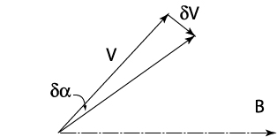
Pitch Angle Scattering (quasi-linear theory)
Parallel acceleration by wave
magnetic field
Pitch-angle scattering
Note that v⊥ also change accordingly to
conserve energy in the particle frame
of reference
Pitch-angle diffusion coefficient

Slide 23
Resonance Time and Total Diffusion
Resonance condition
Shift from resonance
In-tune condition
In-tune length
Diffusion Coefficient
Total angular diffusion

Slide 24
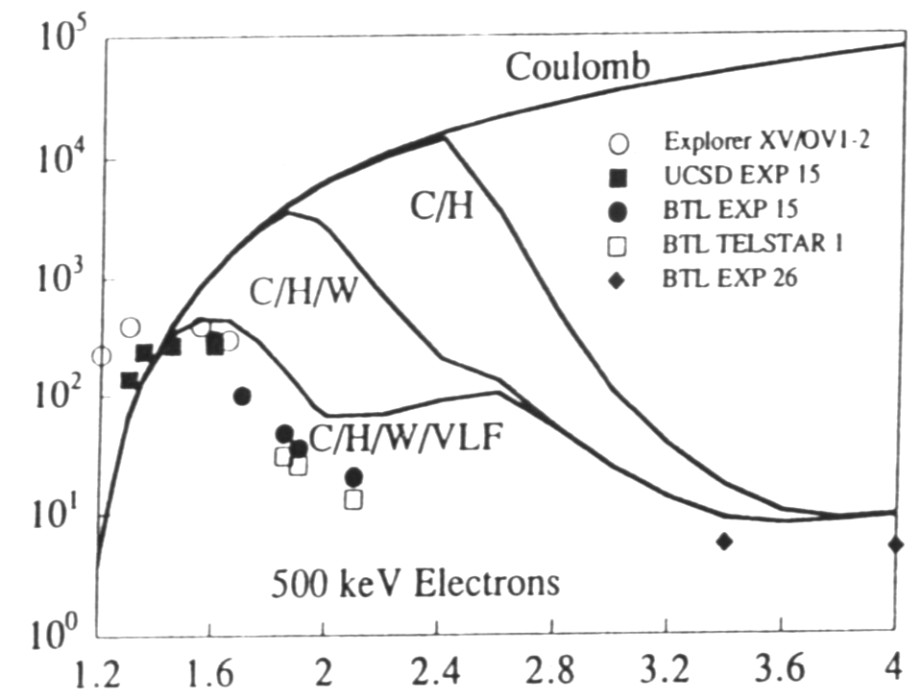
Radiation Belt Remediation
Abel and Thorne, 1998
Precipitation lifetime (days)
L-shell
Lifetime of radiation belt particles are very long, in particular electrons
Objective: Mitigate threats to low-earth orbit satellites (LEO) from energetic electrons by shortening their lifetime.
Energy range: 0.5~2.5 MeV
L-range: 1.7~3.5
Approach: pitch-angle scattering by whistler mode waves

Slide 25
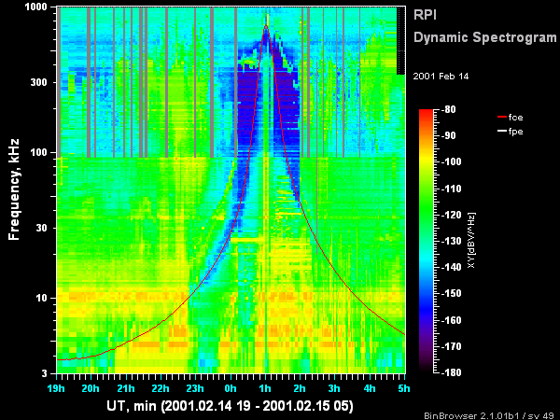
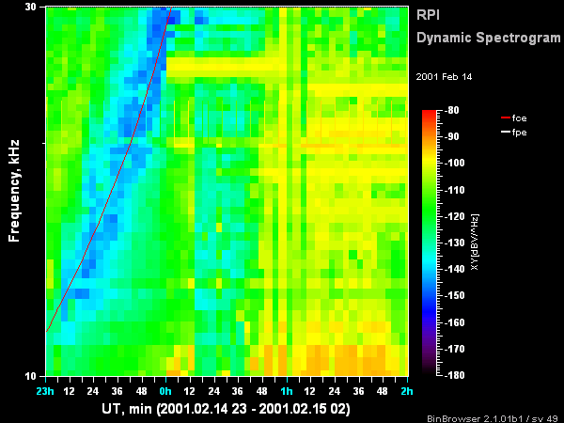
Dynamic Spectra Measured from IMAGE/RPI
Passive mode
NLK-Washington
24.8 kHz

Slide 26
Observations of NML station, 2001/2002
La Moure, ND, L=3.26, 500 kW

Slide 27
Signal amplitude vs. station-footprint
distance
Signal amplitude, dB
10dB/1000km
DHO
Distance, km

Slide 28
VLF power in space
from ground-based transmitters
Peak electric field amplitude: ≤ 100 μV/m
Assuming whistler wave phase velocity: ~ 0.1 c
Magnetic field amplitude at foot: 2×10⁻¹¹ T (20 pT)
Poynting Flux: 5×10⁻⁹ W/m²
Total flux: ~ 50 kW out of 500 kW
Ionospheric coupling factor < 10%
No evidence for wave trapping/amplification in low L-shells
Requires 1 MW transmitter

Slide 29
Manmade Whistler Waves:
Space-borne Transmitters
Questions to address:
  Orbit
  Frequency
  Power
Space-borne transmitter:
  Equatorial orbit: +: long wave-particle interaction time
  –: low transmission efficiency, (plasma conditions)
  –: large spatial area, more power needed
  –: more expensive,
  Low-orbit: +: high transmission efficiency- (high frequencies)
  +: target only 10% of harmful population (energy selective)
  =>low power, small spatial area,
  +: low launch costs
  –: shorter wave-particle interaction time

Slide 30
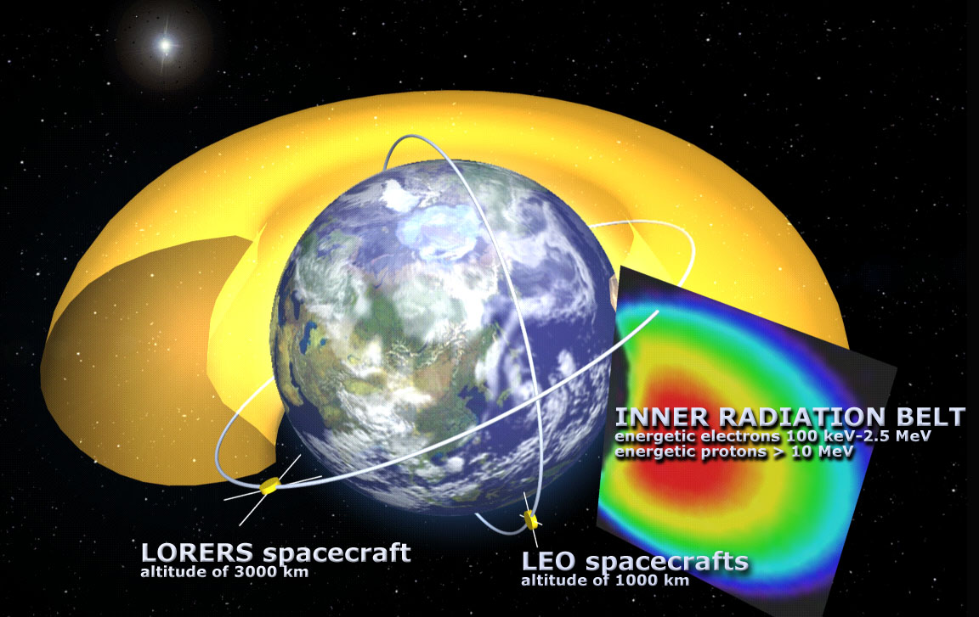
Low-earth Orbit Relativistic Electron Remediation System

Slide 31
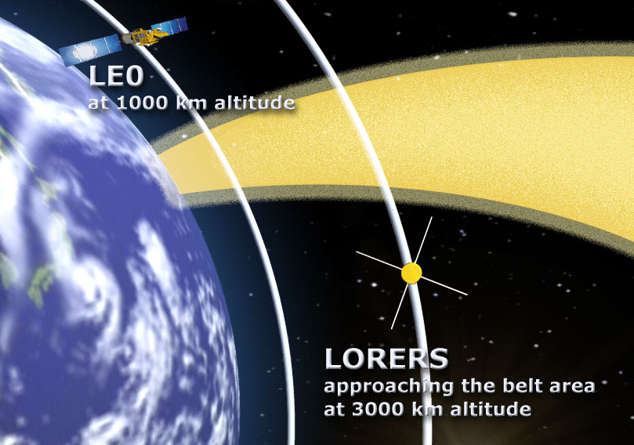
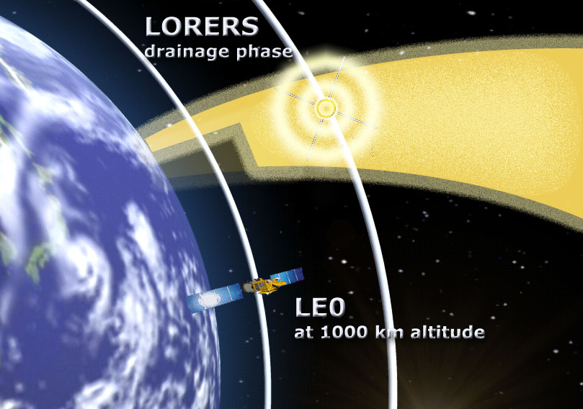
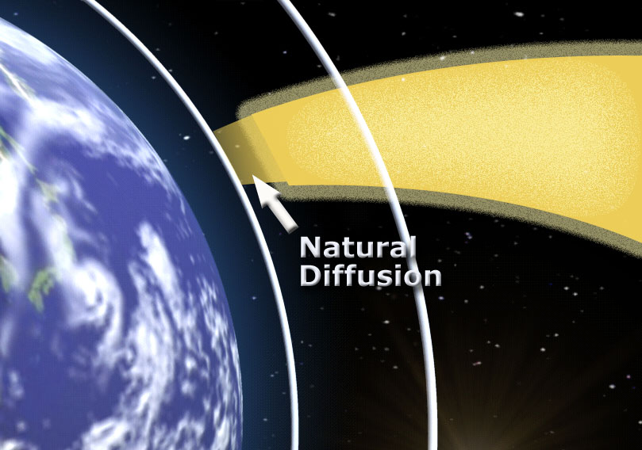
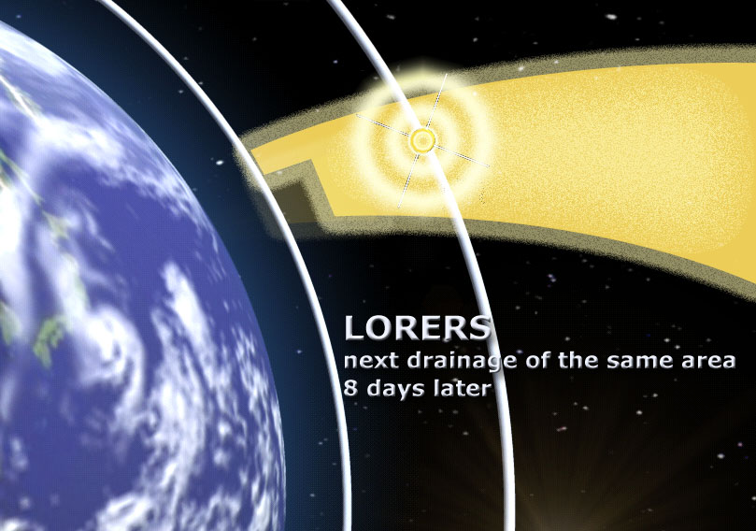
1
2
3
4

Slide 32
LORERS Scenario
Low-altitude (~3000 km) high-inclination (~50°) orbit flying above LEOs (~1000 km) across feet of flux tubes of radiation belt.
Tune to frequencies to clean 0.5~2.5 MeV electrons with pitch angles that have mirror points below 1500 km.
As a result of natural pitch angle diffusion, the lowest mirror point continues to move down from 1500 km after cleaning
Revisit the same region before the lowest mirror point reaches 1000 km due to natural pitch angle diffusion
Re-clean 0~1500 km.
Natural diffusion is the main diffusion mechanism.
LORERS only helps to speed up the diffusion process at the feet of the field lines, which is less than 10 % of the total population.

